Slide 1


The CF Home Sputum-Induction Trial (CF-HomeSpIT)
Primary Outcome Data for Early Morning Sputum-Induction at Home Compared to Same-Day
Sputum-Induction in Clinic
Professor Julian T. Forton
The Children’s Hospital for Wales, UK
Cardiff University School of Medicine

Slide 2
NACFC Presentation Disclaimer
Unless explicitly stated, opinions shared by presenters do not necessarily represent the views of the Cystic Fibrosis Foundation. The Foundation supports NACFC, but does not generally review presentations in advance. The information provided during this conference is intended to be educational and informational. Attendees are encouraged to consult medical professionals for all health care decisions.

Slide 3
Presenter Disclosure
Professor Julian Forton MA MB BChir(Cantab) MRCPCH Phd FHEA
There are no relationships to disclose related to this presentation.

Slide 4
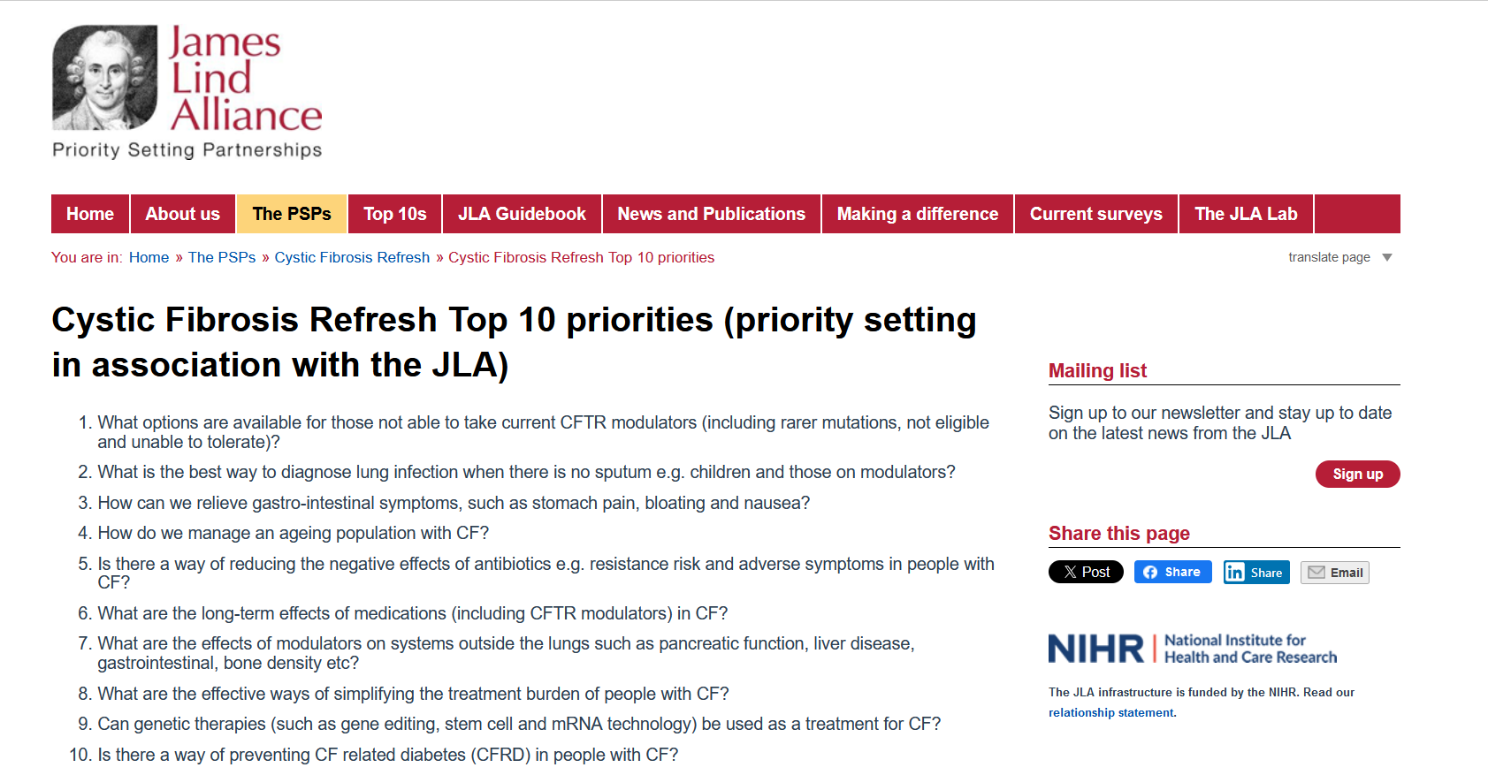
James Lind Alliance - Priority Setting Partnerships

Slide 5
No sputum Yes sputum !

Slide 6
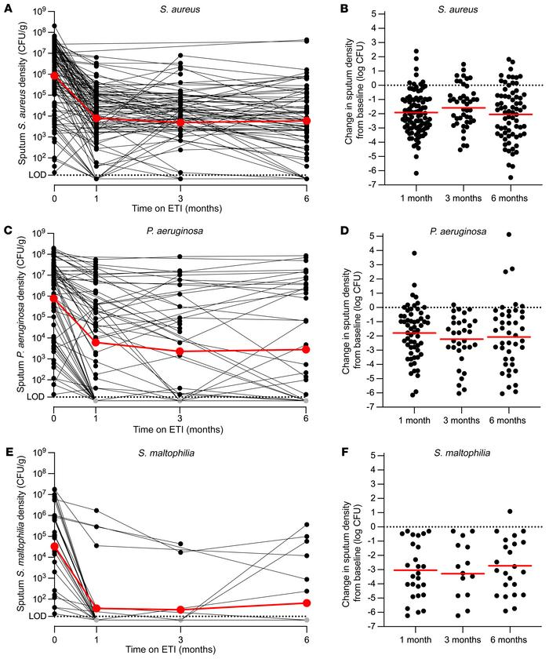
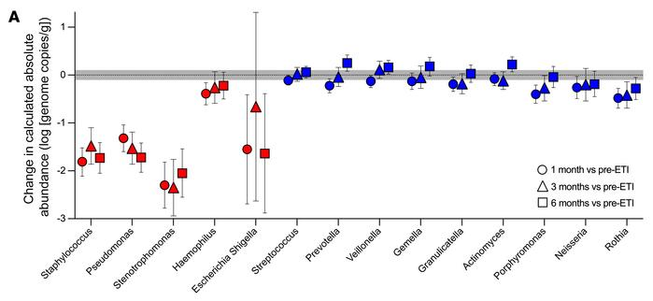
PROMISE-MICRO STUDY
Pharmacologic improvement of CFTR function rapidly decreases sputum pathogen density, but lung infections generally persist
J Clin Invest 2023 May 15;133(10):e167957.doi: 10.1172/JCI167957.

Slide 7
New Challenges
Sputum volume and pathogen density are reduced in patients on HEMT,
BUT pathogens are not eradicated.
Highly sensitive PCR technologies raise new difficulties in defining what constitutes a meaningful infection.
How important are low titre infections in patients on HEMT ?
Two Questions
How best to sample the airway ?
How best to analyse those samples ?

Slide 8
Principles of infection surveillance
VIRUS
OP swab
BAL
PSEUDOMONAS

Slide 9
CF-SpIT
Annual
assessment
Acute
exacerbation
Bronchoscopy
indicated
How to sample
How to analyse
Cough
swab
Induced
sputum
Bronchoscopy
6 lobes
Bank of samples
CF pathogens detected by
conventional microbiology culture
CF pathogens detected
Culture independent microbiology
Microbiome evolution in children with Cystic Fibrosis
Clinical determinants of accelerated evolution
Ronchetti K. et al (2018); Lancet Respir Med. 2018 Jun;6(6):461‐71
The CF‐Sputum Induction Trial (CF‐SpIT) to assess lower airway bacterial sampling in young children with cystic fibrosis: a prospective internally controlled interventional trial.

Slide 10

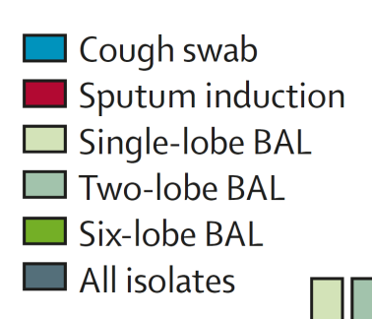
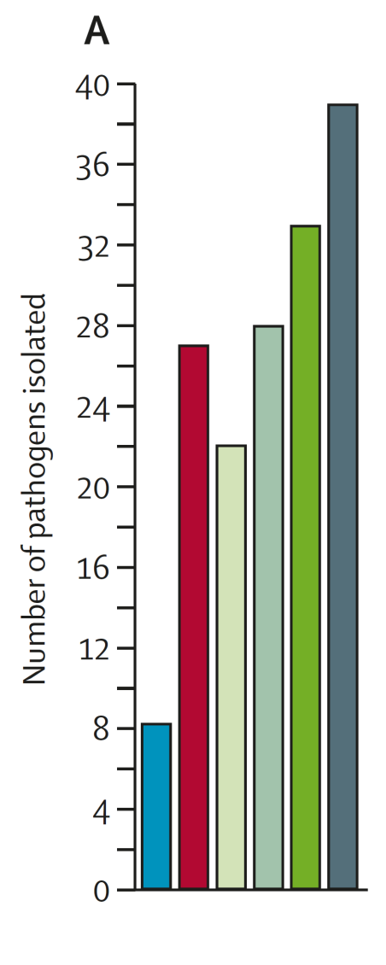
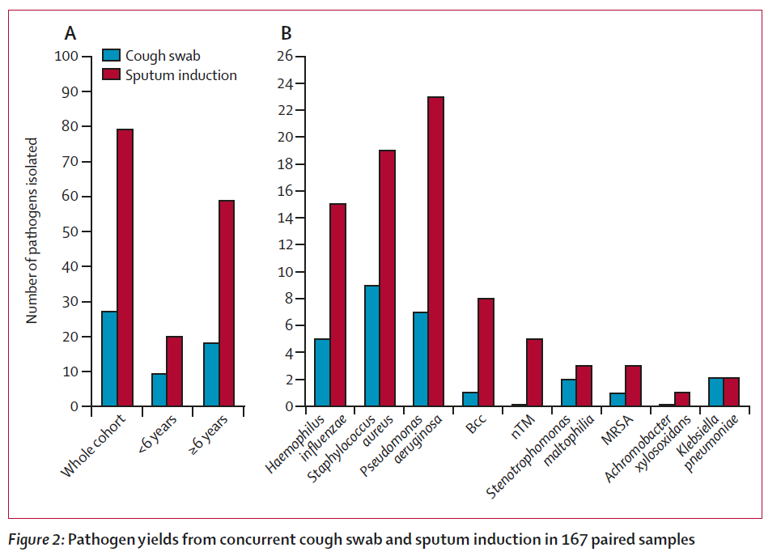
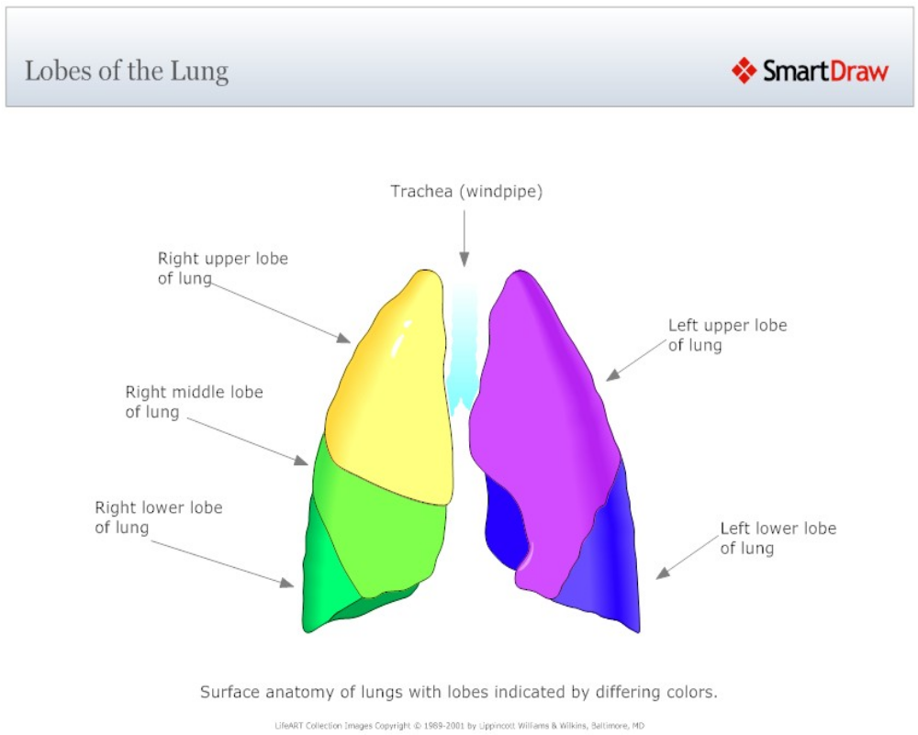
Sputum induction v cough swab
Sputum induction v BAL ( 1 lobe, 2 lobe and 6 lobe)
3 times as many pathogens
Equivalent to 2 lobe BAL
N=167
N=41

Slide 11
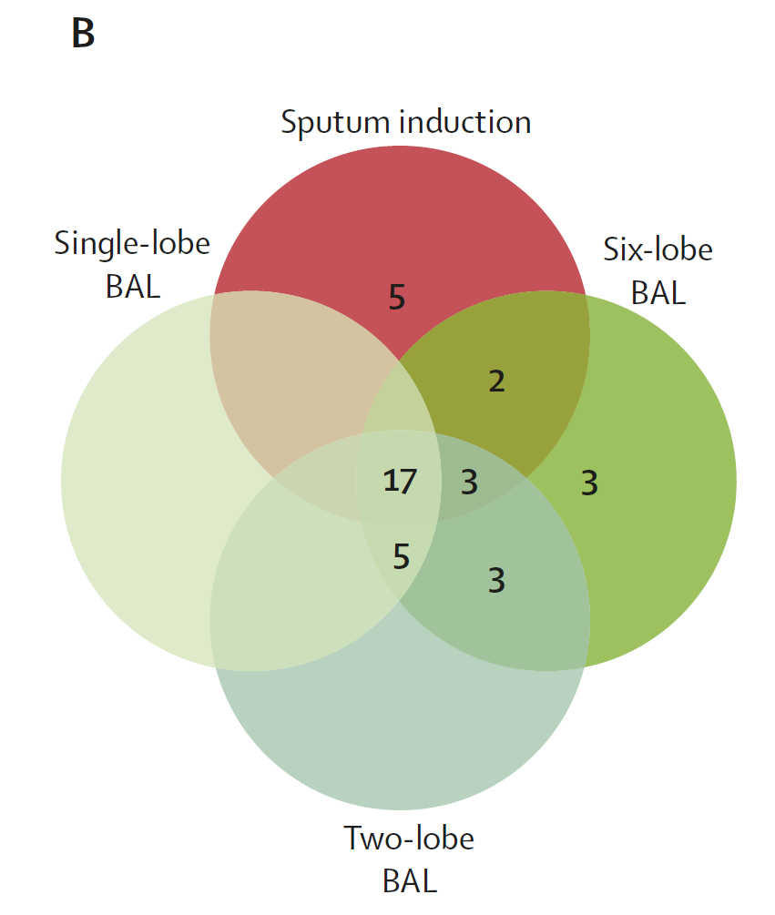
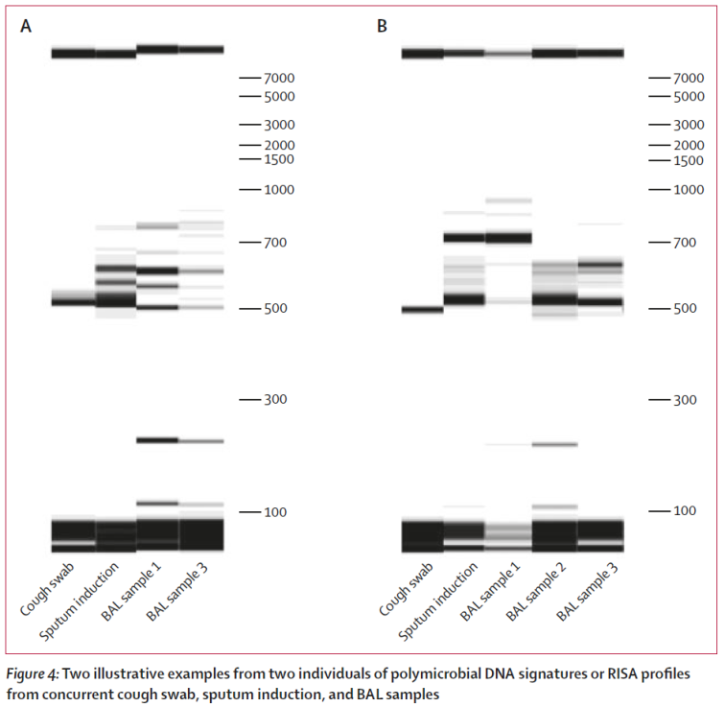
Sputum induction can sample widely from the lower airway compartment
Stage 2 : sputum induction v BAL
n=41

Slide 12
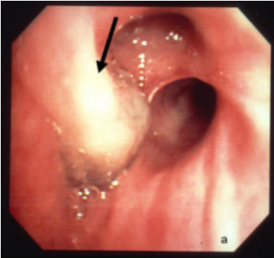
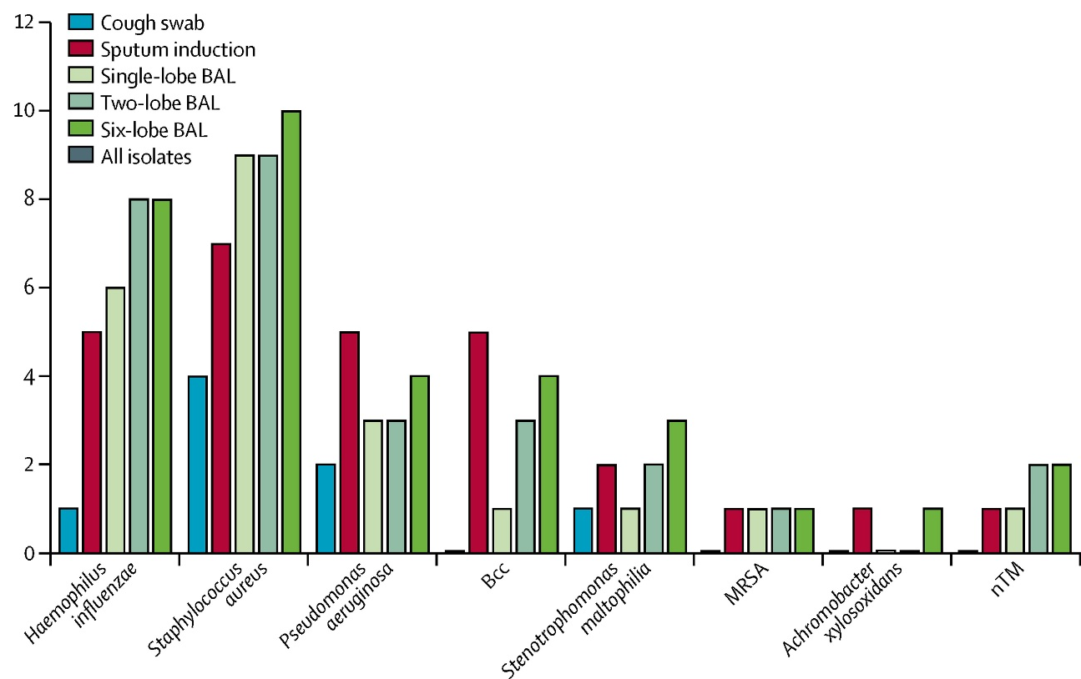
Stage 2 : sputum induction v BAL
n=41
Large airways are a unique compartment

Slide 13
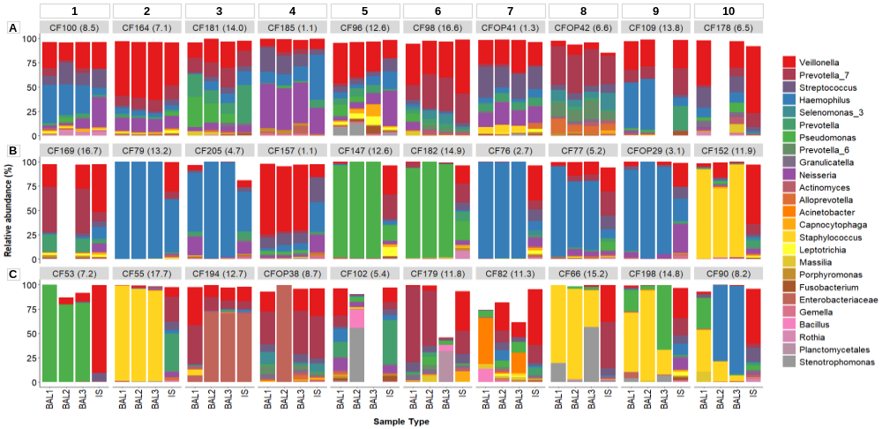
CF SpIT: 30 patients
Paired sputum induction and 6 lobe BAL
Weiser R. et al (2022) The lung microbiota in children with cystic fibrosis captured by induced sputum sampling. J Cyst Fibros. 2022 Nov;21(6):1006-1012.
Microbiota concordance between sputum induction and all BAL compartments
Sputum induction captures a meaningful representation of the lower airway microbiota in 80% of cases

Slide 14
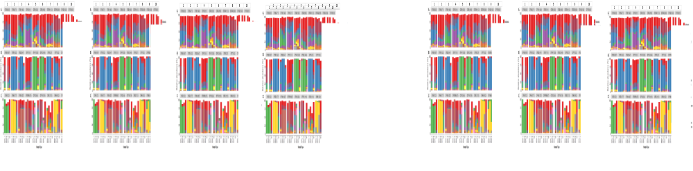
BAL Spatial topography
Concordant BAL Discordant BAL
BAL1 BAL2 BAL3
BAL1 BAL2 BAL3
BAL1 BAL2 BAL3
BAL1 BAL2 BAL3
BAL1 BAL2 BAL3
BAL1 BAL2 BAL3
BAL1 BAL2 BAL3
Weiser R. et al (2022) The lung microbiota in children with cystic fibrosis captured by induced sputum sampling. J Cyst Fibros. 2022 Nov;21(6):1006-1012.

Slide 15
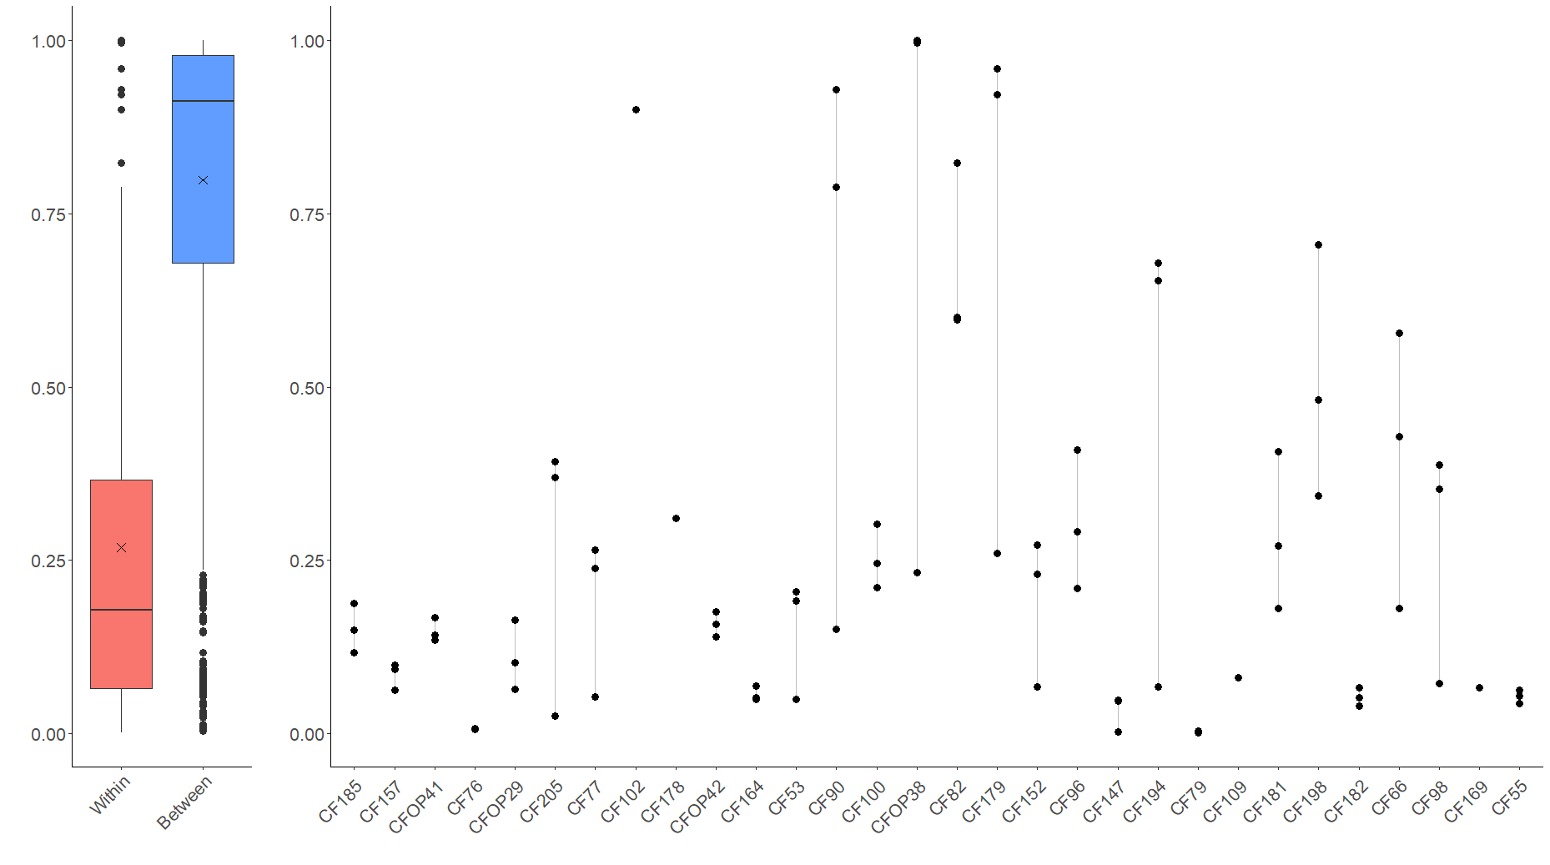
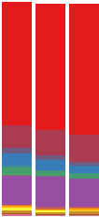
BAL Compartmentalisation
5.4
11.3
Bray-Curtis dissimilarity
14.8
6.5
8.7
11.8
8.5
12.6
14
15.2
1.1
1.3
6.6
8.2
1.1
3.1
5.2
7.1
7.2
11.9
12.7
13.8
16.5
16.7
4.7
14.9
17.7
2.7
12.6
13.2
Sample Groups
Sample code

Slide 16


Sputum Induction for everyone
Sputum induction can capture lower airway pathogens and characterise lower airway microbiology
Spatial microbiology of the airway is complex and difficult to describe with any single sample

Slide 17
Principles of infection surveillance
VIRUS
OP swab
SPUTUM INDUCTION
BAL
PSEUDOMONAS

Slide 18
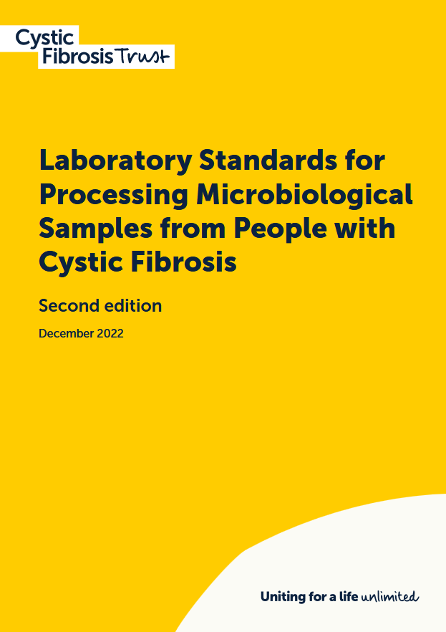
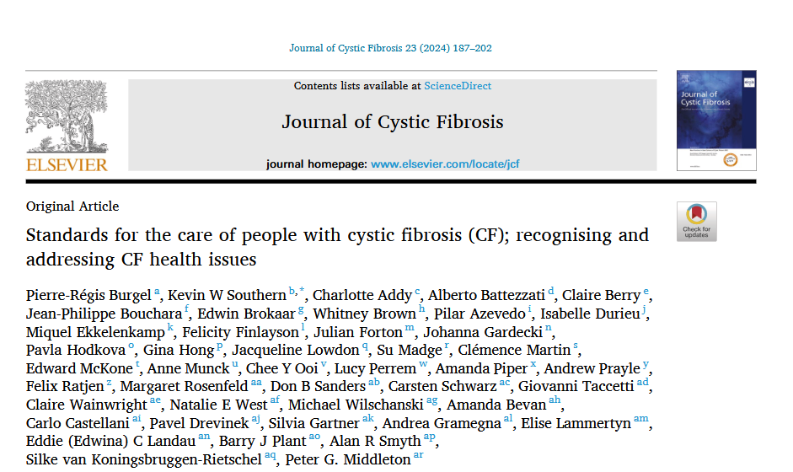
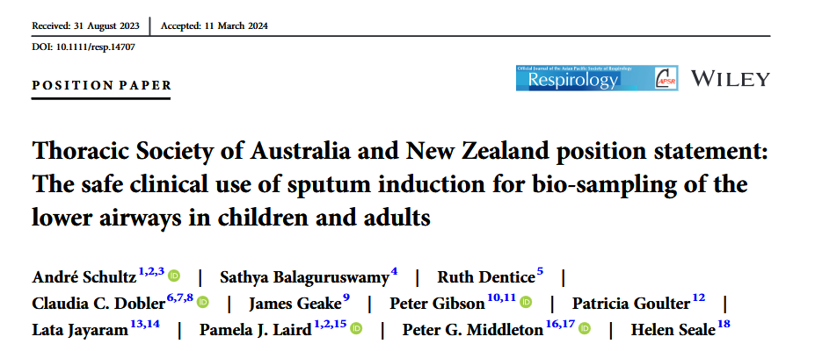

Slide 19

Sputum Induction for everyone ?
Time consuming in clinic
Home sampling ?
Difficult to produce a sample
Patient Training ?

Slide 20
CF-HomeSpIT
The CF Home Sputum-Induction Trial to evaluate home sputum-induction and early morning cough clear sampling in children with Cystic Fibrosis
K. Ronchetti , J.-D. Tame , L. Thia , A. Aseeri , R. Weiser , E. Mahenthiralingam , J.T. Forton.
CF-SpIT Study Group
The Children's Hospital for Wales, Cardiff, United Kingdom
Cardiff University, School of Biosciences, Cardiff, United Kingdom,

Slide 21



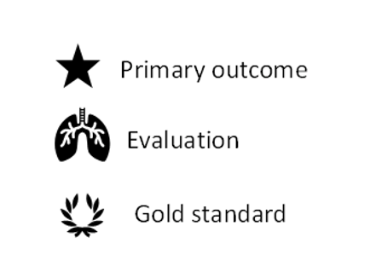
CF-HomeSpIT
The CF Home Sputum Induction Trial
ISRCTN86523335
Early morning
Cough Clear
Early morning
Home sputum induction
Clinic
Cough Swab
Clinic
Cough Clear
Clinic
sputum induction
NHS Clinical Microbiology
Microbiota/ PCR Research
Inflammation
The Cystic Fibrosis Home Sputum-Induction Trial (CF-HomeSpIT - ISRCTN86523335) to evaluate home sputum-induction and early morning saliva sampling in children with cystic fibrosis
Ronchetti, K; Tame, J-D; Thia, L; Aseeri, A; Weiser, R; Mahenthiralingam, E; Forton, J
Journal of Cystic Fibrosis. , 2023, Vol.22, p.S25-S26

Slide 22
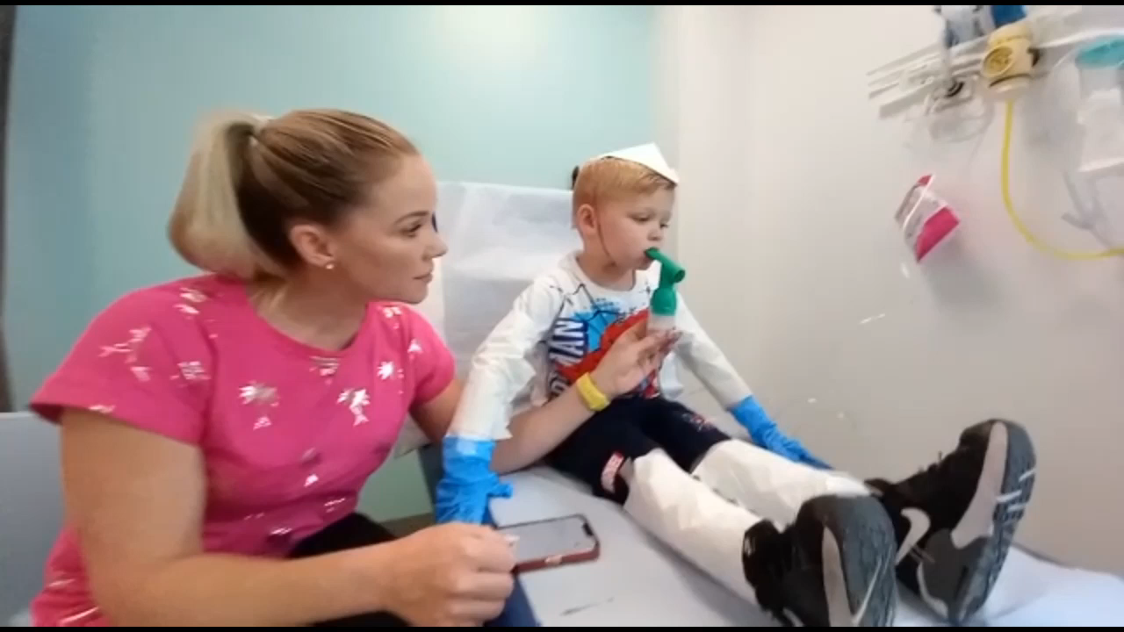
Sputum Induction - Hypertonic saline, exercise, PEP and cough clear

Slide 23
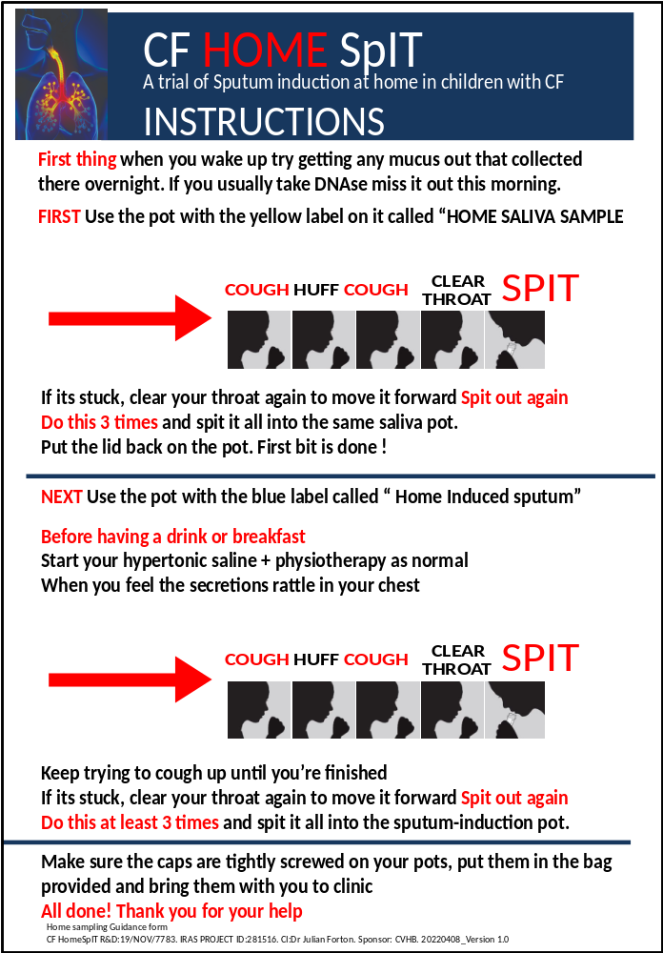
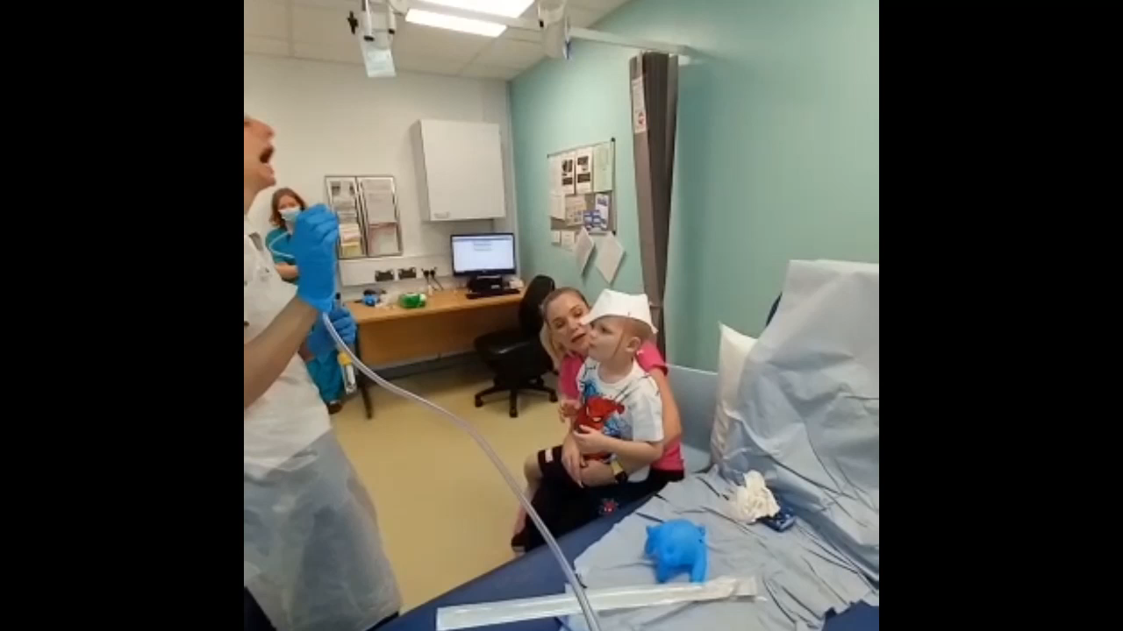
Oropharyngeal suction

Slide 24
Cough clear
Easy cough clear
Oropharyngeal suction

Slide 25
Improving the Cough clear

Slide 26
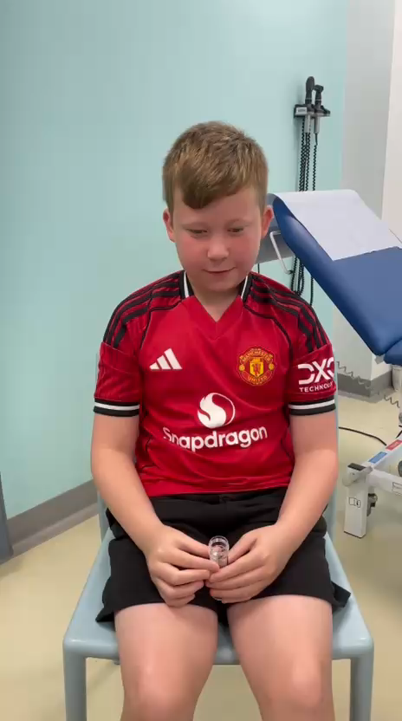


Slide 27
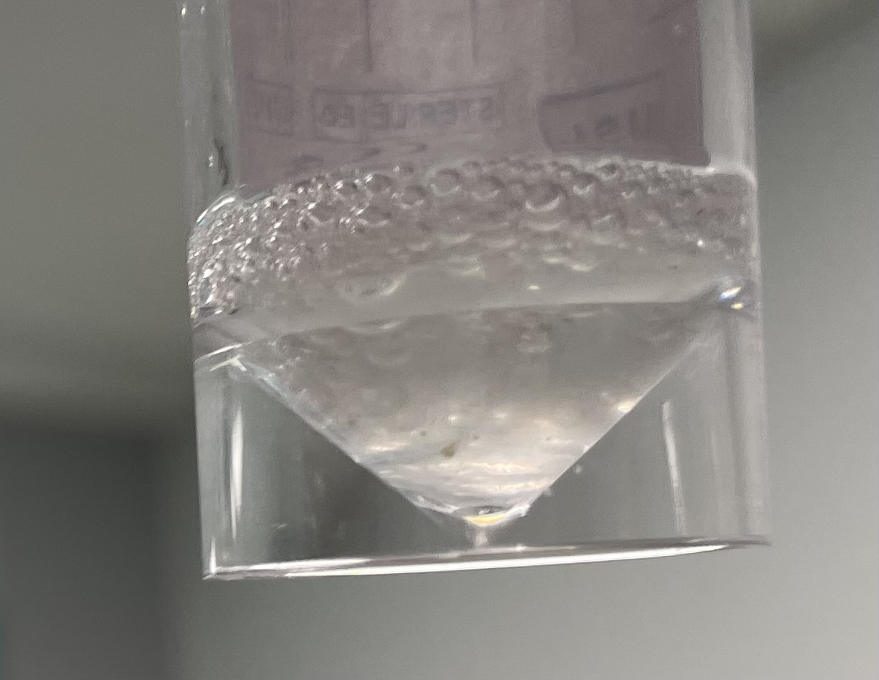
James Lind Alliance - Priority Setting Partnerships
No Sputum? There is always sputum!

Slide 28
CF-HomeSpIT
The CF Home Sputum Induction Trial
ISRCTN86523335
Early morning
Cough Clear
Early morning
Home sputum induction
Clinic
Cough Swab
Clinic
Cough Clear
Clinic
sputum induction
Entry criteria
Attending CF clinic at The Children’s Hospital for Wales
Age > 6 years
Using Hypertonic saline in home physiotherapy regimen

Slide 29
Early morning cough clear
Home sputum induction

Slide 30
CF-HomeSpIT
Patient characteristics
64 patients were recruited and performed 96 complete sampling events.
Sampling events from the same patient were median 395 days apart.
Median age was 11 years.
Median ppFEV1 was 94%. Median ppFVC was 100%
93% of patients were on modulator therapy
20% had a wet cough
Sample success
Home samples were produced on 92/96 (93%) occasions.
Median duration for home sampling was 13 minutes (range 5-40)
No reported side effects
84/96 (87%) home sputum induction samples were described as sputum rather than saliva by microbiology lab
46/96 (47%) home sputum induction samples were in addition described as mucoid, mucopurulent or purulent
Patient acceptability
80/96 (83%) families willing to do home sputum sampling regularly.
Fitting in home sampling before clinic was rated 3.1/10 [Likert scale 0 -10 easy – difficult]
Median chosen frequency from range 1-6 of 4/year.

Slide 31
CF-HomeSpIT
Results
34/96 (35%) individuals isolated one or more classic CF pathogen
40 CF pathogens were identified from all sampling combined

Slide 32
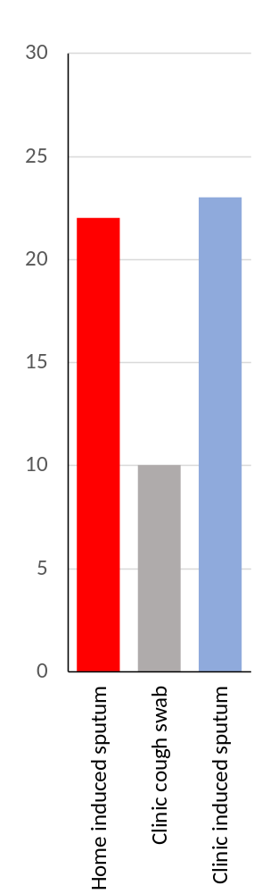
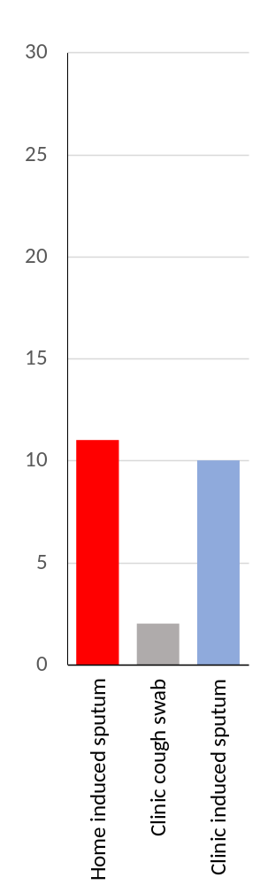
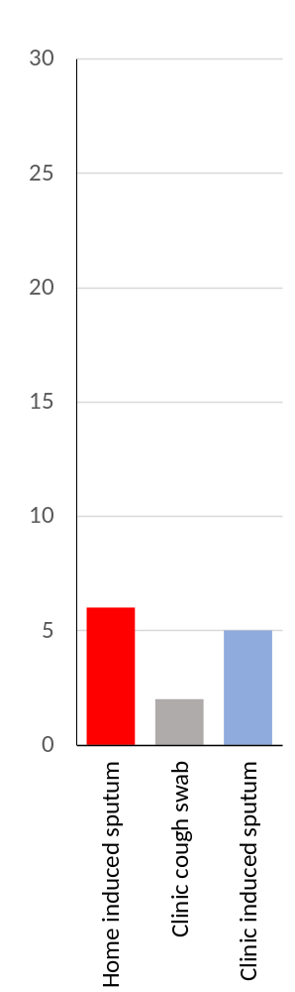
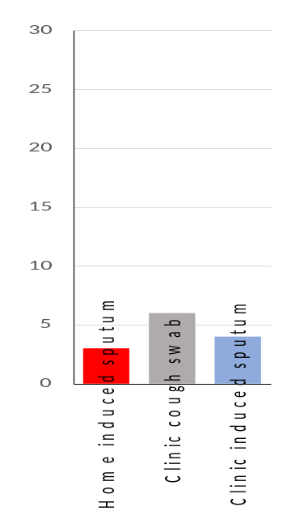
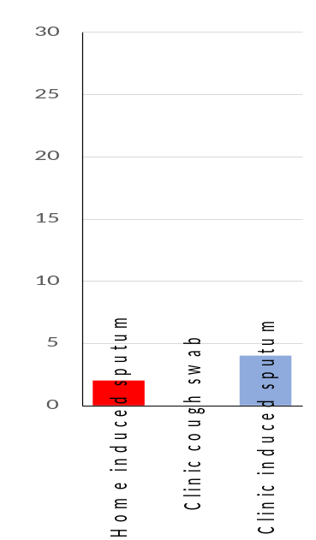
CF-HomeSpIT
Primary Outcome
S. Aureus P. aeruginosa
Home sputum induction v clinic sputum induction
Pathogen detection
H. influenzae BCC, NTM, S. maltophilia

Slide 33
CF-HomeSpIT
The CF Home Sputum Induction Trial
ISRCTN86523335
Early morning
Cough Clear
Early morning
Home sputum induction
Clinic
Cough Swab
Clinic
Cough Clear
Clinic
sputum induction
NHS Clinical Microbiology
Microbiota/ PCR Research
Inflammation
WS13.01 The Cystic Fibrosis Home Sputum-Induction Trial (CF-HomeSpIT - ISRCTN86523335) to evaluate home sputum-induction and early morning saliva sampling in children with cystic fibrosis
Ronchetti, K; Tame, J-D; Thia, L; Aseeri, A; Weiser, R; Mahenthiralingam, E; Forton, J
Journal of Cystic Fibrosis. , 2023, Vol.22, p.S25-S26
DOI: 10.1016/S1569-1993(23)00259-X

Slide 34
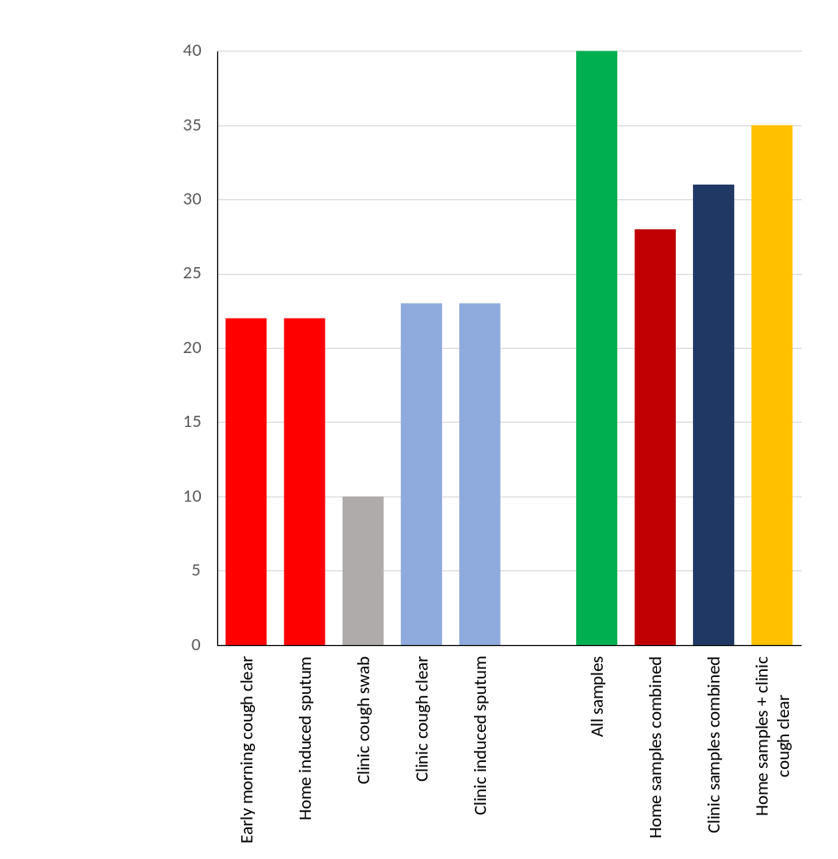
CF-HomeSpIT
All samples
Early morning cough clear 22/40 55%
Home sputum-induction 22/40 55%
Clinic cough swab 10/40 25%
Clinic cough clear 23/40 58%
Clinic sputum-induction 23/40 58%
Combining sampling approaches increases pathogen yield
28/40 (sensitivity 0.7) were isolated on home samples combined.
31/40 (sensitivity 0.77) were isolated on clinic samples combined
35/40 (sensitivity 0.88) isolated on home samples + clinic cough clear
Bacterial isolates

Slide 35
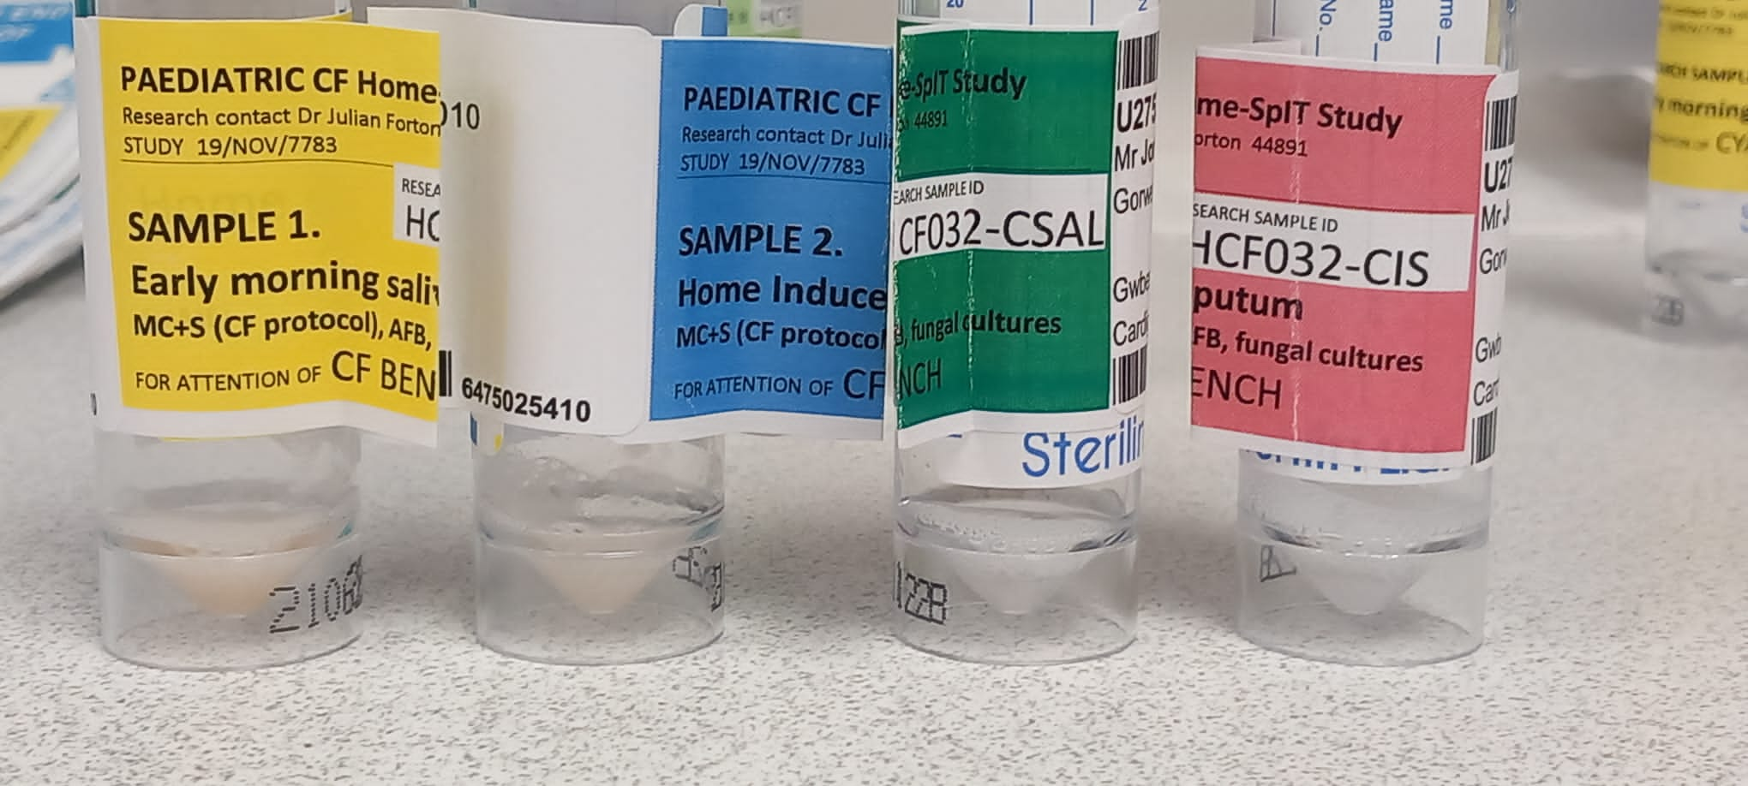
CF-HomeSpIT
Sample discordance
Samples are not equivalent
emCC hIS cCS cCC cIS

Slide 36
CF-HomeSpIT
Conclusions
Unsupervised home sputum-induction
using a standardised approach to expectoration is possible, well tolerated, acceptable to families and has comparable pathogen yield to supervised clinic sputum-induction.
Additional gains from pre-saline cough clear
Additional pathogen detection are obtained from a pre-saline spontaneous cough-clear sample using the same standardised approach to expectoration. These pre-saline undiluted samples may contain higher pathogen titre and should be incorporated into all sputum-induction protocols.
Stand alone cough-clear samples in clinic
In isolation take 1-2 minutes to carry out, identify greater than twice as many classic CF pathogens as conventional oropharyngeal sampling and present a novel, straightforward addition to pathogen surveillance in clinic

Slide 37
Thank you

Slide 38


CFSpIT Research Group
The Children’s Hospital for Wales
Prof Julian T. Forton
Kath Ronchetti Research Physiotherapist
Hannah Morgan CF Physiotherapist
Jodee Tame CF Physiotherapist
Department of Biosciences, Cardiff University
Prof Eshwar Mahenthiralingam
Dr Rebecca Weiser
Abdullah Aseeri
Department of Microbiology, UHW, Cardiff
Dr Rishi Dhillon

