Slide 1


The place of respiratory support in palliative conditions
Prof Julian Forton
Consultant in Paediatric Respiratory Medicine
The Children’s Hospital for Wales, Cardiff

Slide 2
Palliative conditions - who, when and where?
Which patients are palliative?
What else do we do apart from ventilation?
What situations should we discuss?
Why are decisions difficult

Slide 3
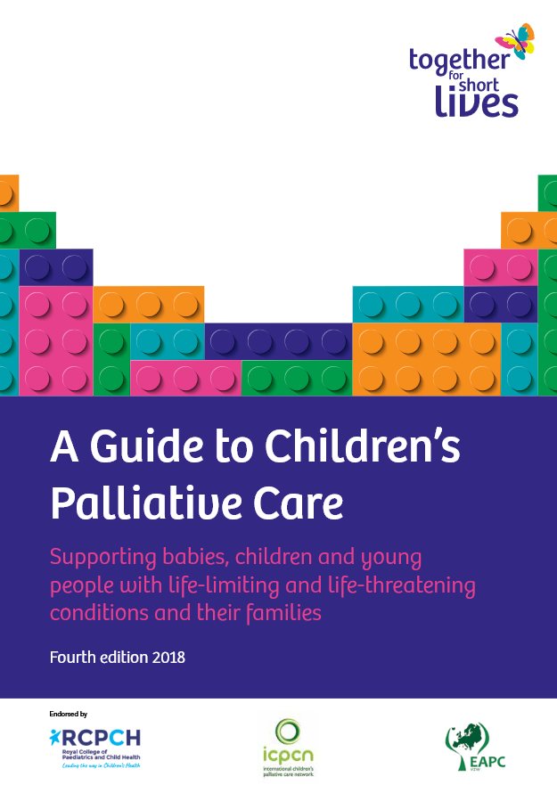
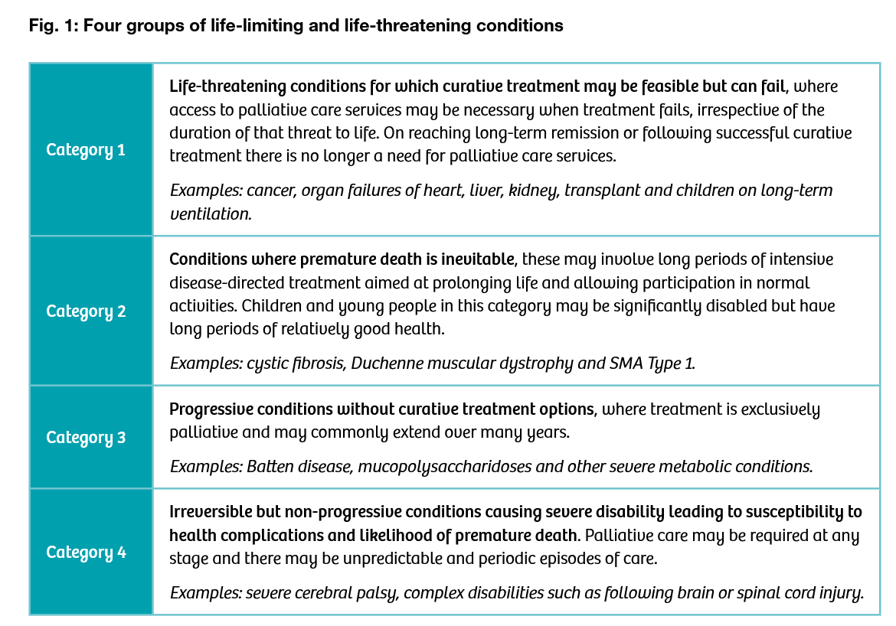
Cancer
Neuromuscular
Metabolic
Cerebral Palsy

Slide 4
Respiratory patients
Chronic disease
Palliative condition

Slide 6
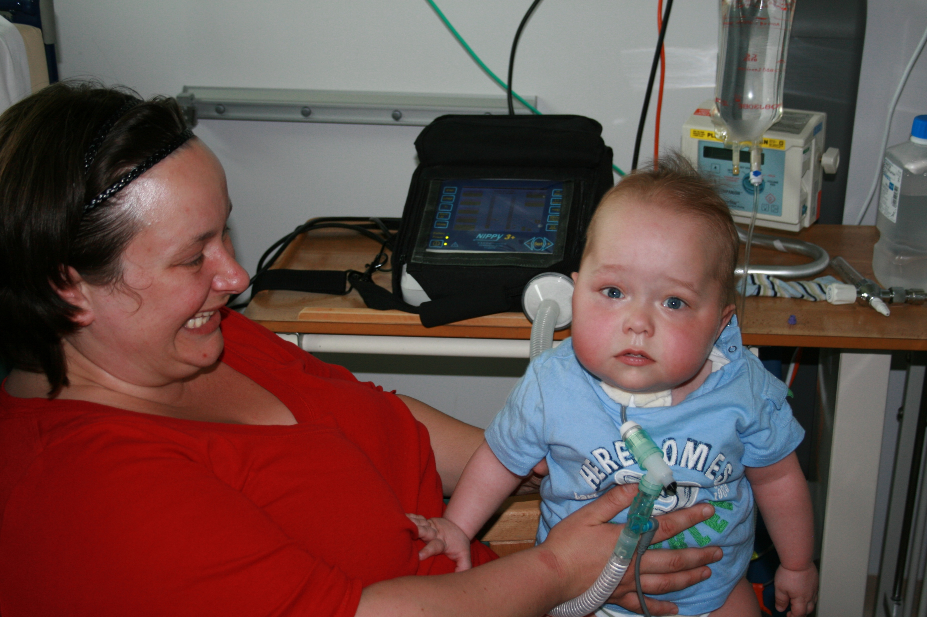
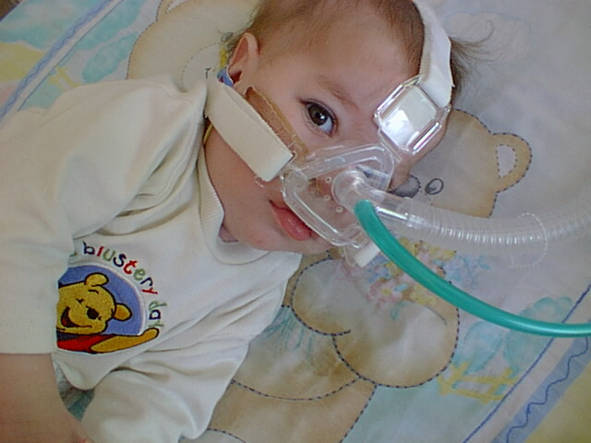
What options exist for home ventilation?
Invasive ventilation via tracheostomy Non-invasive ventilation via mask

Slide 7

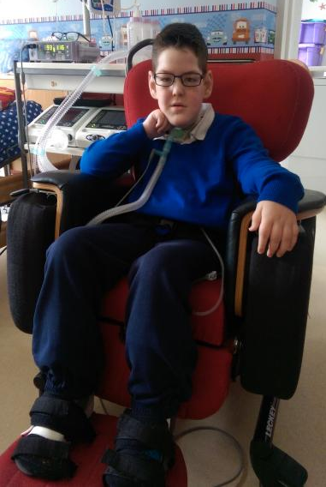
Home ventilation Tracheostomy
24/7
vulnerable

Slide 8
Non-invasive ventilation

Slide 9
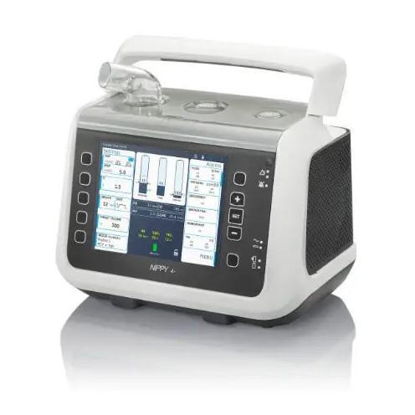
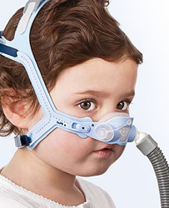
Home ventilation non-invasive via mask
New and evolving technology
Used in patients with reserve – not for those needing 24/7 ventilation
NIV available where before : Tracheostomy ventilation or withdrawal of care
Change in cultural expectations
Optimise breathing and sleep
Attentiveness to relieve suffering
Availability of home ventilation
Home care package
Exponential increase in users

Slide 10
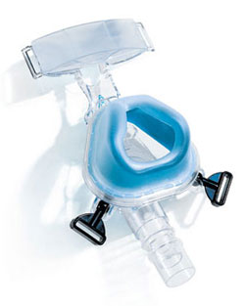
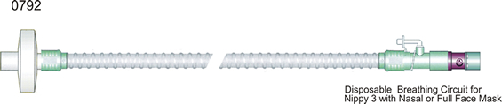
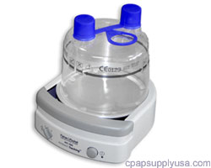
Home ventilation non-invasive via mask
Ventilator accessories interface with patient

Slide 11
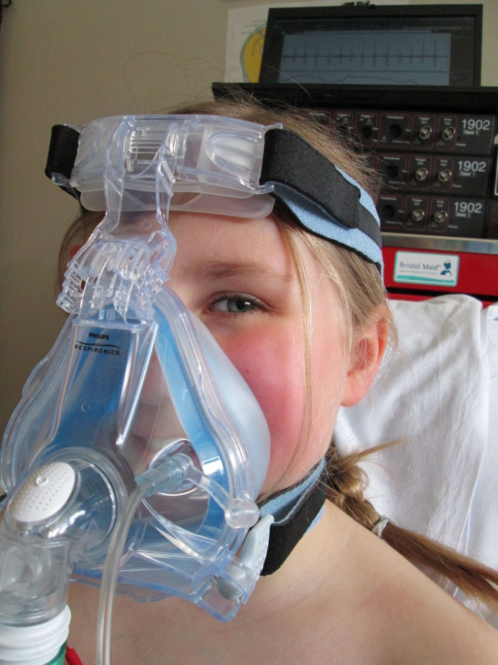
Home ventilation non-invasive via mask

Slide 12
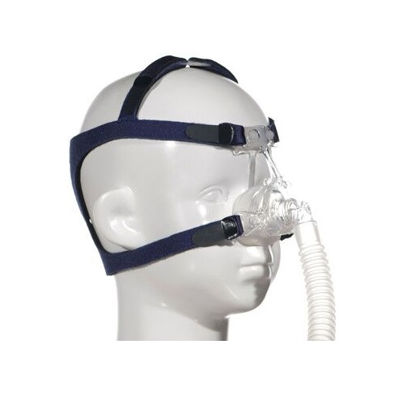
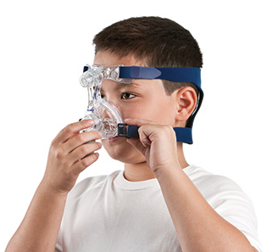
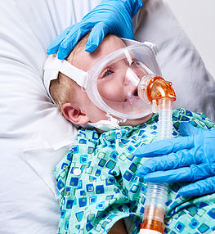
Home ventilation non-invasive via mask
Many mask interfaces for many different faces

Slide 13
Home ventilation who gets ventilated at home
Central breathing disorders
Neuromuscular weakness
Severe airways obstruction
Neurodisability - Chest hygiene, secretions, infections
Breathing problems manifest first in sleep

Slide 14
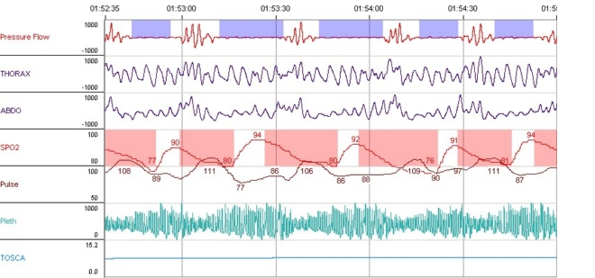
Obstructive sleep apneoa
Active sleep asynchrony, absent nasal flow, desaturation, arousal and recovery

Slide 15
Central breathing disorders
Periodic breathing - infant

Slide 16
Central breathing disorders
Brainstem tumour

Slide 17
Muscle weakness
Cyclical hypopnea - early signs of respiratory insufficiency

Slide 18
Home ventilation
NICU
PICU
Spinal
Oncology
Neurology
Craniofacial and
Cleft
services
ENT
Neuromuscular
services
Metabolic
Disease
sleep
Trach
Vent
NIV

Slide 19
Home ventilation
Neurology
Neuromuscular
services
Muscle weakness Neurodisability
Specialist
physiotherapy
sleep
Ventilatory failure
Poor secretion clearance
Weak respiratory muscles
Weak cough
Aspiration
Scoliosis
Poor secretion clearance
Ventilatory failure
Poor cough
Aspiration
Scoliosis
Limited cognition
Sedative medication
Dystonia
NIV

Slide 20
Paediatric Respiratory Medicine
ILD
Bronchoscopy
Cystic Fibrosis
PICU
Sleep
medicine
Vascular rings
Specialist
physiotherapy
Empyema
Muscle disease
Home
mechanical
ventilation
Neurodisability
Thoracic
malformations
NICU
Immune
deficiency

Slide 21
Paediatric Respiratory Medicine
ILD
Bronchoscopy
Cystic Fibrosis
PICU
Sleep
medicine
Vascular rings
Specialist
physiotherapy
Empyema
Muscle disease
Home
mechanical
ventilation
Neurodisability
Thoracic
malformations
NICU
Immune
deficiency

Slide 22
Paediatric Respiratory Medicine
ILD
Bronchoscopy
Cystic Fibrosis
PICU
Sleep
medicine
Vascular rings
Specialist
physiotherapy
Empyema
Muscle disease
Home
mechanical
ventilation
Neurodisability
Thoracic
malformations
NICU
Immune
deficiency

Slide 23
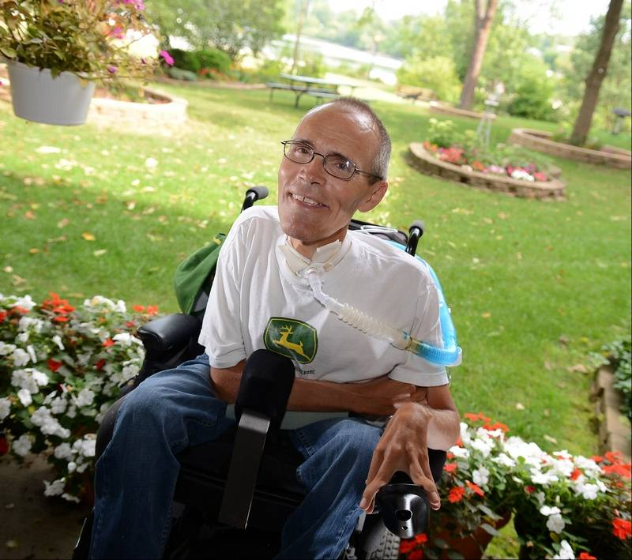
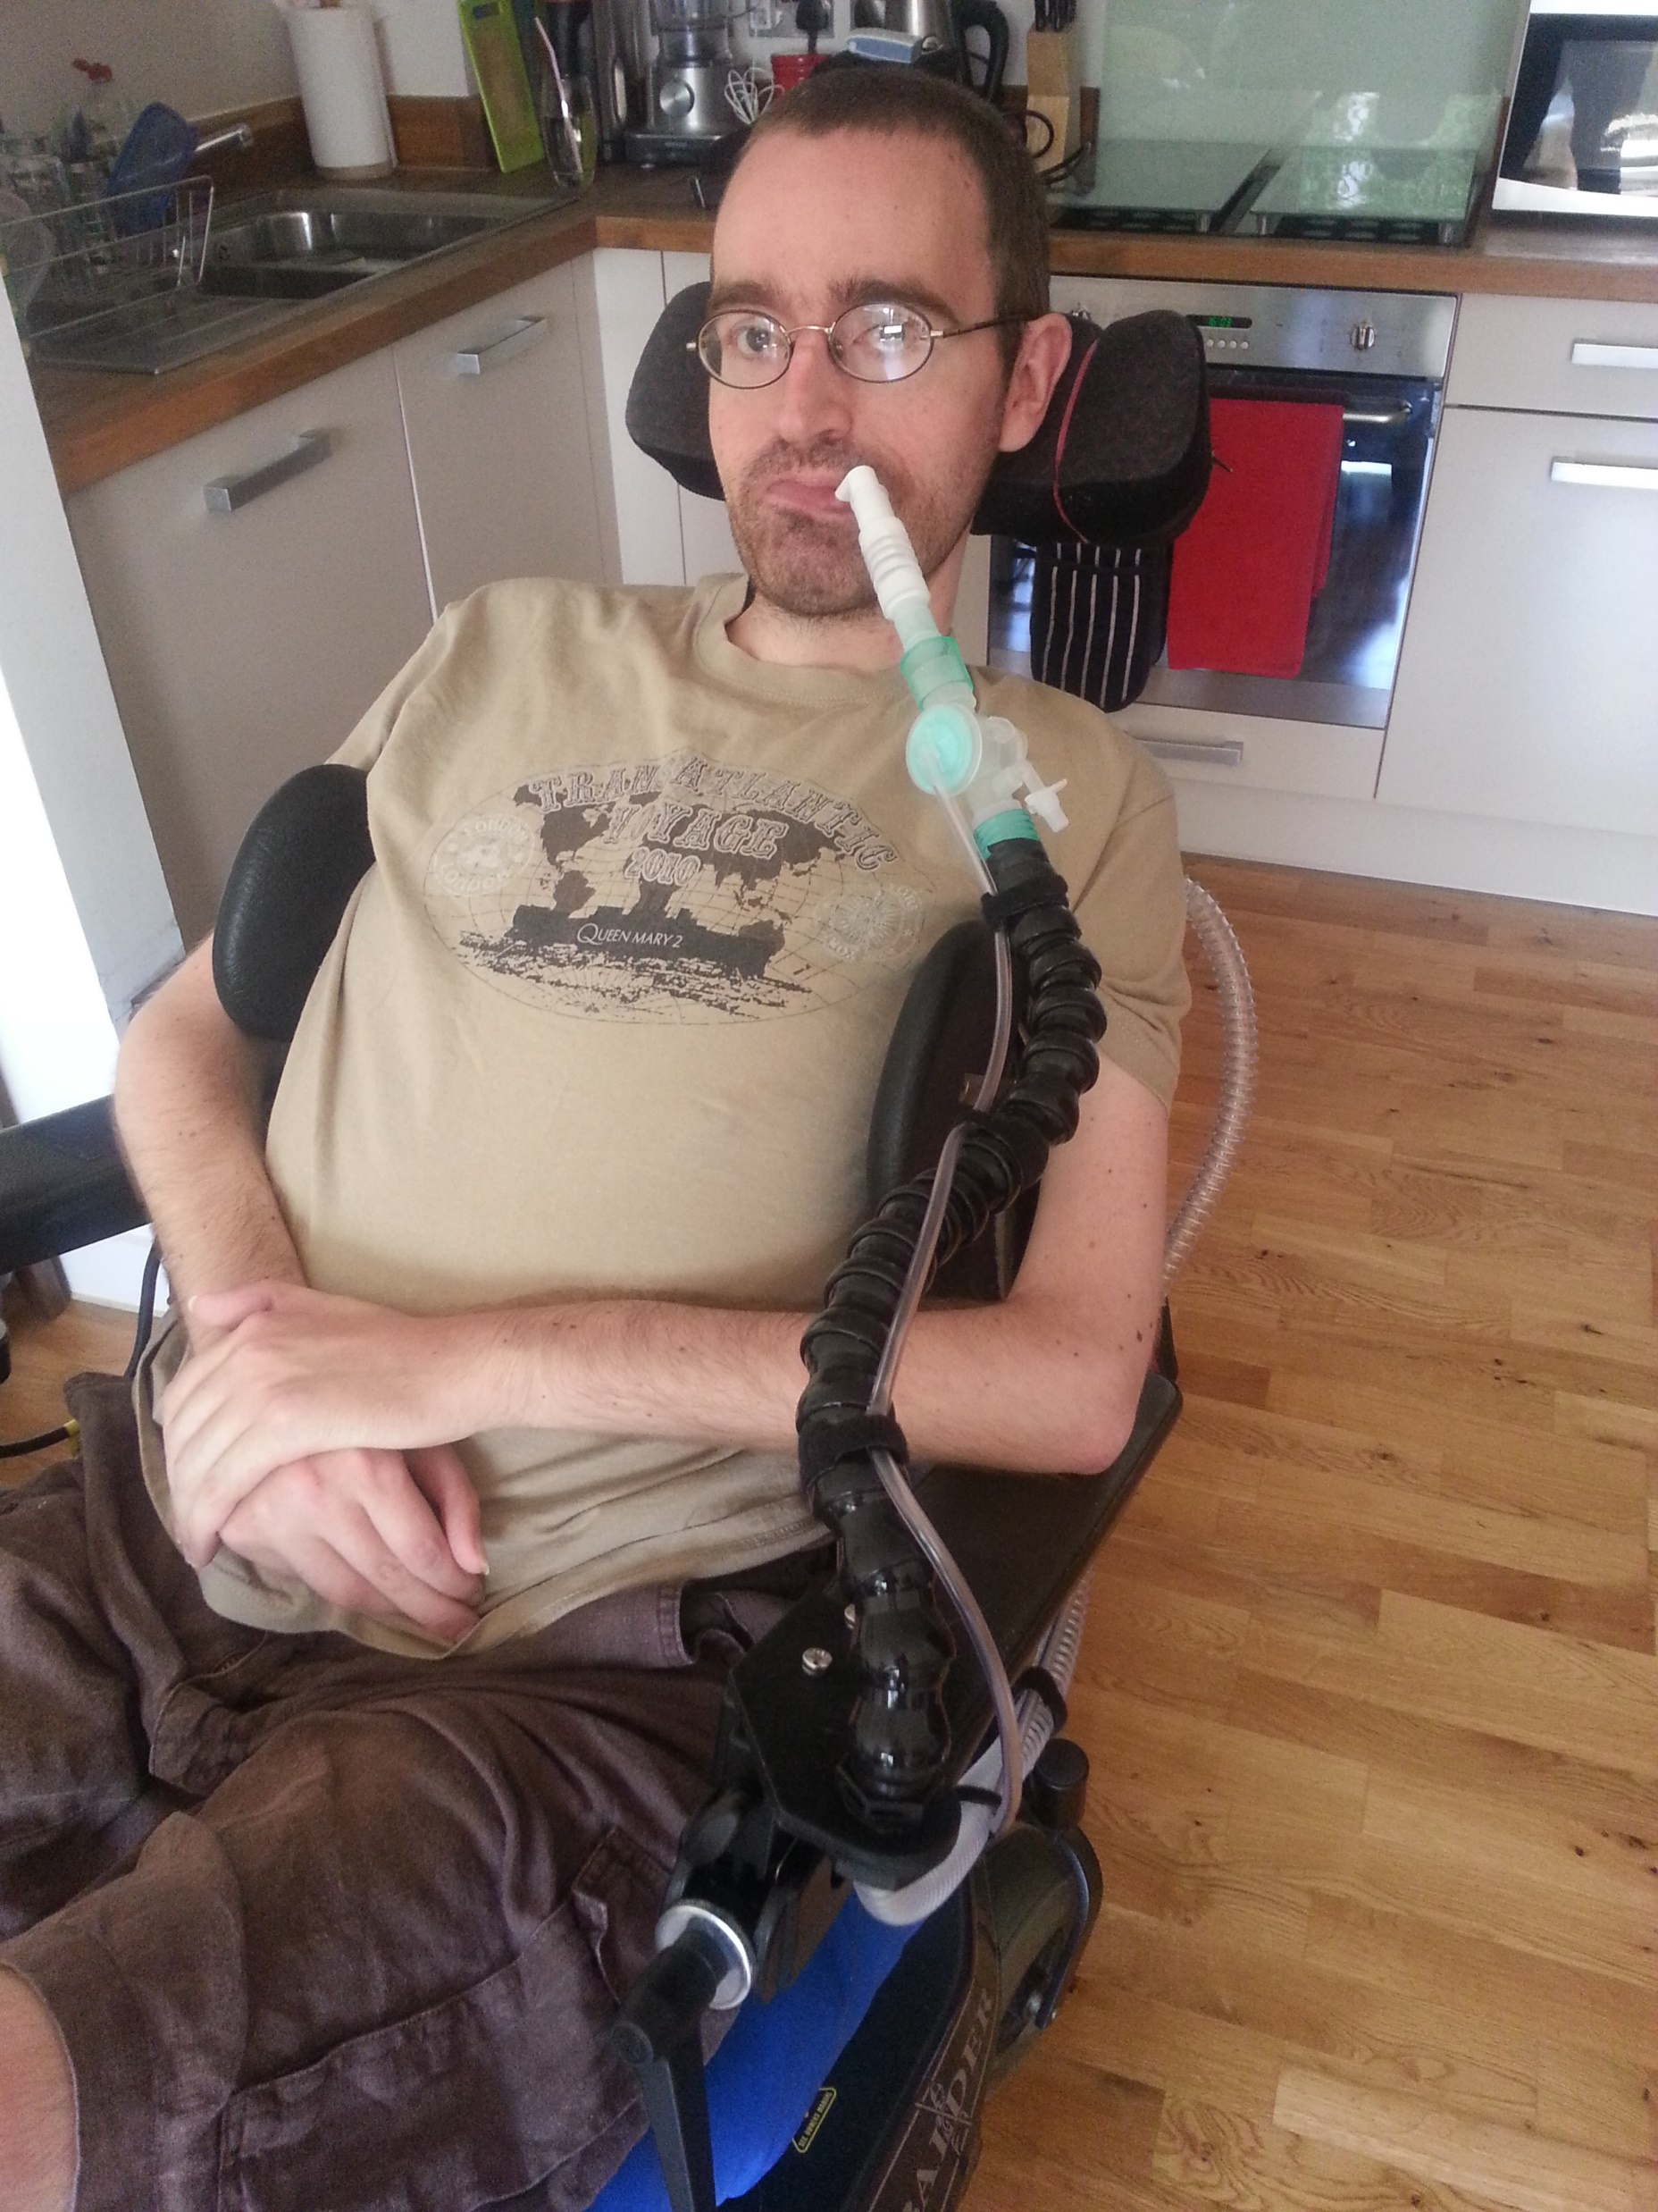

Slide 24
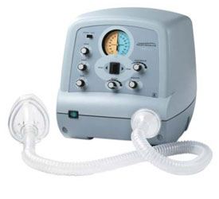
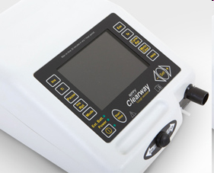
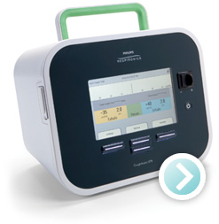
Advances in secretion clearance + Physiotherapy
Mechanical Insufflation/Exsufflation

Slide 25
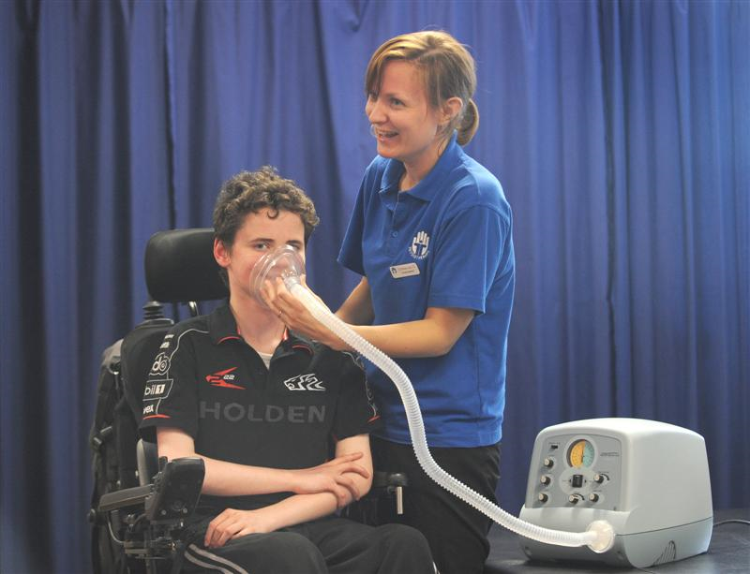
Advances in secretion clearance + physiotherpy
Mechanical Insufflation/Exsufflation

Slide 26
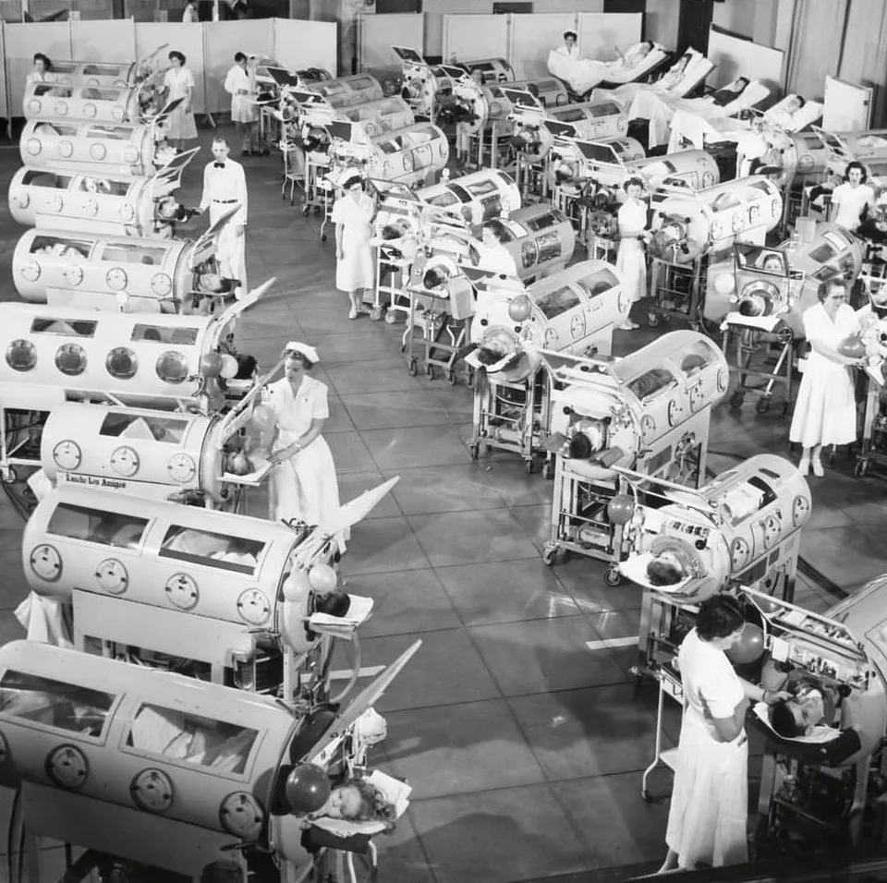
Polio
1950’s

Slide 27
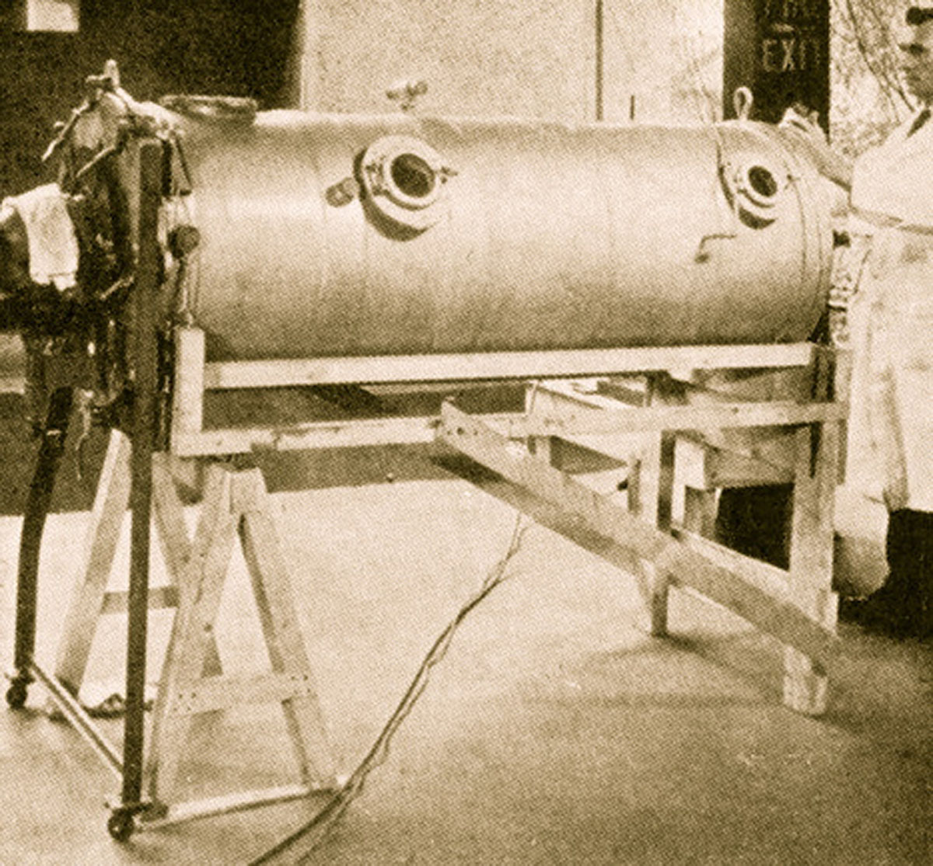
Drinker and Shaw
respirator 1929

Slide 28
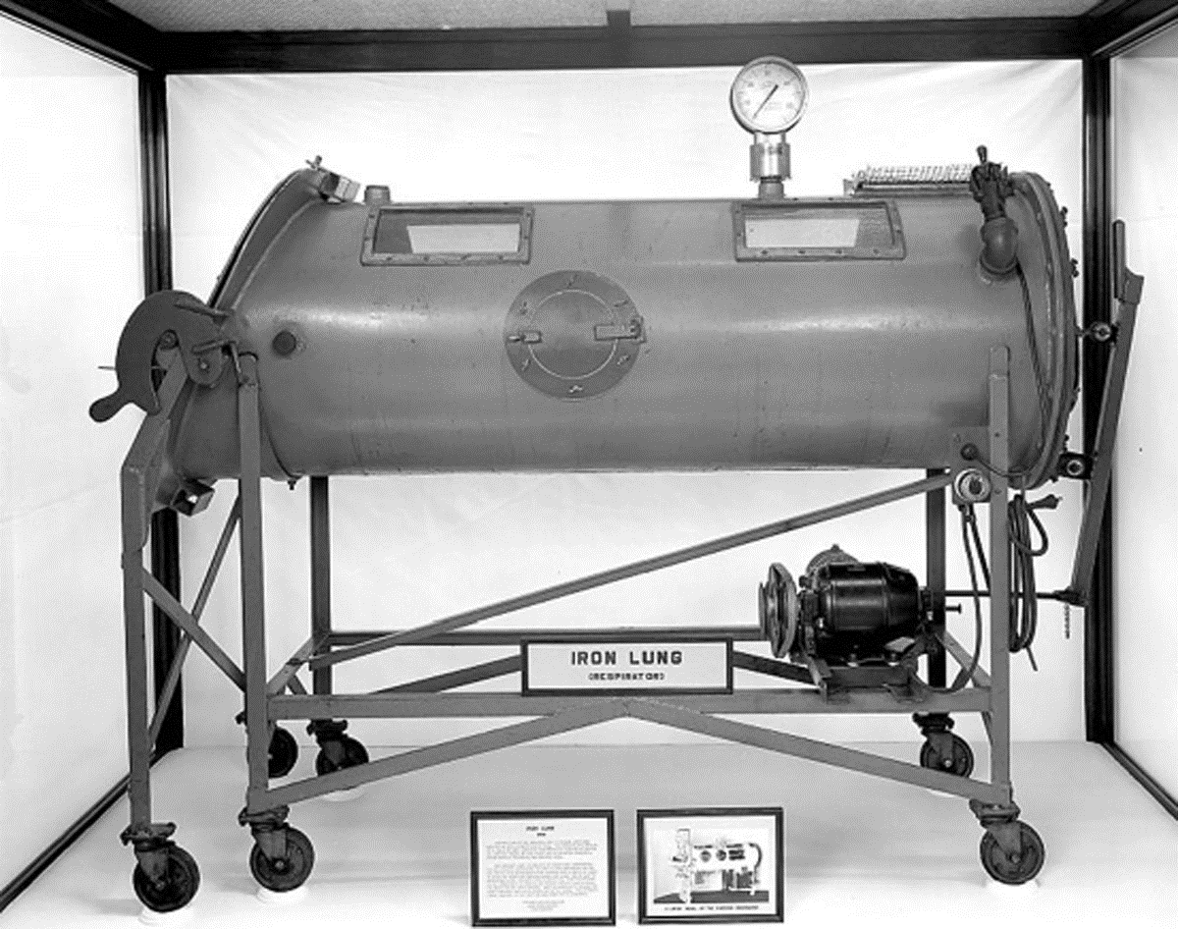
Emerson
Iron lung 1931

Slide 29
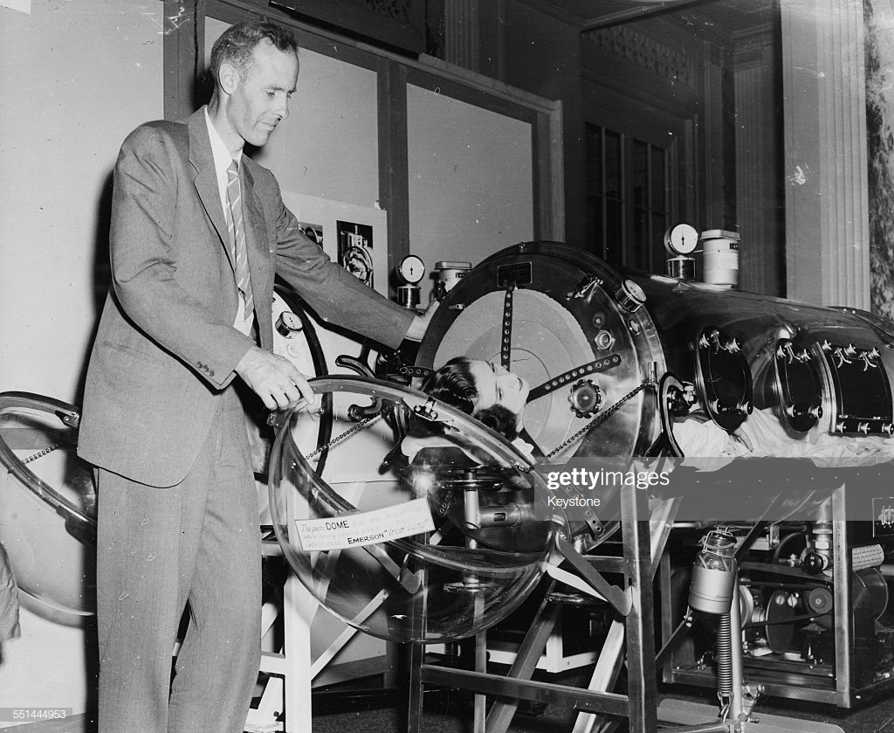
Emerson
Iron lung 1950s

Slide 30
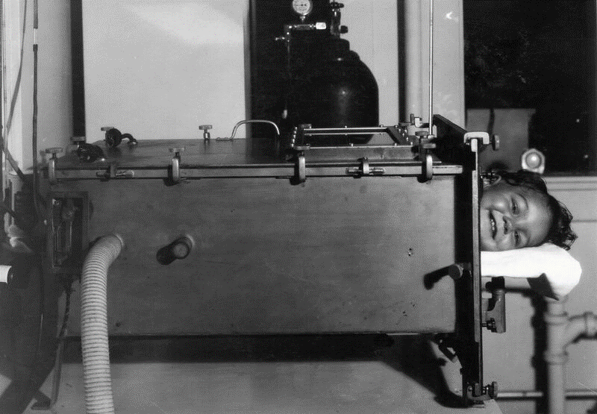

Slide 31
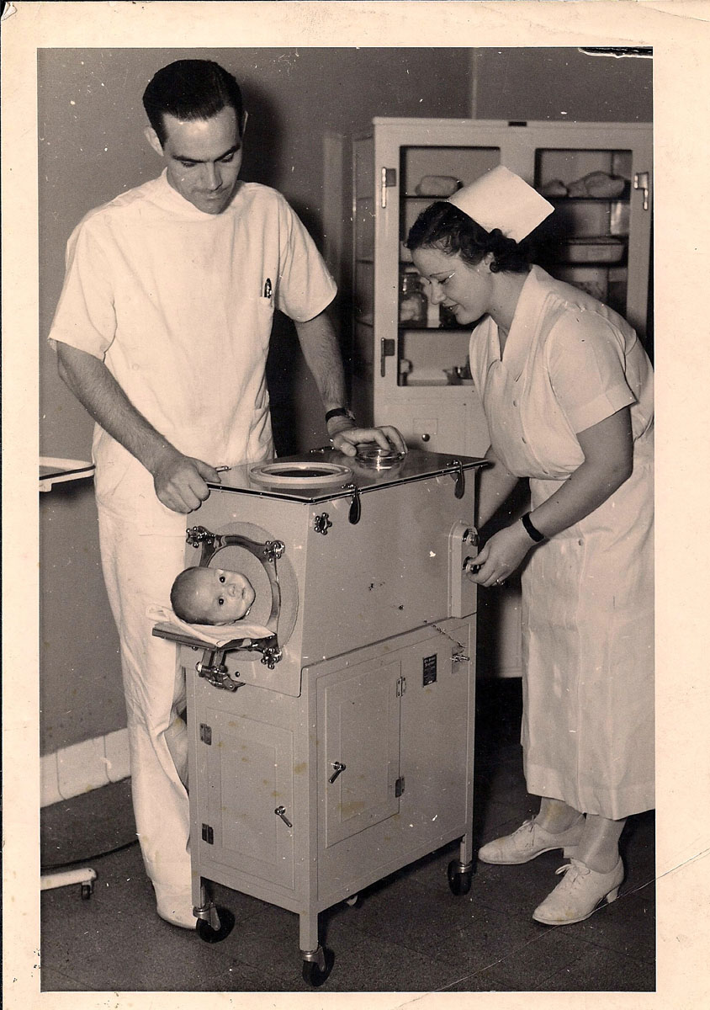

Slide 32
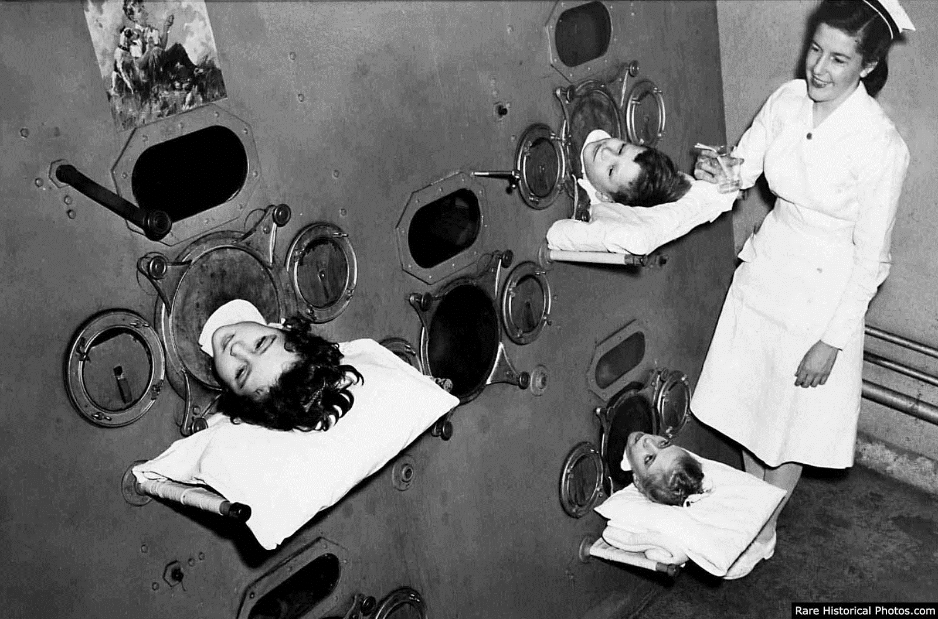

Slide 33
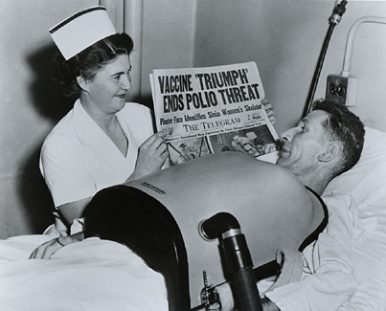
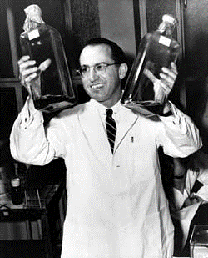
1960s

Slide 34
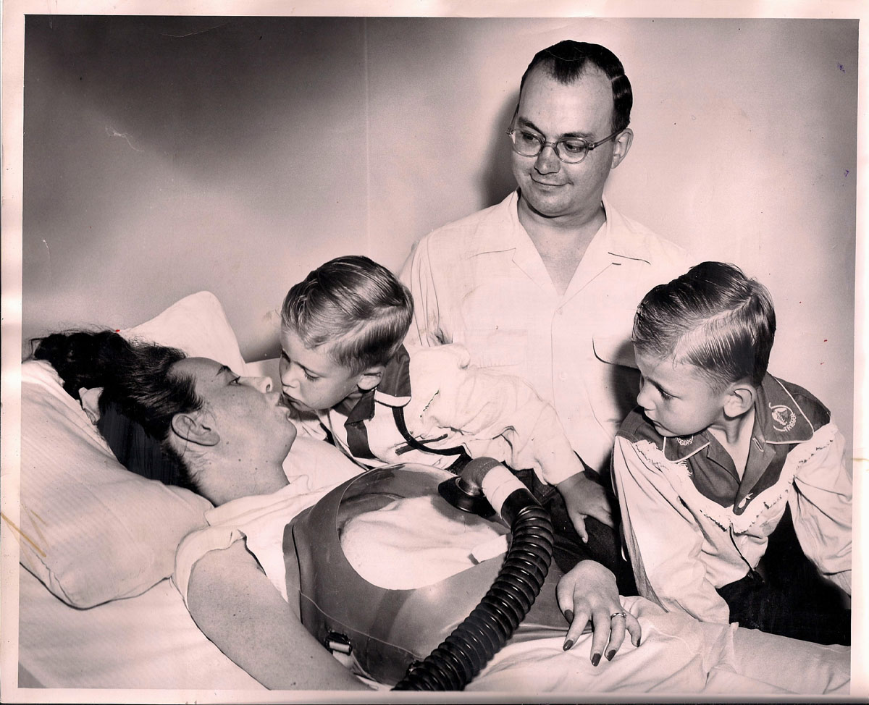
1960s

Slide 35
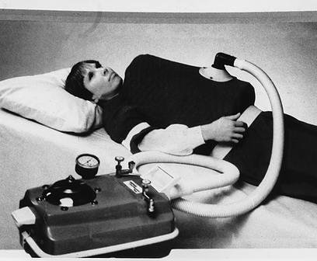
1970s

Slide 36
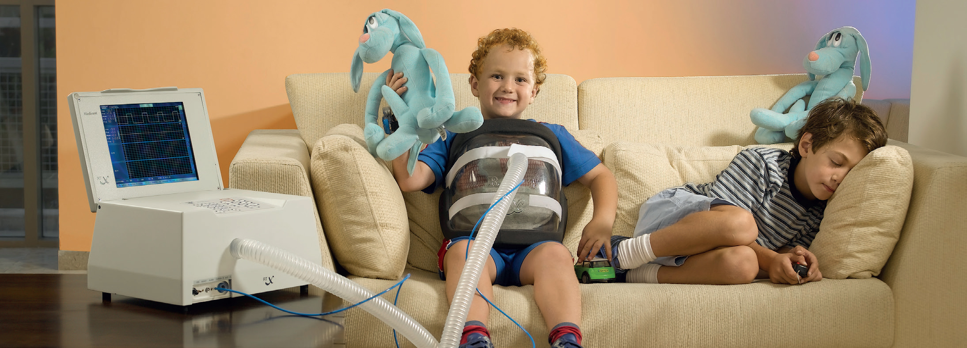
Today

Slide 37
Emerson
Iron lung 1950s

Slide 38
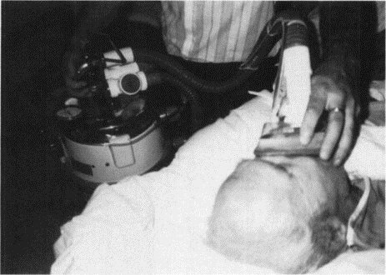
Emerson
Cofflator

Slide 39
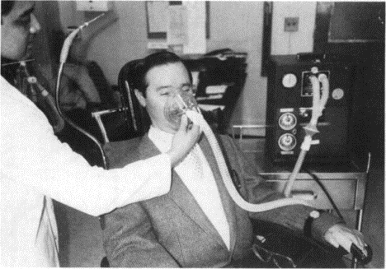
Emerson
Cofflator

Slide 40
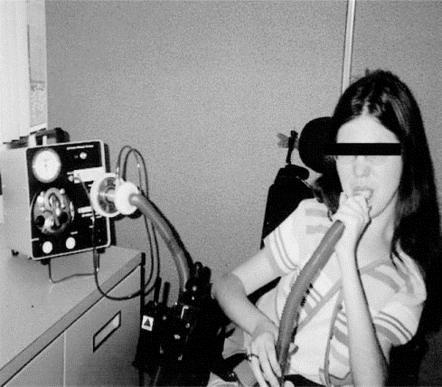
Emerson
Cofflator

Slide 41
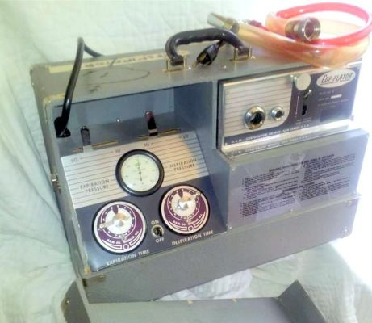
Emerson
Cofflator

Slide 42
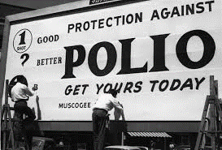
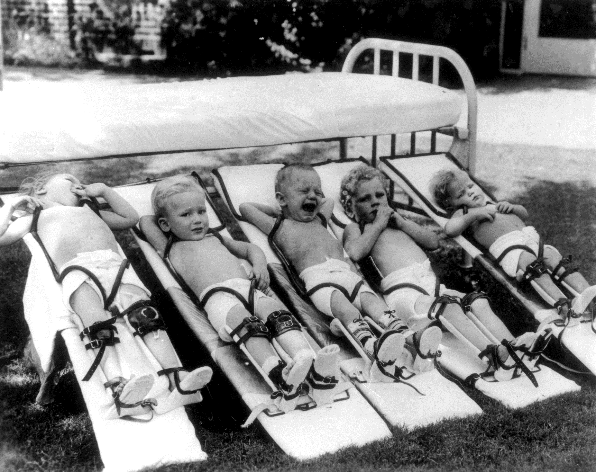
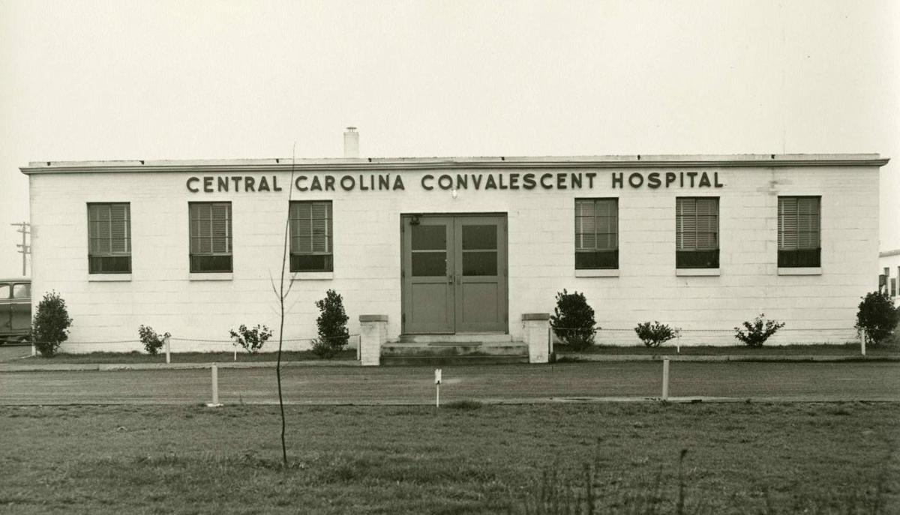
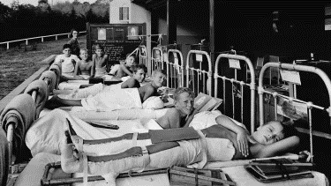

Slide 43
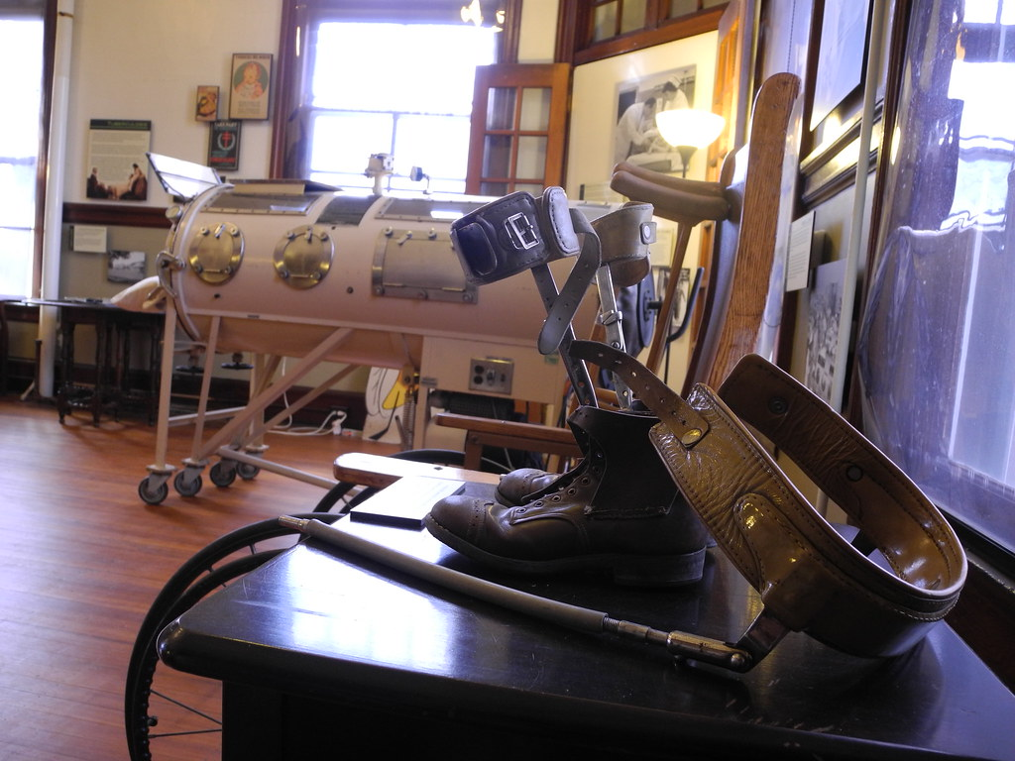

Slide 44
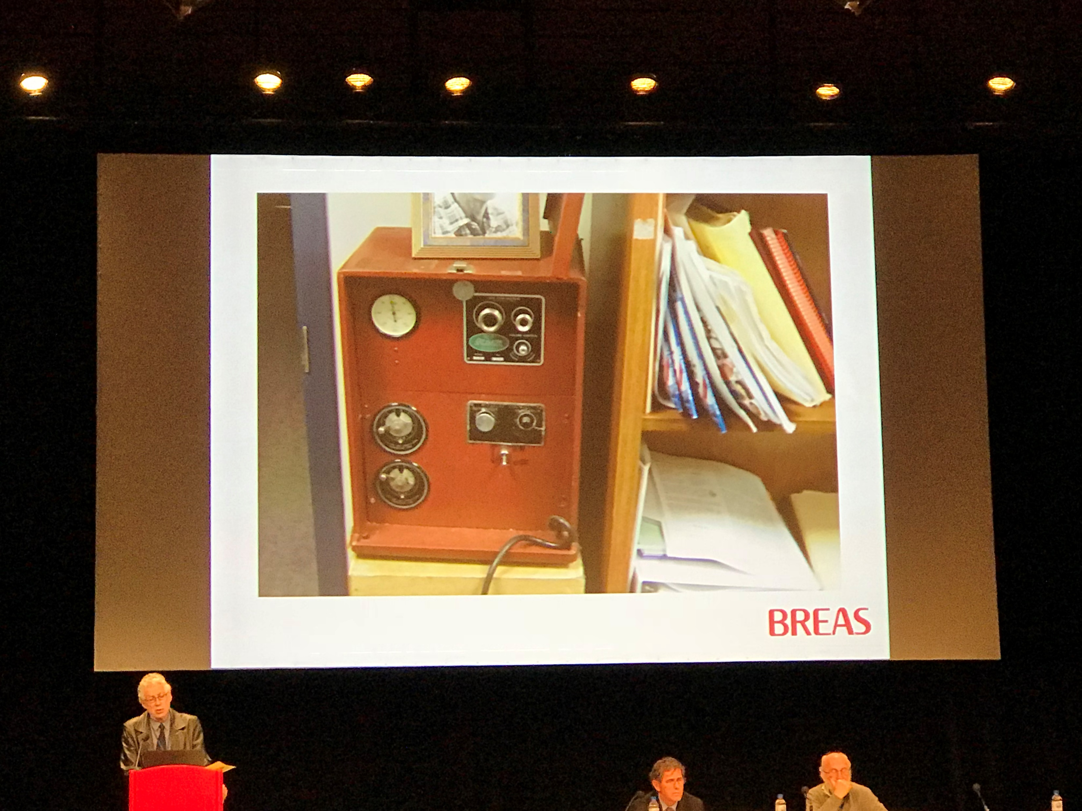
Dr John Bach
New York

Slide 45
Advances in secretion clearance
Mechanical Insufflation/Exsufflation
Emerson Cough assist

Slide 46
Advances in Physiotherapy have enabled expansion of NIV use
Non-invasive
ventilation
Cough assist
physiotherapy

Slide 47
Broad aims of home ventilation Improve Quality of Life
Discharge home
Live in the community
Reduce respiratory exacerbations
*Reduce frequency of PICU/HDU admissions
*Reduce frequency of hospital admissions
*Reduce frequency of serious chest infection
Maintain normal ventilation
Improve chest hygiene
Preserve chest shape

Slide 48
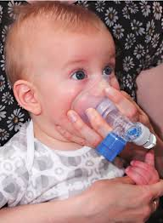
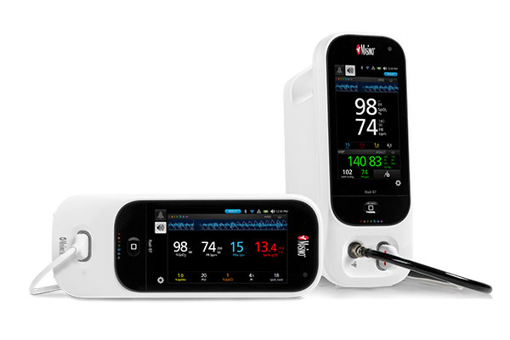
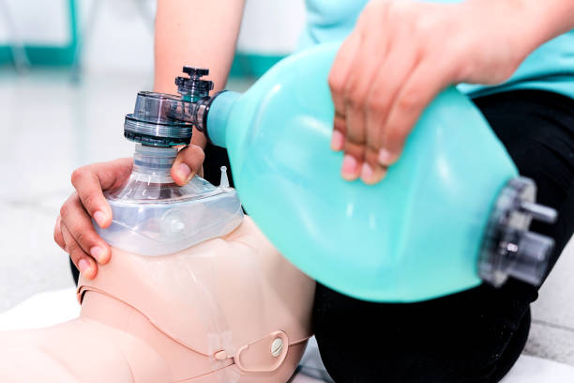
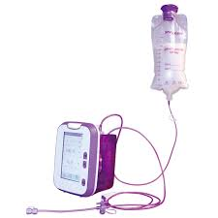
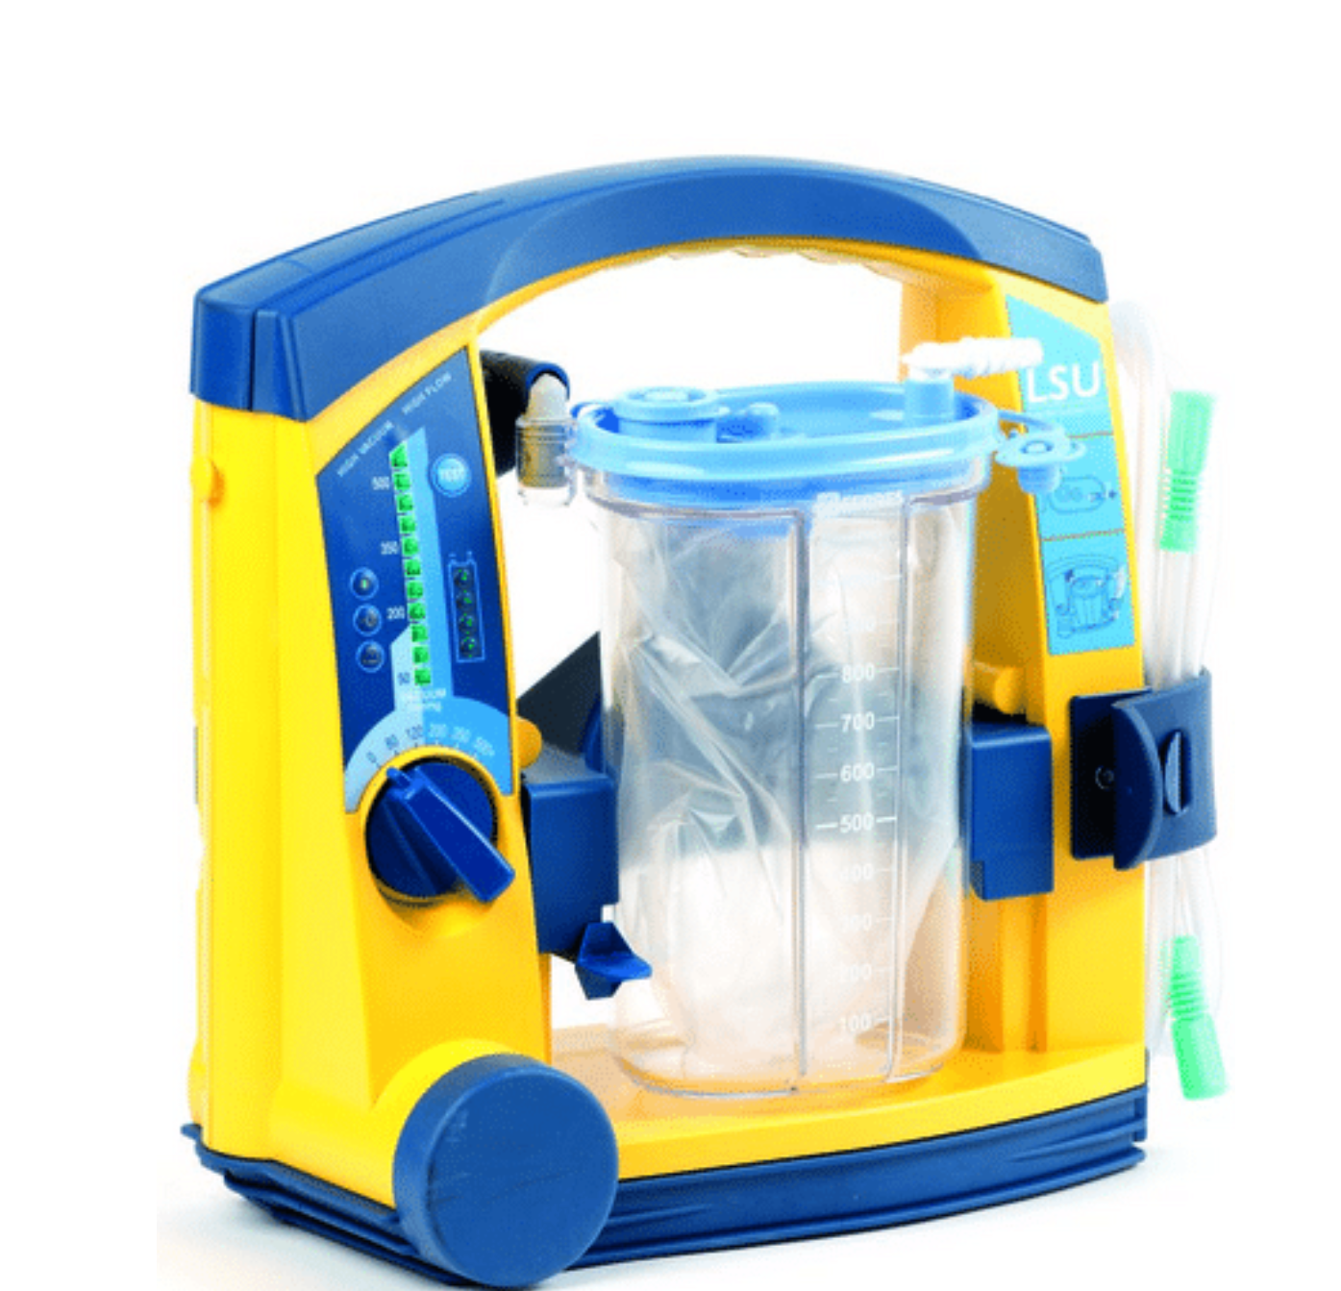
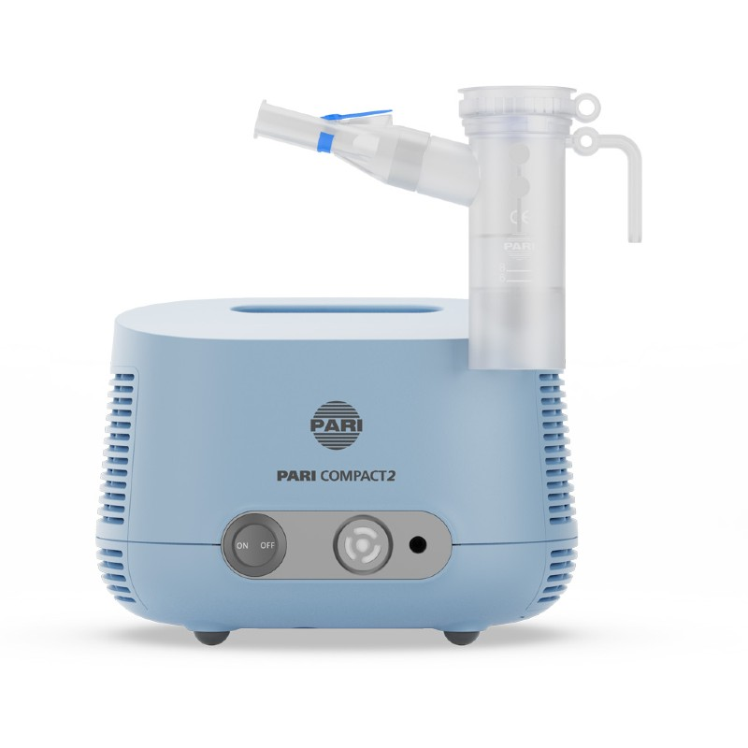
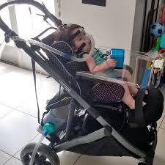



Slide 49


1-2 months

Slide 50


Non-invasive ventilation
Tracheostomy ventilation
24/7 ventilator dependent
Respiratory failure
More fragile
More admissions
More chest infections
Loss of voice
Tracheal infection
More suction ++
More discomfort
More stimulation (dystonia, seizures)
Home care package
12-18 months ward admission
1-2 months

Slide 51
Decisions for Long-Term Ventilation for Children. Perspectives of Family Members.
Edwards JD, Panitch HB, Nelson JE, Miller RL, Morris MC.
Ann Am Thorac Soc. 2020 Jan;17(1):72-80.

Slide 52
Parents’ emotional and psychological experience with decision-making
“I’m left with no choice.”
“It’s my baby girl, and I’m going to do whatever to keep her alive.”
“The thing is, I know he will be on everything his whole life, and I know there is no [other] option….. It’s not easy.”
“It’s scary that you might make a wrong decision based on your feelings and your wants, instead of the child’s, which is hard to do.”
“I feel like it’s the end of the world. I can’t do it. I don’t want to have a hole in my child’s neck.”

Slide 53
Parents’ communication and decision support needs
“I think a parent needs to know everything, the good and the bad, whether they want to hear it or not.”
“I didn’t want to know too much about [negative things about my child’s condition], and I still don’t want to know too much about it as far as, you know, what to expect….. I think a parent needs to know everything, the good and the bad, ... relevant to this day right now.”
“But in the hospital, when they say that he needs a trach, they didn’t explain to me all these [other] things [about caring for a child who uses long-term invasive ventilation]; they just say he needs a trach.”

Slide 54
Parents’ views on the option not to initiate
“Yes, I do understand why [a family might choose not to initiate long-term ventilation]. Again, it’s very invasive to have a trach, and I think it can clash with religious beliefs and just prolonging what may be the end of the child’s life just to have to be on a machine.”
“I think that there’s a point where technology can keep someone alive without regard for the quality of that life. And so, there comes a point where a decision has to be made and say, you know, ‘What are we trying to prolong here?’”
“I would make sure you know all your options [and] what is being done. All the tools and technology that is provided doesn’t mean that it’s the right thing to do, just because the doctor is telling you, ‘We’re gonna do this next, or we’re gonna do that next.’ [Parents] shouldn’t feel afraid if something is really in the back of their minds or a gut feeling…. You’re not crazy for having those thoughts; there is nothing wrong with you.’”

Slide 55
Impact on families
Caregiver burden
24/7 availability
Increased expenses and having to stop work
Extraordinary demands and expectations placed on parents
Anxiety
technical and physical aspects of care
Disruption to carer and finances
Sleep deprivation
Loss of social relationships and isolation
Social isolation
Lack of home care and community services
Difficulty talking to others about situation
Family functioning
82% problems with daily family functioning
Marital stress common
Less attention given to siblings
Major realigning of family roles
Normalisation
Family home feeling like a public rather than private place
Lack of privacy
Positives
HMV enabled the child to be at home with the family before dying
Helped family members to be more understanding and compassionate
Most studies found that with effort, families were able to achieve a sense of normality in their routine.
Most helpful
Home care package
Direct contact with respiratory care specialists
Canadian Journal of Respiratory, Critical Care, and Sleep Medicine, 2(sup1), 88–93.
Keilty, K., & Daniels, C. (2018).

Slide 56
Example Scenarios
Introduction of portable domestic ventilation in patients with palliative conditions
SMA type 1, 2
Congenital myopathy
Duchenne Muscular Dystrophy
Brainstem tumour
Cerebral palsy
Neurodisability
Metabolic
Other progressive disease
End of life
Compassionate extubation
Travel to hospice / home

Slide 57
Cerebral palsy
Neurodisability
Metabolic
Other progressive disease

Slide 58


Anticipation of outcome
Current status
How dependent on ventilation
How dependent on physiotherapy
Strength of cough and ability to clear secretions
Level of cognitive functioning
Severity of lung disease
Scoliosis and MSK
Dystonia and epilepsy
Other co-morbidity
Honest anticipation of success
Discharge from Hospital
Vulnerability to repeat exacerbations
Repeat PICU admissions from ward
Inadequate stability for discharge
Long wait for care package
Die in hospital
Discharge from Hospital
Honest account of life at home
Advantages and burdens
Family and patient experiences
Repeat hospital admissions
Estimate of life expectancy

Slide 59


