Slide 1



Scottish Cystic Fibrosis Group
No Sputum? There is always sputum!
Prof Julian Forton
The Children’s Hospital for Wales
Cardiff, UK

Slide 2
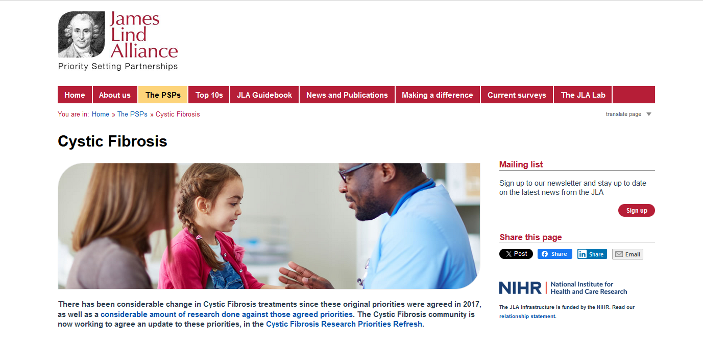
Sampling in patients on HEMT

Slide 3
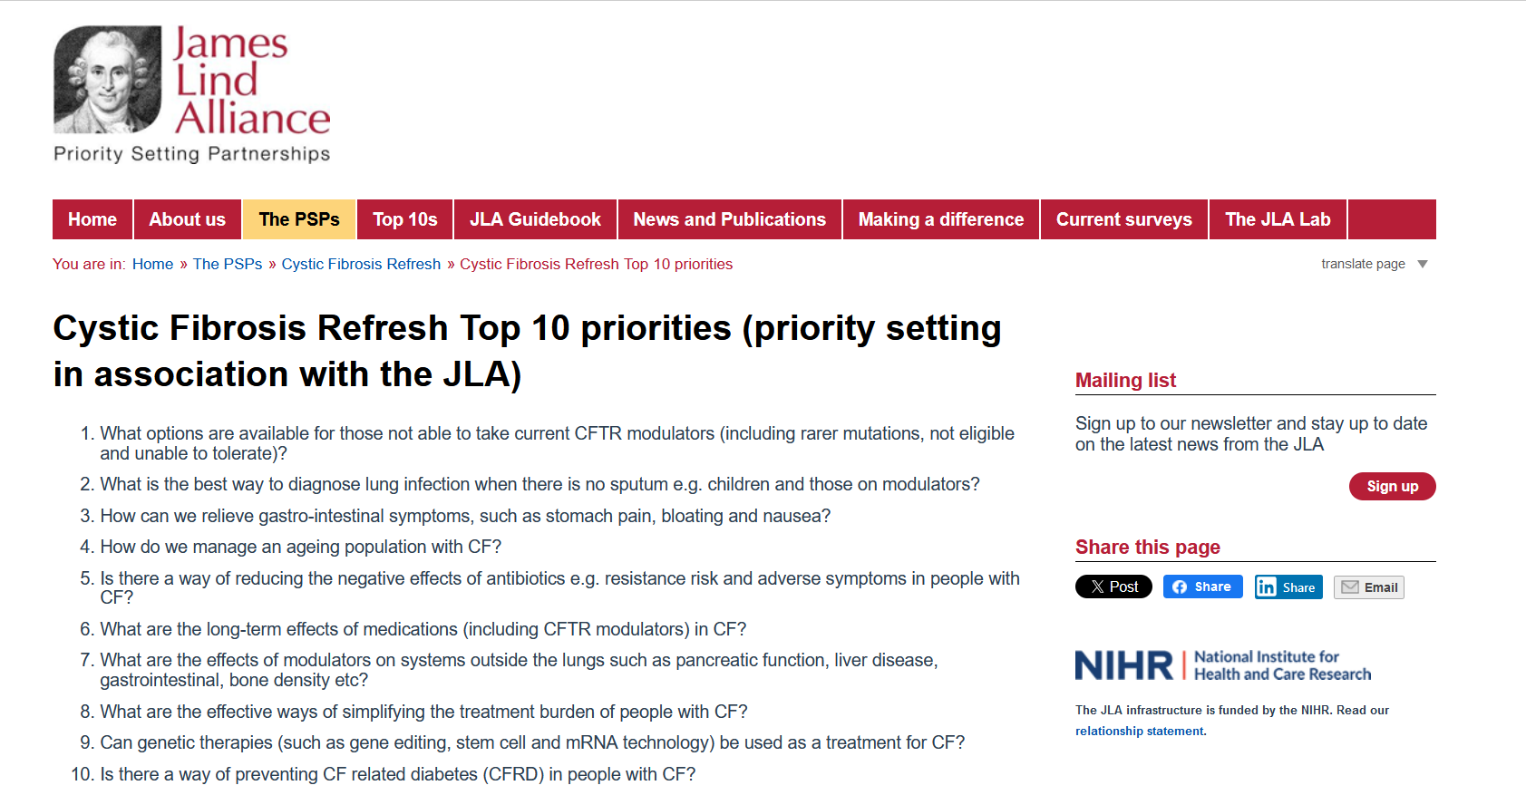

Sampling in patients on HEMT

Slide 4
New Challenges
Sputum volume and pathogen density are reduced in patients on HEMT,
BUT Pathogens are not eradicated
Highly sensitive PCR technologies means we need to redefine what actually constitutes an infection
Two Questions
How best to sample the airway ?
How best to analyse those samples ?

Slide 5

Principles of infection surveillance
VIRUS
OP swab
BAL
PSEUDOMONAS

Slide 6
CF-SpIT
Annual
assessment
Acute
exacerbation
Bronchoscopy
indicated
How to sample
How to analyse
Cough
swab
Induced
sputum
Bronchoscopy
6 lobes
Bank of samples
CF pathogens detected by
conventional microbiology culture
CF pathogens detected
Culture independent microbiology
Microbiome evolution in children with Cystic Fibrosis
Clinical determinants of accelerated evolution
Ronchetti K. et al (2018)
The CF‐Sputum Induction Trial (CF‐SpIT) to assess lower airway bacterial sampling in young children with cystic fibrosis: a prospective internally controlled interventional trial. Lancet Respir Med. 2018 Jun;6(6):461‐71

Slide 7

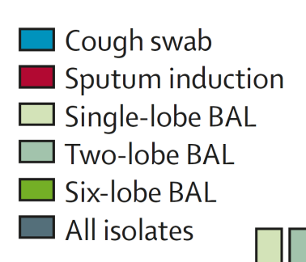
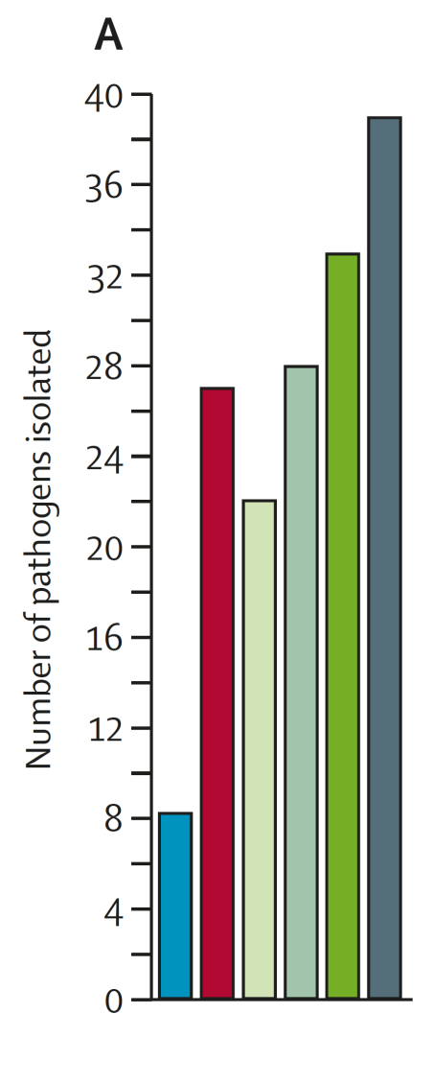
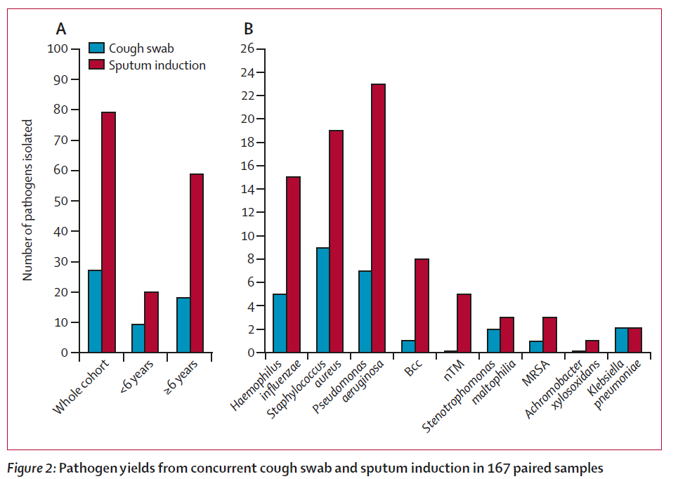
Sputum induction v cough swab
Sputum induction v BAL ( 1 lobe, 2 lobe and 6 lobe)
3 times as many pathogens
Equivalent to 2 lobe BAL
Lancet Respir Med. 2018 Jun;6(6):461‐71

Slide 8
CF SpIT: 30 patients
Paired sputum induction and 6 lobe BAL
Weiser R. et al (2022) The lung microbiota in children with cystic fibrosis captured by induced sputum sampling. J Cyst Fibros. 2022 Nov;21(6):1006-1012.
close
Examples of clear concordance between samples from a single patient
Act as biological replicates
Consistency in processing methodology
Confidence that a genuine biological signal is being captured
Sputum induction captures a meaningful representation of the lower airway microbiota in 80% of cases

Slide 9

Sputum Induction for everyone
Sputum induction can capture lower airway pathogens and characterise lower airway microbiota
Spatial microbiology of the airway is complex and difficult to describe with any single sample

Slide 10
Principles of infection surveillance
VIRUS
OP swab
SPUTUM INDUCTION
BAL
PSEUDOMONAS

Slide 11

Time consuming in clinic
Home sampling ?
Difficult to produce a sample
Patient Training ?

Slide 12
Modulator therapy infection surveillance
VIRUS
OP swab
SPUTUM INDUCTION
BAL
PSEUDOMONAS

Slide 13

Modulator therapy infection surveillance
VIRUS
OP swab
SPUTUM INDUCTION
BAL
PSEUDOMONAS

Slide 14
CF-HomeSpIT
The CF Home Sputum-Induction Trial to evaluate home sputum-induction and early morning cough clear saliva sampling in children with Cystic Fibrosis
K. Ronchetti , J.-D. Tame , L. Thia , A. Aseeri , R. Weiser , E. Mahenthiralingam , J.T. Forton.
CF-SpIT Study Group
The Children's Hospital for Wales, Cardiff, United Kingdom
Cardiff University, School of Biosciences, Cardiff, United Kingdom,
NIHR Portfolio ID – 54158. ISRCTN86523335

Slide 15



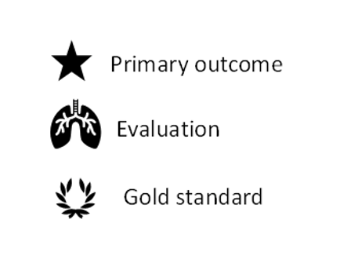
CF-HomeSpIT
The CF Home Sputum Induction Trial
ISRCTN86523335
Early morning
Cough Clear Saliva
Early morning
Home sputum induction
Clinic
Cough Swab
Clinic
Cough Clear Saliva
Clinic
sputum induction
NHS Clinical Microbiology
Microbiome Research
Inflammation
WS13.01 The Cystic Fibrosis Home Sputum-Induction Trial (CF-HomeSpIT - ISRCTN86523335) to evaluate home sputum-induction and early morning saliva sampling in children with cystic fibrosis
Ronchetti, K; Tame, J-D; Thia, L; Aseeri, A; Weiser, R; Mahenthiralingam, E; Forton, J
Journal of Cystic Fibrosis. , 2023, Vol.22, p.S25-S26
DOI: 10.1016/S1569-1993(23)00259-X

Slide 16
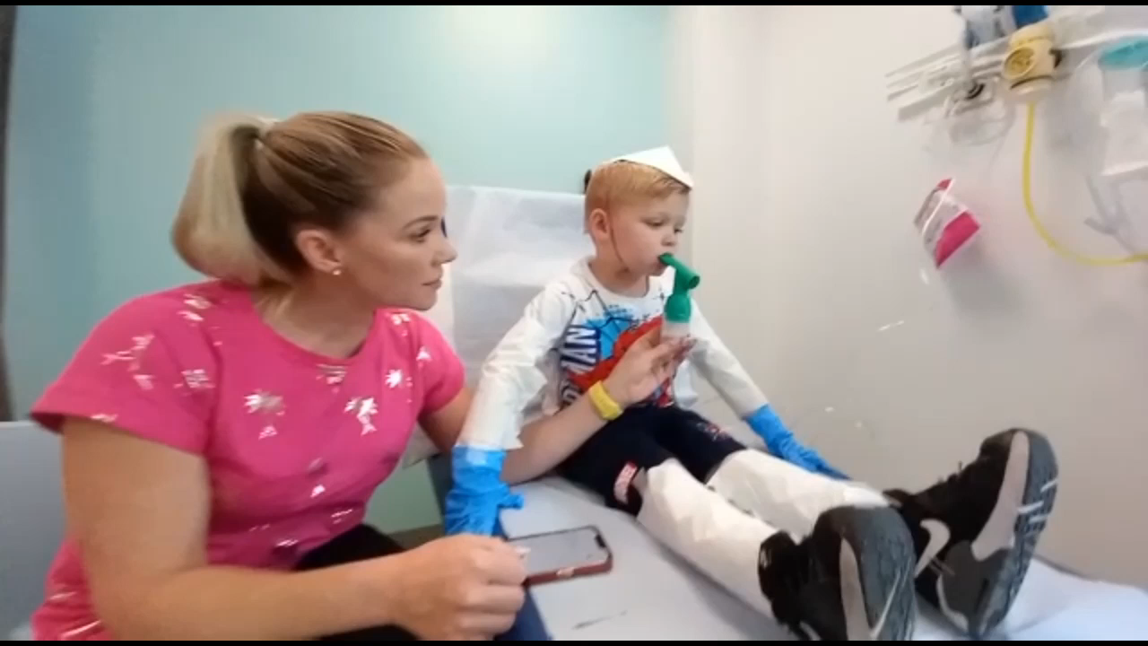
Sputum Induction - Hypertonic saline, exercise, PEP and cough clear

Slide 17
Cough clear
Easy cough clear
Oropharyngeal suction

Slide 18
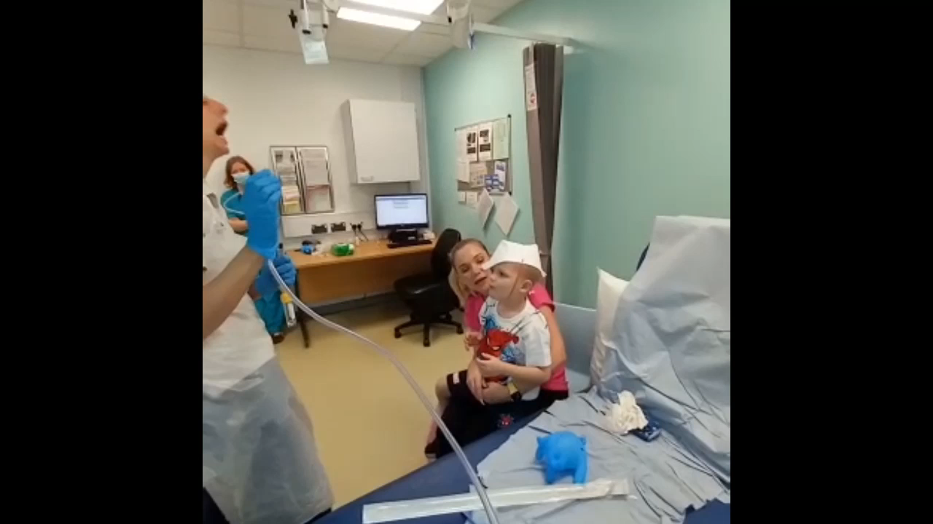
Oropharyngeal suction

Slide 19
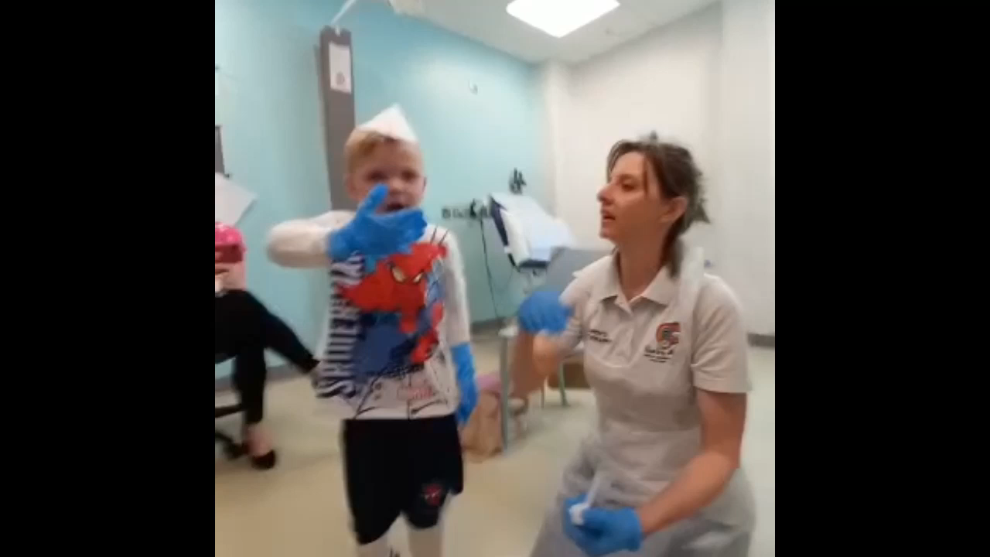

Slide 20
Early morning cough clear saliva
Home sputum induction

Slide 21
50
CF-HomeSpIT
Patient characteristics: first 50 recruits (Jan2024)
Age | 11.4 years [range 4.0-17.1]
FEV1 % | 91% [range 73-121]
Wet cough on day of sampling | 10/50 [20%]
Modulator therapy (all) | 46/50 [92%]
Orkambi | 7/50 [14%]
Kaftrio | 39/50 [78%]

Slide 22
50
CF-HomeSpIT
Qualitative assessment
Data
Interim data on first 50 patients recruited to CF HomeSpIT
Age 11.4 years [range 4.0-17.1]
46/50 (92%) patients on HEMT
Results
46/50 (92%) patients managed to produce home samples
Median duration taken at home: 10 mins (range 5-20)
No reported side effects
42/46 (91%) home samples reported as sputum rather than saliva
29/42 (69%) sputum samples reported as mucoid, mucopurulent or purulent
Acceptability
48/50 (96%) willing to do home sputum sampling regularly
Fitting in home sampling before clinic was rated 3.1/10
Likert scale 0 -10 easy - difficult
Median chosen frequency from range 1-6 / year = 4

Slide 23
CF-HomeSpIT
Interim Results for first 80 recruited patients
Median age 11.3 years ( Range 4.0-17.1 years)

Slide 24
CF-HomeSpIT
Interim Results for first 80 patients
26/80 (32.5%) patients were pathogen positive from all approaches taken together
27 classical pathogens were identified in total
8/80 (10%) cough swabs were pathogen positive

Slide 25
CF-HomeSpIT
Interim Results for first 80 patients

Slide 26
CF-HomeSpIT
Interim Results for first 80 patients
74% 67% 96% 82%

Slide 27
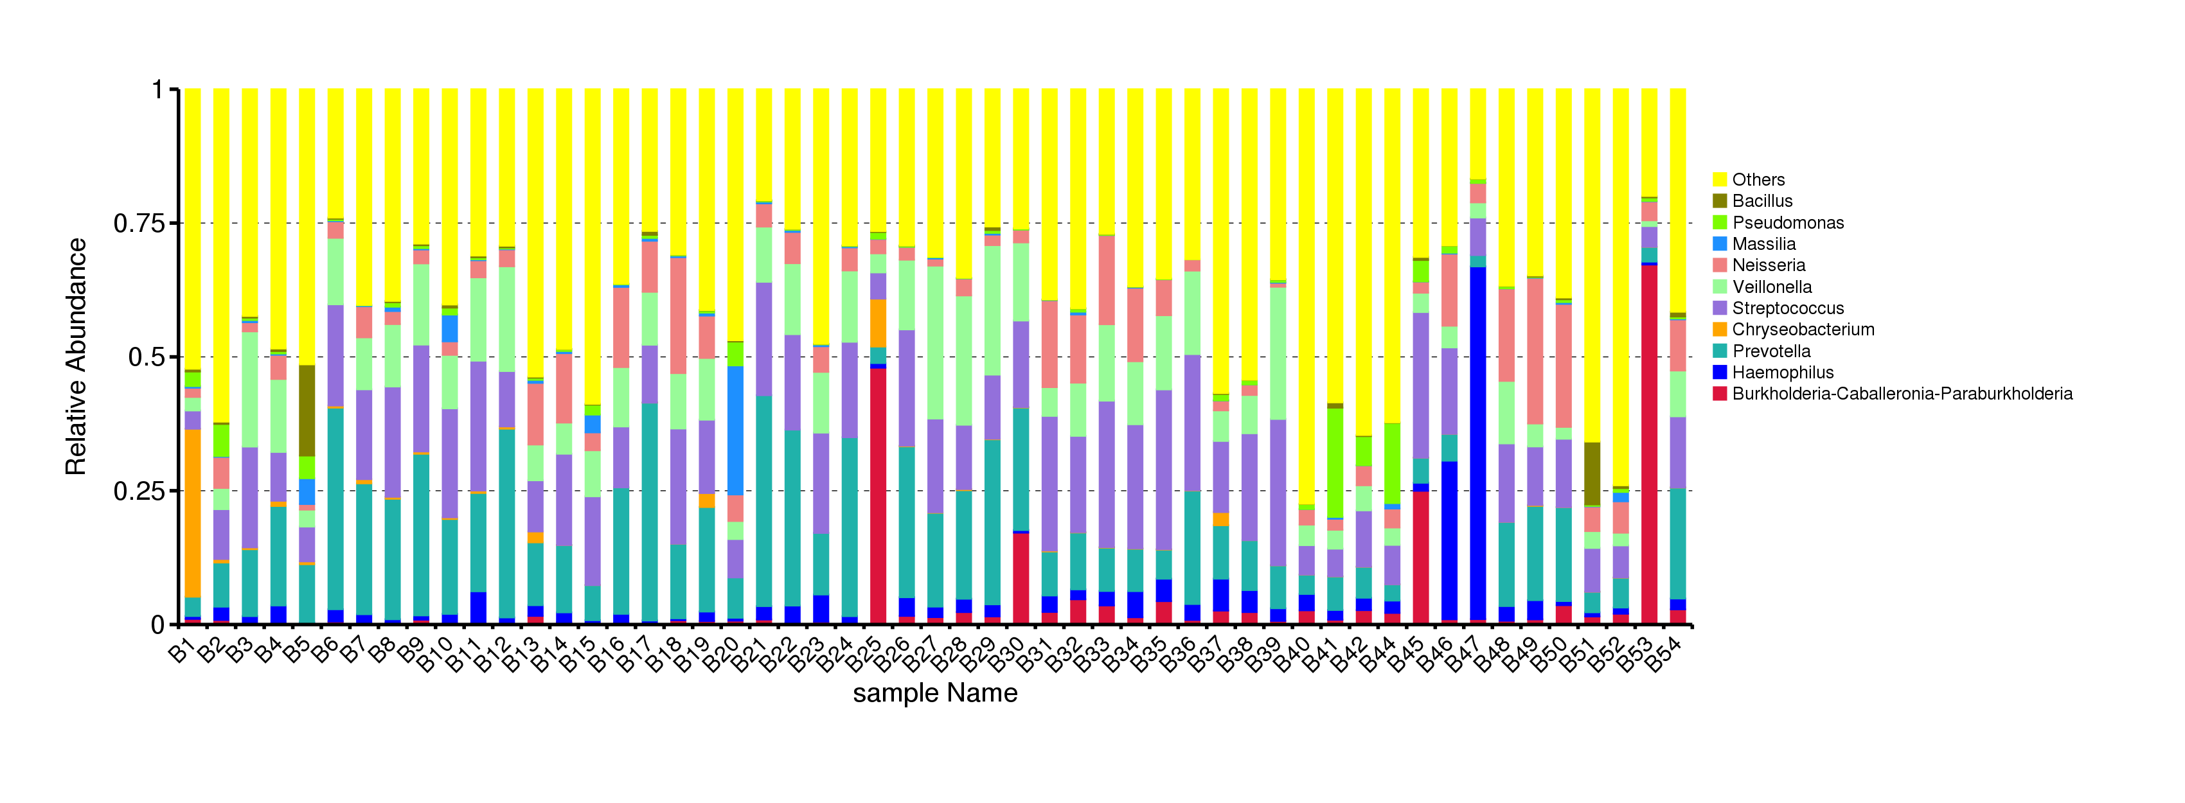
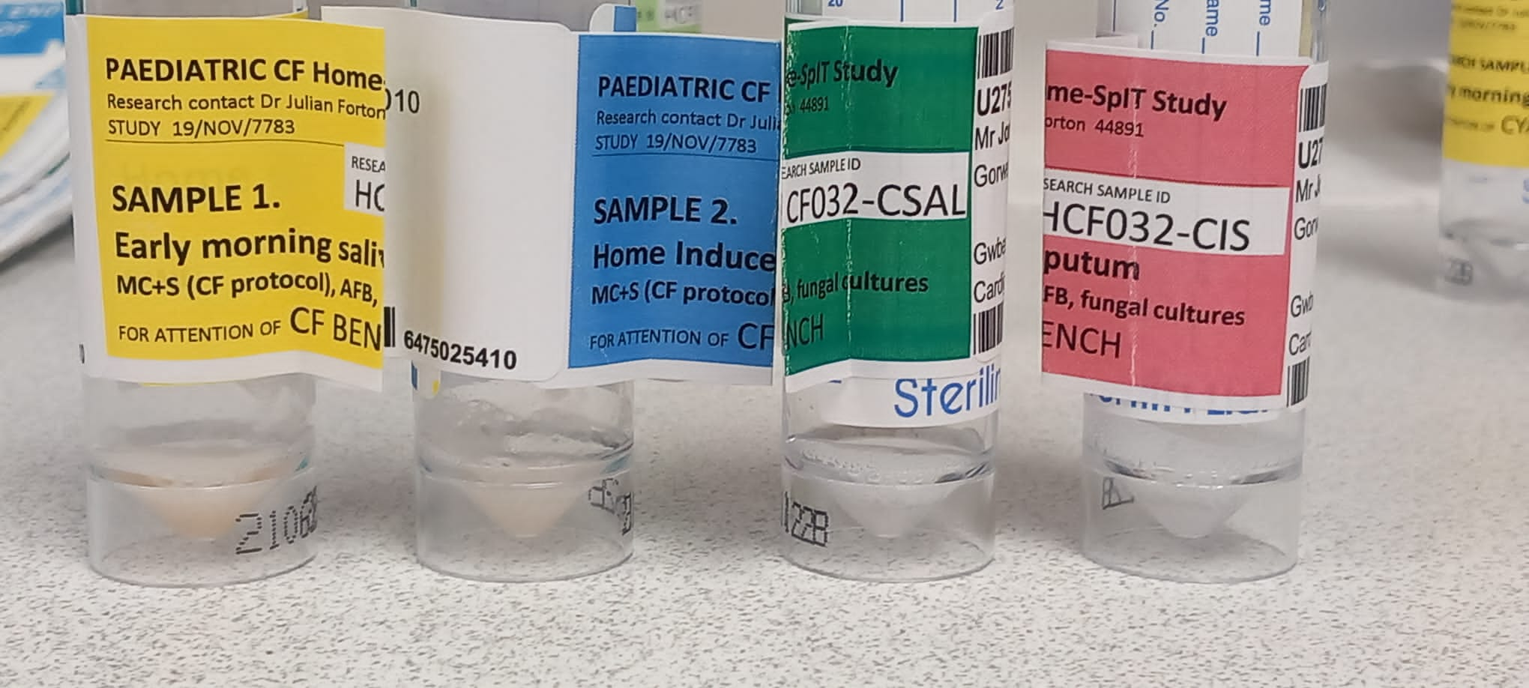
CF-HomeSpIT
Interim Results for microbiota
Patient 14
emSAL hIS cCS cSAL cIS

Slide 28
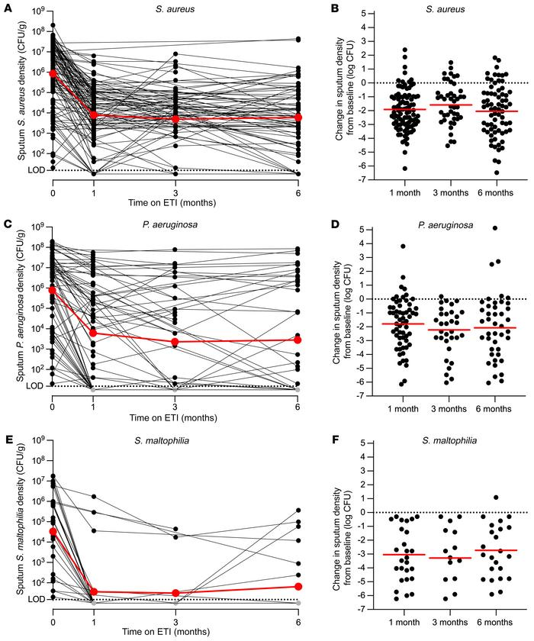
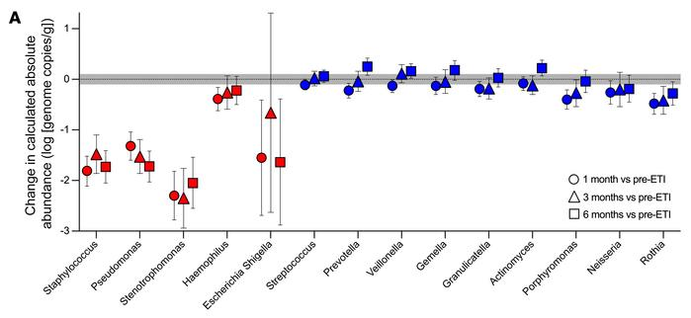
PROMISE-MICRO STUDY
Pharmacologic improvement of CFTR function rapidly decreases sputum pathogen density, but lung infections generally persist
J Clin Invest 2023 May 15;133(10):e167957.doi: 10.1172/JCI167957.

Slide 29
CF SpIT research group
Sputum induction positivity before and after Modulator therapy
.
Pre-modulator Cohort
Modulator Cohort
CF-SpIT CF-HomeSpIT
Forton et al. Journal of Cystic Fibrosis (2024) 23:S12-S13

Slide 30
CF-HomeSpIT
Home-sampling is possible, with comparable pathogen yield compared to supervised clinic sampling
Combining approaches to sampling increases pathogen yield
Early morning cough clear saliva is a novel, quick, practical approach to sampling that warrants further evaluation
Home sampling may also benefit adult populations who now produce less sputum and in whom new approaches to pathogen surveillance need to be explored

Slide 31
What is sputum nowadays
Jobs for the clinician
Reset your own expectations
Integrate sputum sampling into service
Talk to your microbiologist

Slide 32
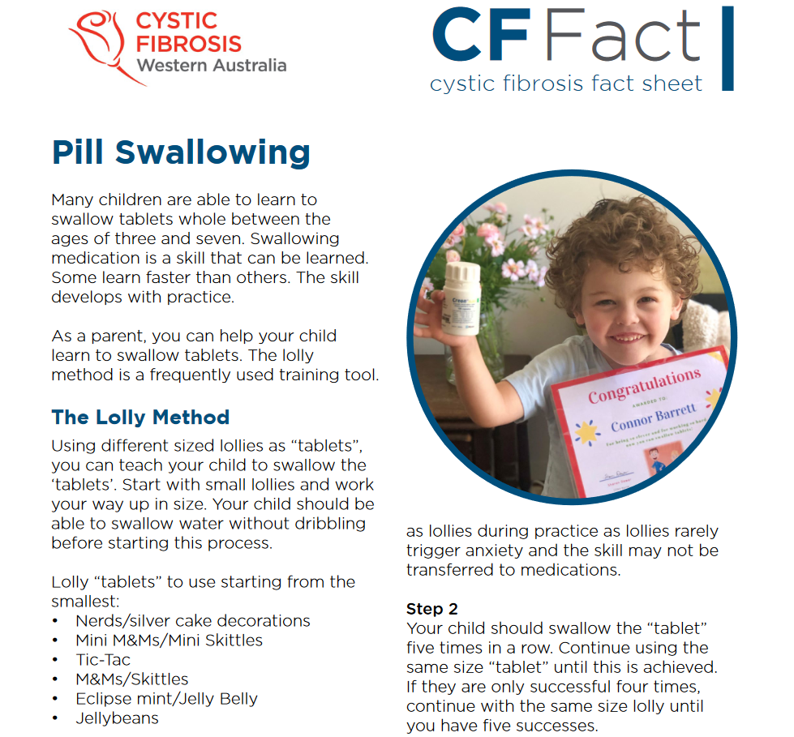
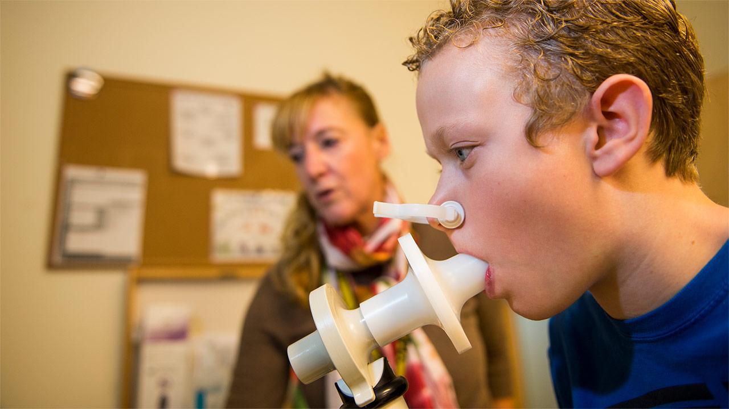
CF Community
Expertise in Patient Training
Children’s Hospital Colorado

Slide 33
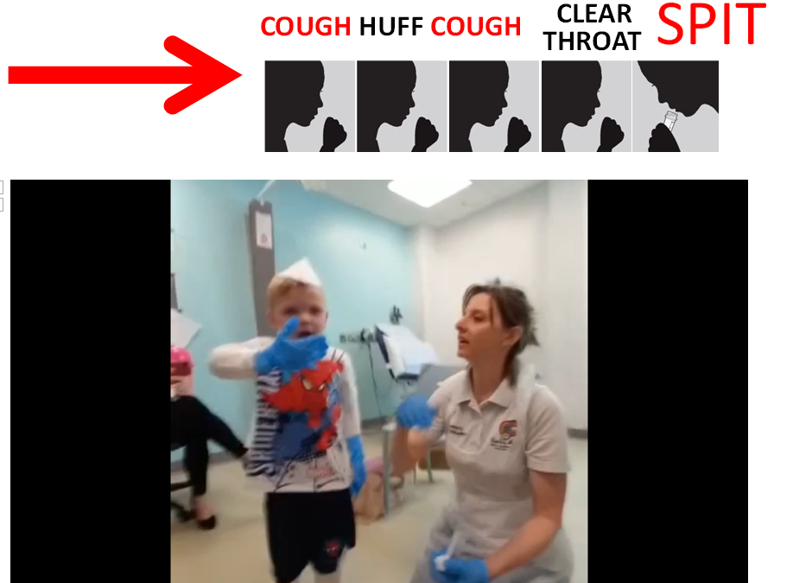
Training
Sputum induction is worth it

Slide 34





CFSpIT Research Group
The Children’s Hospital for Wales
Prof Julian T. Forton
Kath Ronchetti Research Physiotherapist
Hannah Morgan CF Physiotherapist
Jodee Tame CF Physiotherapist
Dr Juliette Oakley Clinical Research Fellow MD
Department of Biosciences, Cardiff University
Prof Eshwar Mahenthiralingham
Dr Rebecca Weiser
Abdullah Aseeri
Department of Microbiology, UHW, Cardiff
Dr Rishi Dhillon

