Slide 1
Effects of Modulator therapy
Compliance with treatment
Transition to adult care
Professor Julian Forton
The Children’s Hospital from Wales, Cardiff, UK
Cardiff University School of Medicine

Slide 2
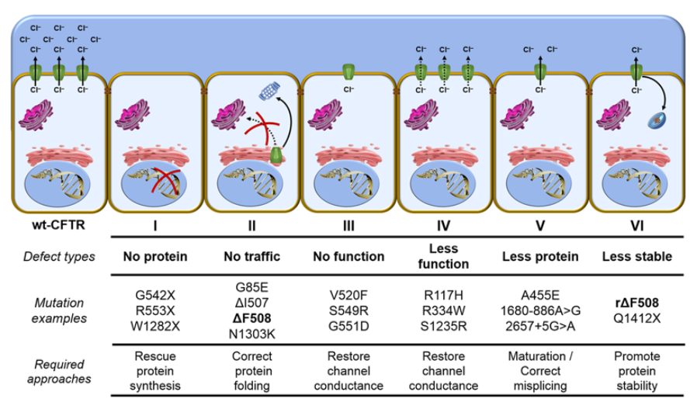
Modulator therapy 6 CFTR class mutations
x

Slide 3
Modulator therapy
Combination therapy = compounded effect
Modulators improve production, intracellular processing, and/or function of the defective CFTR protein
In combination there is a compounded effect on improving CFTR function
Ivacaftor IVA
Orkambi IVA/LUMA
Symkevi IVA/TEZ
Kaftrio IVA/TEZ/ELEX

Slide 4
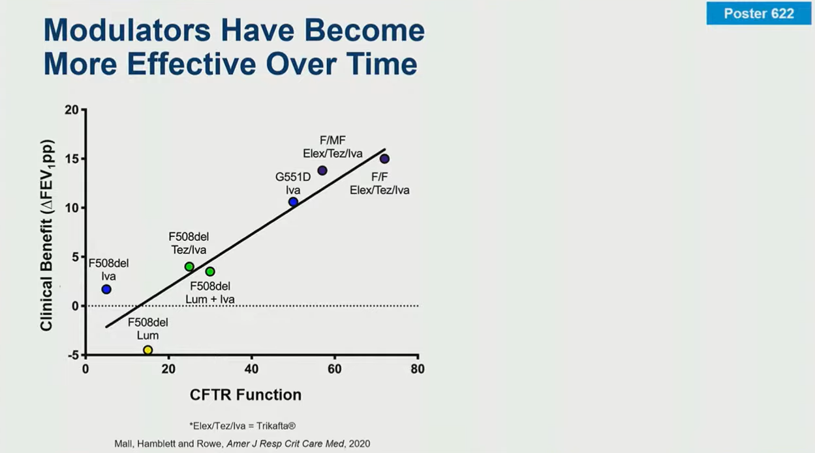
Highly effective modulator therapy
HEMT
Ivacaftor
Kaftrio

Slide 5
Modulator therapy
Combination therapy = UK licenses
Modulators improve production, intracellular processing, and/or function of the defective CFTR protein
In combination there is a compounded effect
Ivacaftor Age > 1 month G551D
Orkambi Age > 1 years dF508/ dF508
Symkevi Age > 6 years dF508/ dF508
Kaftrio Age > 2 Years dF508 / any

Slide 6
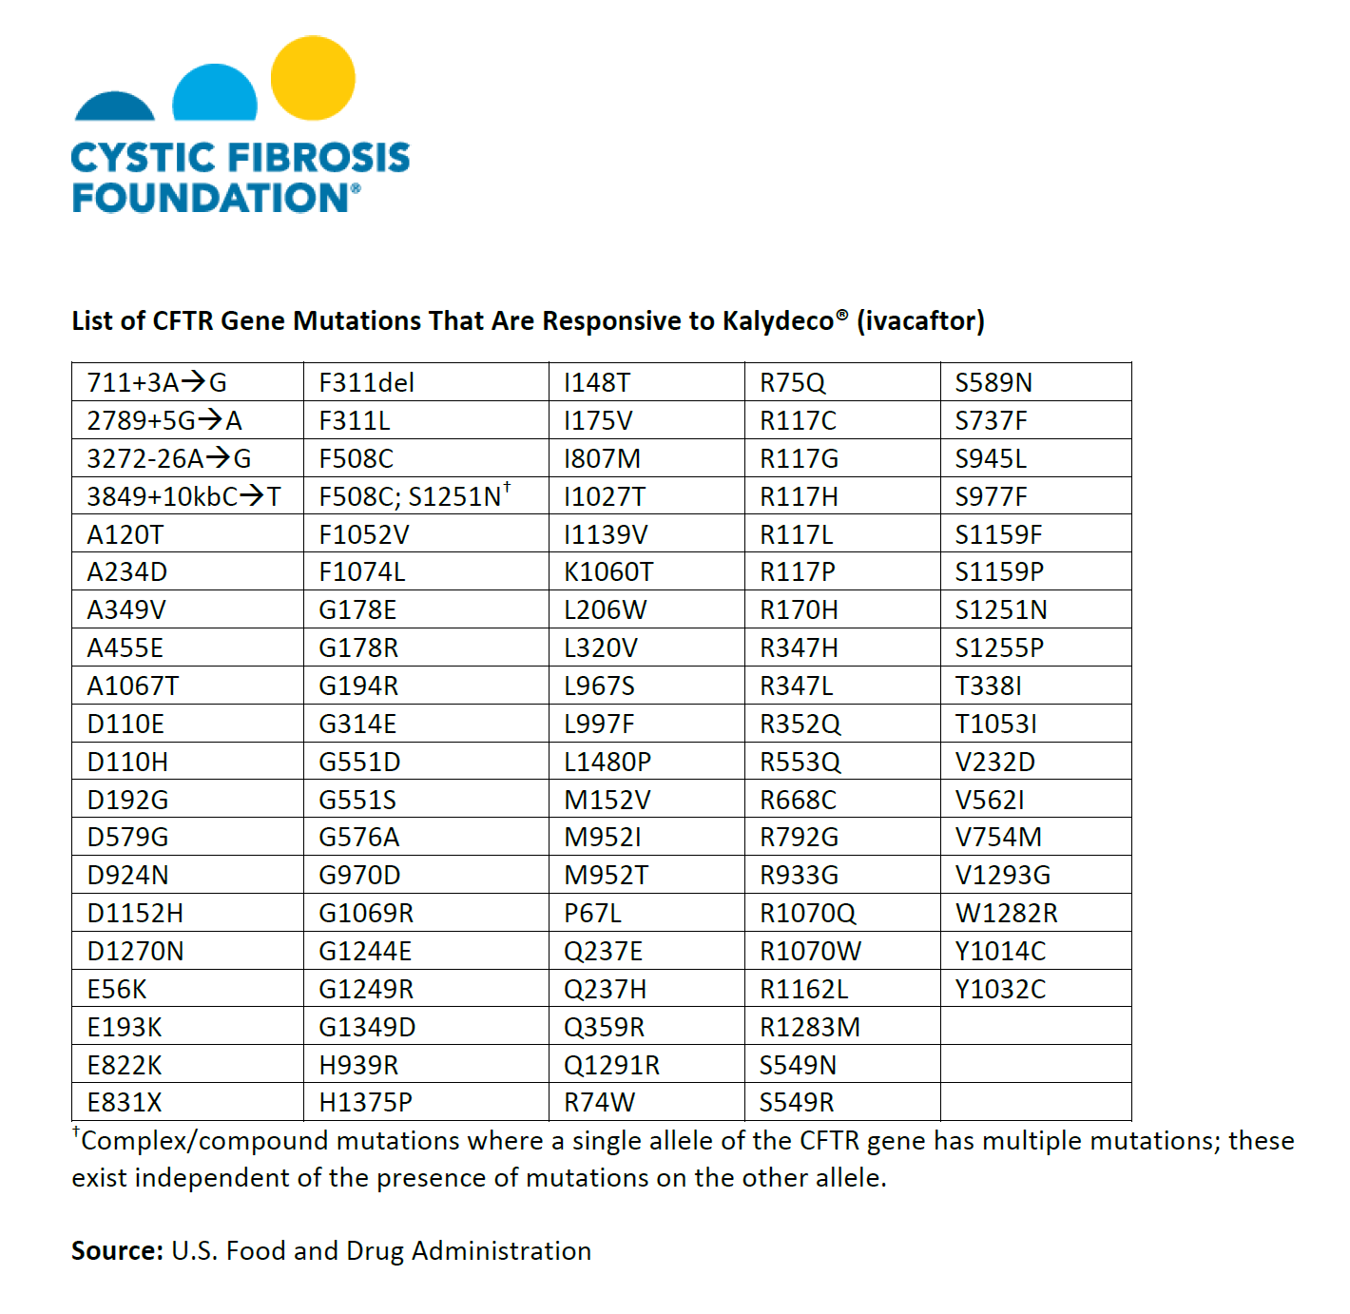
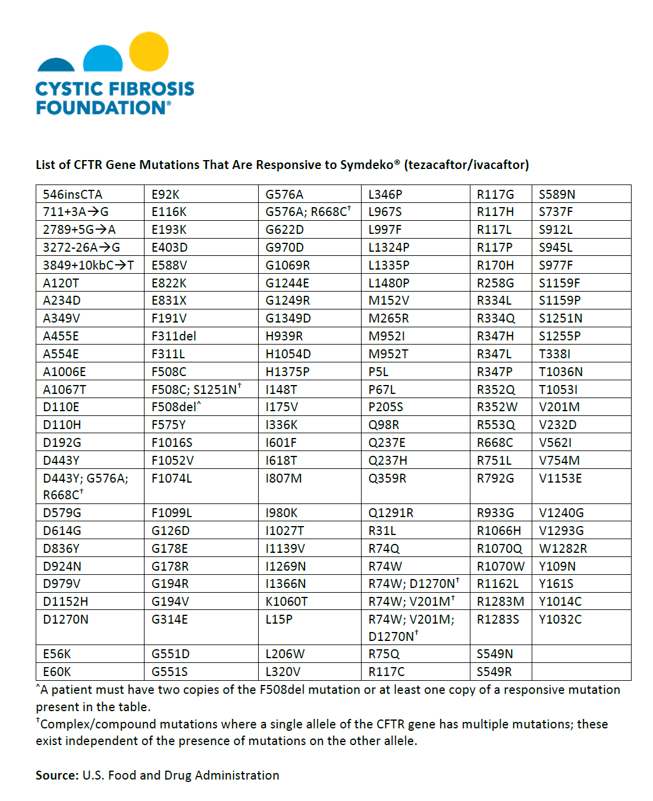
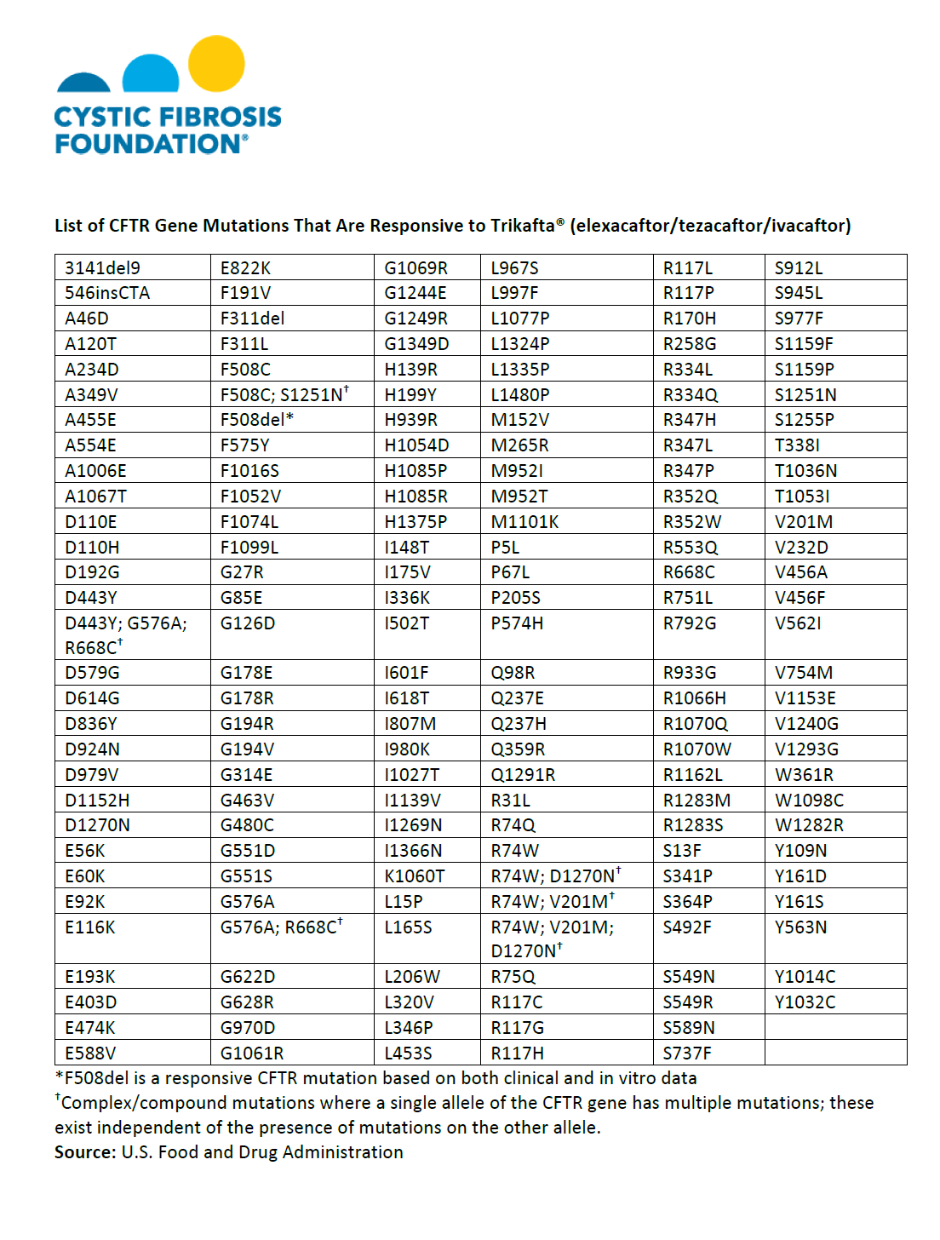
October 2024 – UK license extended to all FDA approved mutations

Slide 7
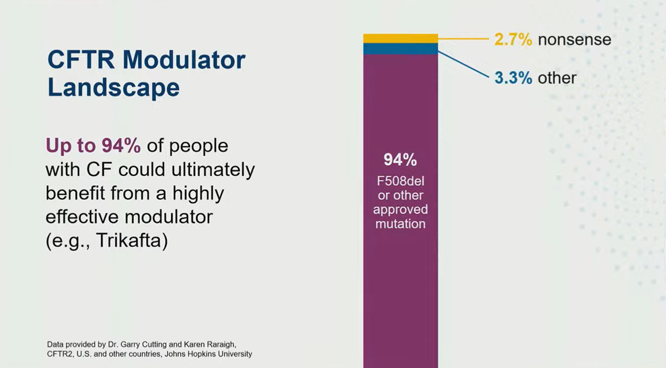

Slide 8
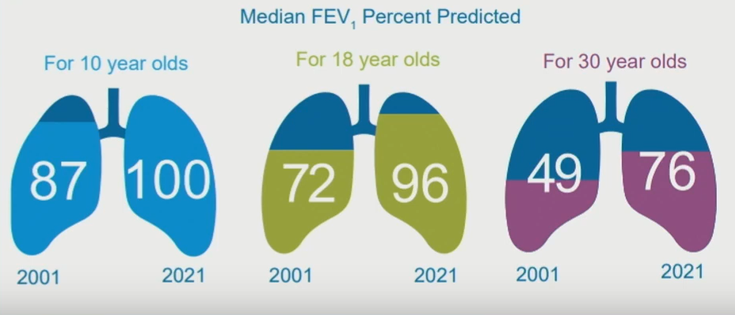
Outcomes of Modulator therapy

Slide 9
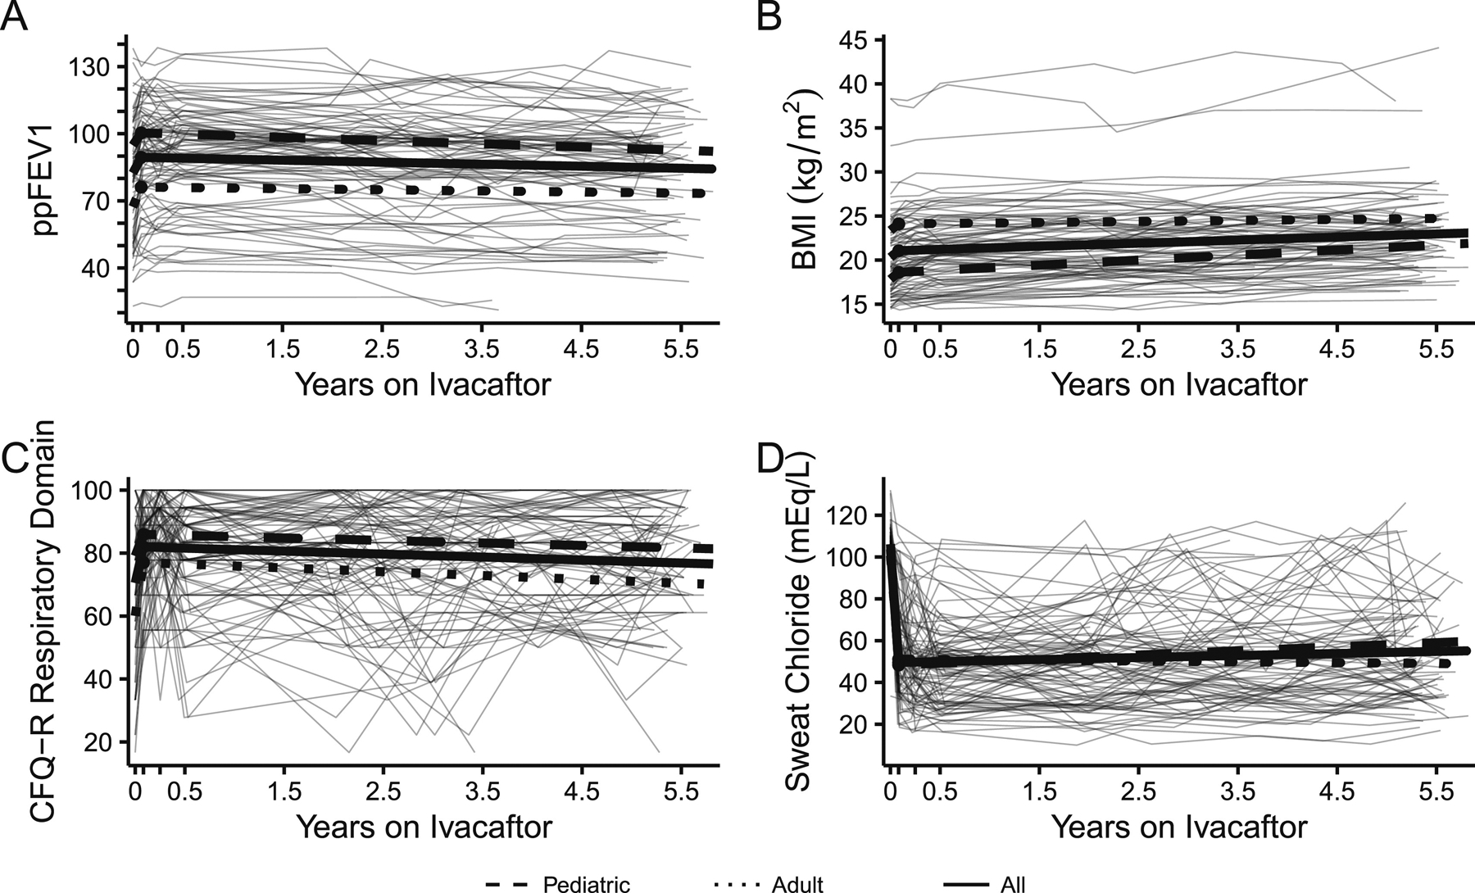
GOAL Study [IVACAFTOR]: Long term clinical effectiveness of ivacaftor in people with the G551D CFTR mutation
J Cyst Fibros. 2021 Mar; 20(2): 213–219.

Slide 10
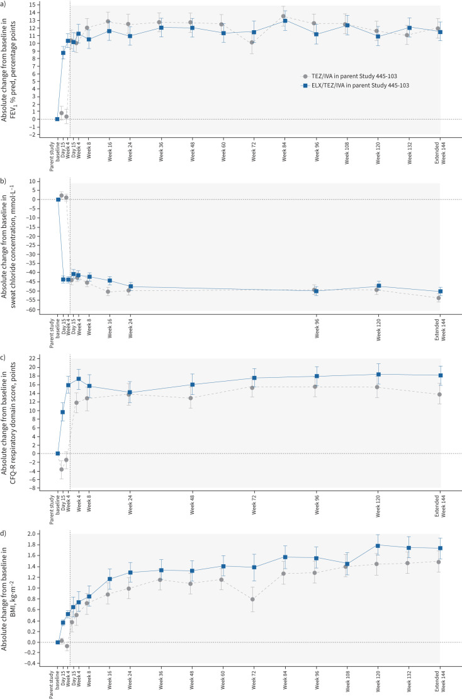
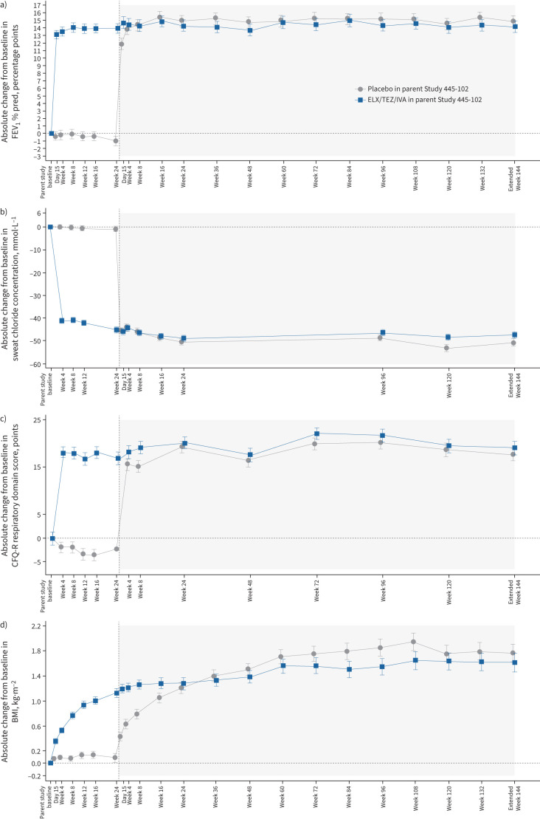
VX17-445-105 study [KAFTRIO]
Long-term safety and efficacy of elexacaftor/tezacaftor/Ivacaftor at 144 weeks
Eur Respir J. 2023 Dec 7;62(6):2202029.
Daines CL, Tullis E et al. VX17-445-105 Study Group.
DF508/MF DF508 / DF508
FEV1
Sweat Test
CFQ-R
BMI

Slide 11
Effect of Modulator therapy on infection

Slide 12
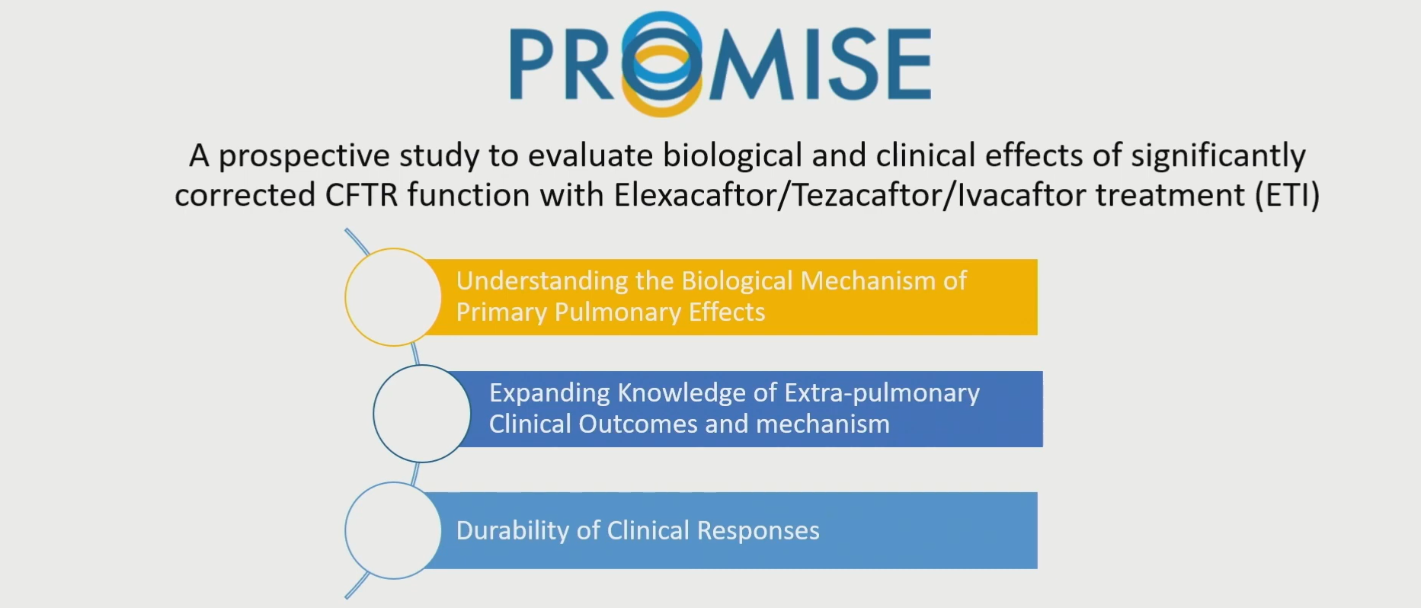
Multicenter observational prospective cohort study examining efficacy in post approval “real world” setting N=487

Slide 13
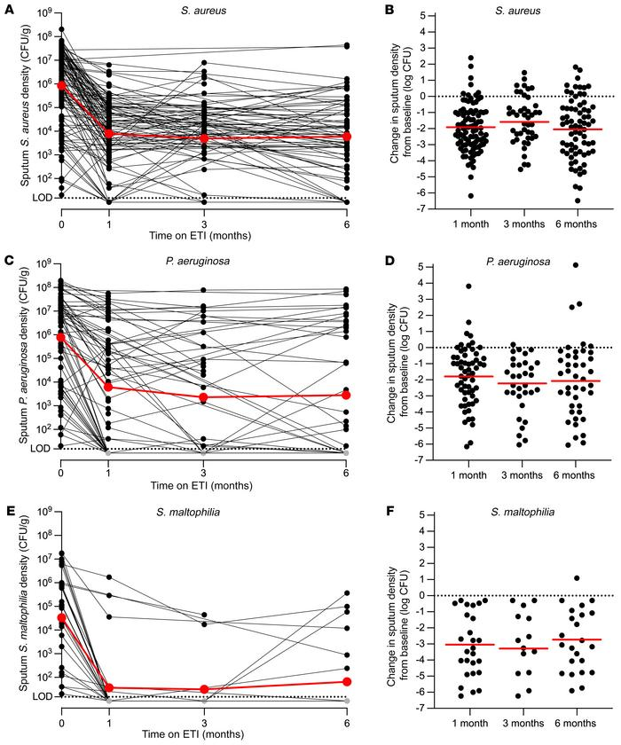
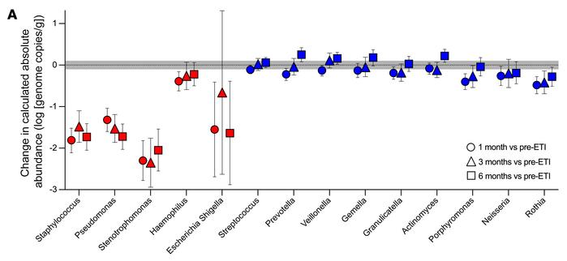
PROMISE-MICRO STUDY
Pharmacologic improvement of CFTR function rapidly decreases sputum pathogen density, but lung infections generally persist
J Clin Invest 2023 May 15;133(10):e167957.doi: 10.1172/JCI167957.

Slide 14
CF SpIT research group
Sputum induction positivity before and after Modulator therapy
.
Pre-modulator Cohort
Modulator Cohort
Forton et al. Journal of Cystic Fibrosis (2024) 23:S12-S13

Slide 15
Effect of Modulator therapy on inflammation

Slide 16
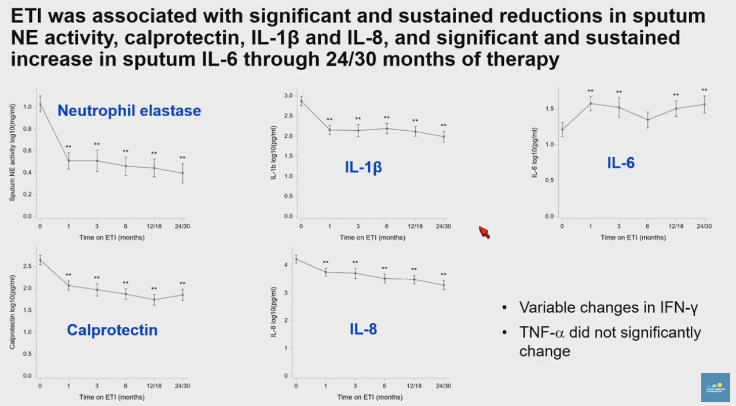
PROMISE-INFLAMMATION STUDY
Long term effects of ETI therapy on airway and systemic inflammation in CF
Changes in airway inflammation were associated with changes in clinical outcomes at 24 months

Slide 17

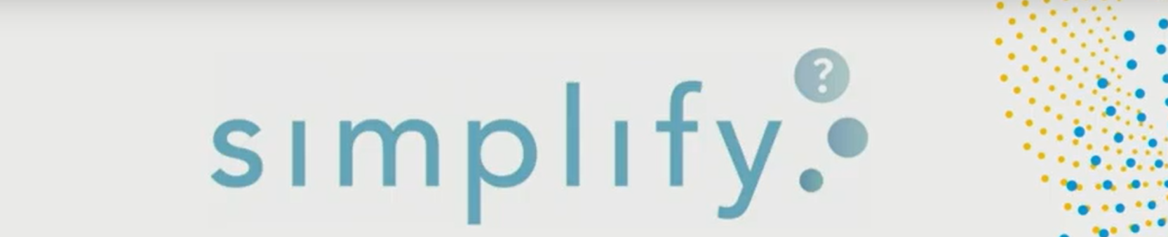

Effect of withdrawing therapies in patients on modulator therapy

Slide 18
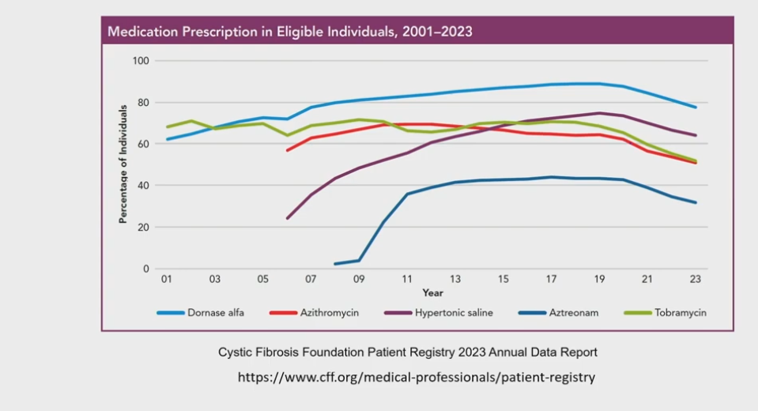

Slide 19
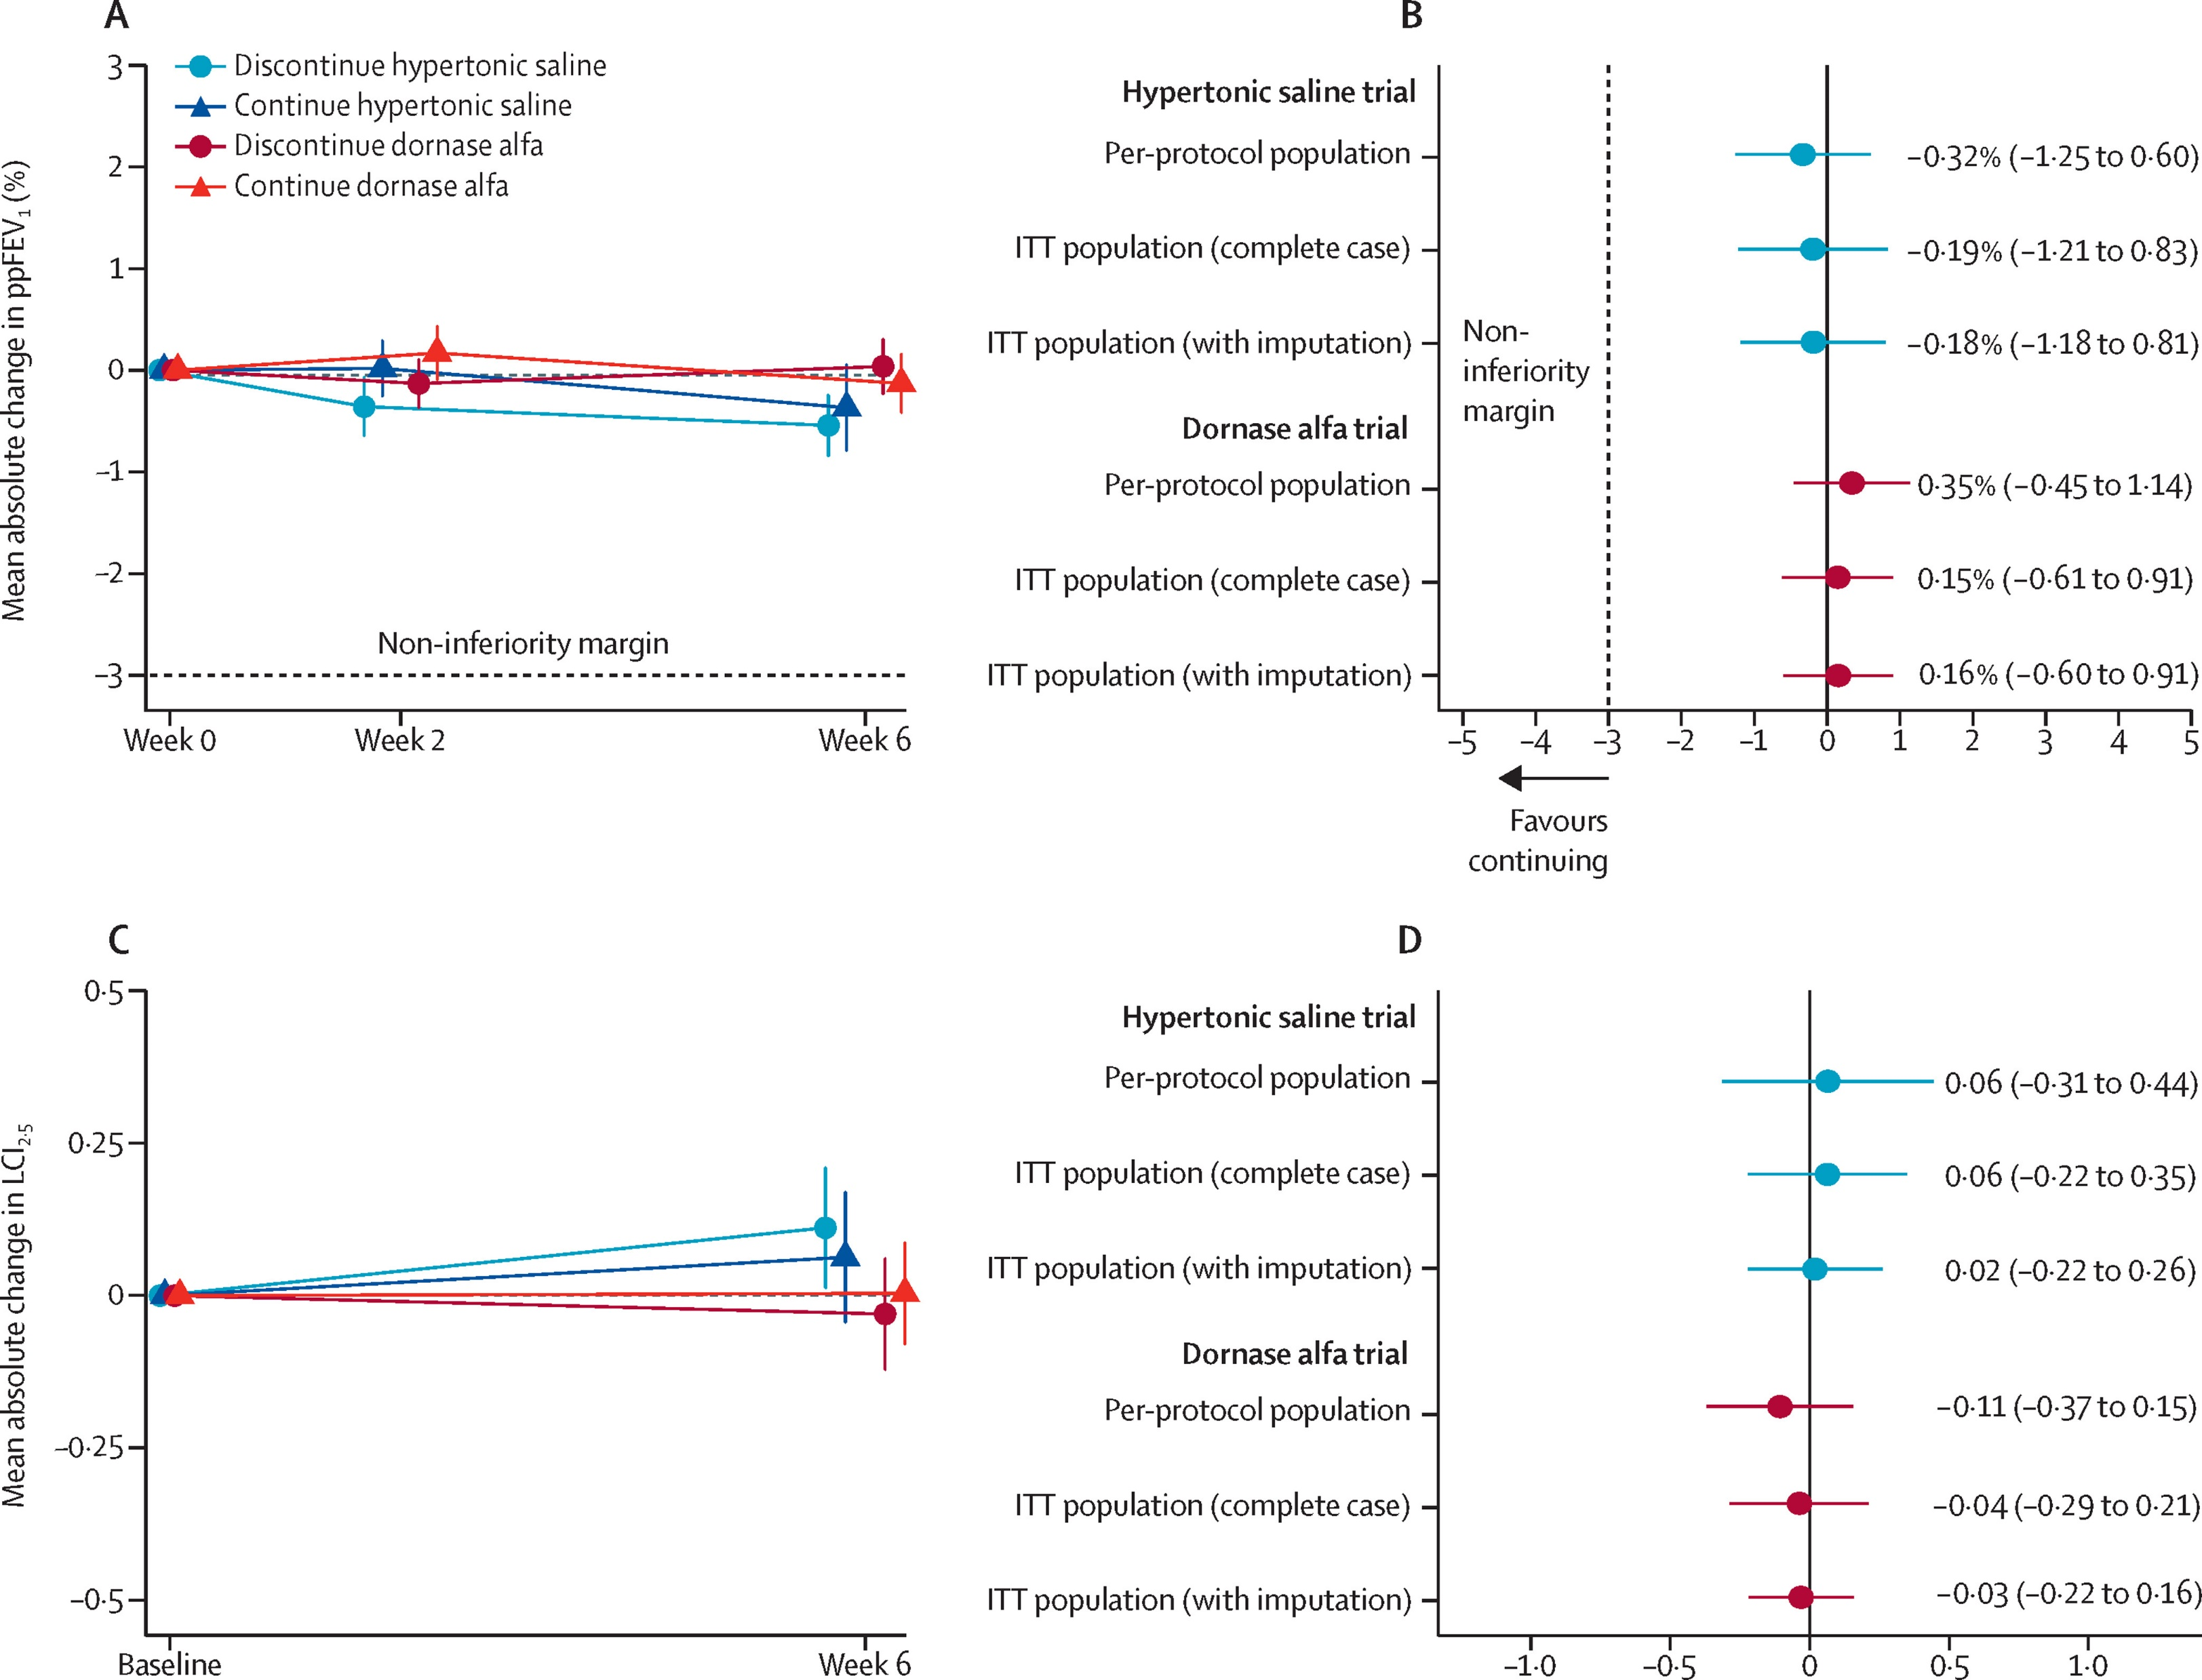
SIMPLIFY STUDY
Discontinuation versus continuation of hypertonic saline or dornase alfa in modulator treated people with cystic fibrosis (SIMPLIFY): results from two parallel, multicentre, open-label, randomised, controlled, non-inferiority trials
Mayer-Hamblett, NicoleKloster, Margaret et al. The Lancet Respiratory Medicine, Volume 11, Issue 4, 329 – 340. 2023
FEV1 LCI

Slide 20
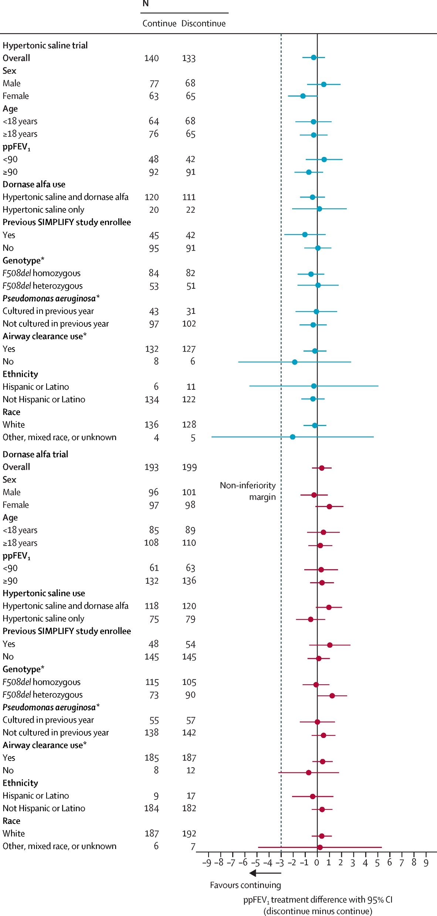
Hypertonic saline Dornase Alpha

Slide 21
LONG TERM Effect of withdrawing therapies in patients on modulator therapy …… ????

Slide 22
COMPLIANCE with modulator therapy

Slide 23
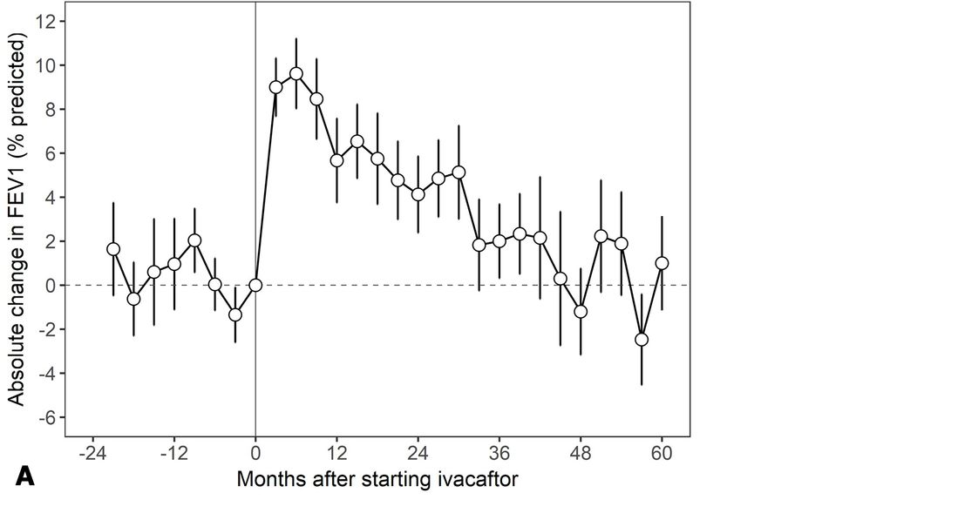
Longitudinal effects of ivacaftor with the Gly551Asp mutation: a 5-year study
Thorax. 2021 Sep;76(9):874-879 PMID: 33579778.
N=35 adults
9.6% increase in FEV1
Steady decline over 5 years
Drop in IV treatment and exacerbations
FEV1 better in patients with higher medical possession rates
Patients will still need optimisation
Strategies for medication adherence

Slide 24

How can regular sweat testing help us manage our patients?
Method:
Between 2020-22 Sweat tests and spirometry were performed in before and after commencing ETI in 65 6-18 years who attend the South Wales Paediatric Cystic Fibrosis Service
N = | 65
Female = | 33 (51%)
Age = | 11.7 (6-14.3)
D-FEV₁ = | +6.3% (SD 13.7)
D-CL = | -46.6mmol/l (SD28.9)
Notes:
Large-scale real-world data identifies only weak correlation between sweat chloride response to Elexacaftor/Tezacaftor/Ivacaftor (ETI) and change in FEV
Pearson correlation between [D-Cl] and [D-FEV %] was -0.84 [NS] for the whole cohort, -0.18 [NS] for subgroup age <12 years, and -0.3 [p=0.05] for subgroup age>12 years

Slide 25

Good sweat test response to modulator, poor lung function response
 | 15/65 (23% ) CL reduction of <20mmol/l
 | 13/65 (20%) FEV1% drop with CL >30mmol/l
Morgan, H. et al. Journal of Cystic Fibrosis, Volume 23, S59
Notes:
We identified 2 groups of interest. 15/65 (23%) patients demonstrated a drop in sweat chloride <20 mmol/l and were identified as non-compliant with ETI.
13/65 (20%) patients demonstrated a drop in FEV % despite a drop in sweat chloride >30mmol/l, and were identified as ETI-compliant poor responders.

Slide 26

Poor sweat test repsonse ? Poor compliance or poor absorption
 | 15/65 (23% ) CL reduction of <20mmol/l
 | 13/65 (20%) FEV1% drop with CL >30mmol/l
Morgan, H. et al. Journal of Cystic Fibrosis, Volume 23, S59
Notes:
We identified 2 groups of interest. 15/65 (23%) patients demonstrated a drop in sweat chloride <20 mmol/l and were identified as non-compliant with ETI.
13/65 (20%) patients demonstrated a drop in FEV % despite a drop in sweat chloride >30mmol/l, and were identified as ETI-compliant poor responders.

Slide 27
Changes in FEV₁ and sweat chloride CL after commencement of ETI
 | 15/65 (23% ) CL reduction of <20mmol/l
 | 13/65 (20%) FEV1% drop with CL >30mmol/l
Morgan, H. et al. Journal of Cystic Fibrosis, Volume 23, S59
Notes:
We identified 2 groups of interest. 15/65 (23%) patients demonstrated a drop in sweat chloride <20 mmol/l and were identified as non-compliant with ETI.
13/65 (20%) patients demonstrated a drop in FEV % despite a drop in sweat chloride >30mmol/l, and were identified as ETI-compliant poor responders.

Slide 28
Modulators have transformed CF outcomes
Develop new approaches for modulator treated patients
Classic care for patients ineligible for modulator therapy
Assume nothing
Are they taking their modulators ?
Regular Sweat testing imperative

Slide 29
Transition
Transition from child to adult
Transition to adult services for medcial care

Slide 30
Adolescence
The process of adolescence is a period of preparation for adulthood during which time several key developmental experiences occur.
Physical and sexual maturation
Movement toward social and economic independence
Development of identity
The acquisition of skills needed to carry out adult relationships and roles
The capacity for abstract reasoning
Adolescence (age 10-19 years) is a time of tremendous growth and potential, but is also a time of considerable risk during which social contexts exert powerful influences. (WHO)

Slide 31
Stages of Adolescence
 | Early Adolescence | Mid Adolescence | Late Adolescence
INDEPENDENCE | Less interest in family activities. Pleasant then nasty Crave privacy | Hostile to parents. May assert independence when not under adult supervision. Adults feel they have lost control. | Parents more comfortable with youth’s individuality and decision making skills. Youth is more confident and asks for advice from adults.
BODY IMAGE | Body hair, menstrual cramps, body odour Intense need to feel normal Continual comparisons | More at ease with changes Make the most of their bodies: body building, dieting, makeup, clothes.. Dating and sexual behaviours | Comfortable with body Sexual behaviours less exploitative, more loving Start to consider birth control
PEER RELATIONS | Pull away from family Gain support from peers | Peer group is extremely strong Sharing of intense relationships Conforming with group is essential - clothing, music…. - smoking, drinking, sexual activity and other risk taking behaviours | Youths become more confident in own decision making and so the group holds less sway Group demands less conformity Individuality is acceptable
IDENTITY Emergence of abstract reasoning along with personal values and morals | Concrete thinking See things in back and white Values and morals reflect those of their parents | Lack of abstract reasoning contributes to a feeling of invincibility, and makes it hard to see another persons viewpoint This leads to risk taking behaviour and lack of compromise Values and morals reflect those of their peer group | Ability to reason and make informed decisions Values and morals return to reflect those of their parents and family

Slide 32
What measures may help improve compliance with medication?
Non-adherence may occur in up to 50% of cases.
In adolescence, self definition, social exploration and independence, conflicts with the demands of treatment for chronic disease.
Good adherence to treatment requires the cooperation of both patient and parents.
A well organized household with a well structured daily routine will tend to promote
Chaotic households are more likely to struggle with adherence
A cohesive family where the climate is supportive and responsive, rather than critical and disengaging will be more successful at accommodating the treatment burden

Slide 33
Approach to non-adherence to therapy
Ensure patient and parents understand why treatments are necessary
Provide a written treatment plan
  This provides all carers within the family and the patient with a clear guideline.
  It helps avoid confusion
  It should be user friendly for the family
Teenagers from age 14 years
See alone in clinic and then with their parents
Same doctor each time so that a trusting relationship can develop.
Discuss compliance openly and sympathetically, no paternalism or disappointment
What compliance exists should be praised
Simplify treatment and allow negotiation
Adapt treatment to the teenager’s lifestyle

Slide 34



Slide 35

Transition to adult care
For patients and parents

Slide 36
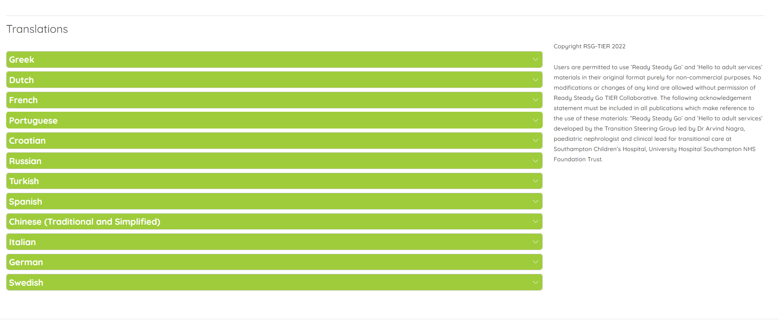

Slide 37
Transition to adult care Service structure
Adolescent clinic from age 12 in evening (4-8pm)
Twice yearly transition clinics with both paediatric and adult MDT from age 14 years
Transition clinics first in Children’s Hospital then in Adult Hospital
Family visits to the Adult centre with paediatric nurses
Age of transition depends on maturity – late adolescence 16-18 years

Slide 38


