Slide 1




Estonia United Kingdom
ECFC Twinning Programme
Prof Julian Forton
Dr Jamie Duckers
Dr Silvi Plado
Dr Maire Vasar
22nd November 2024

Slide 2
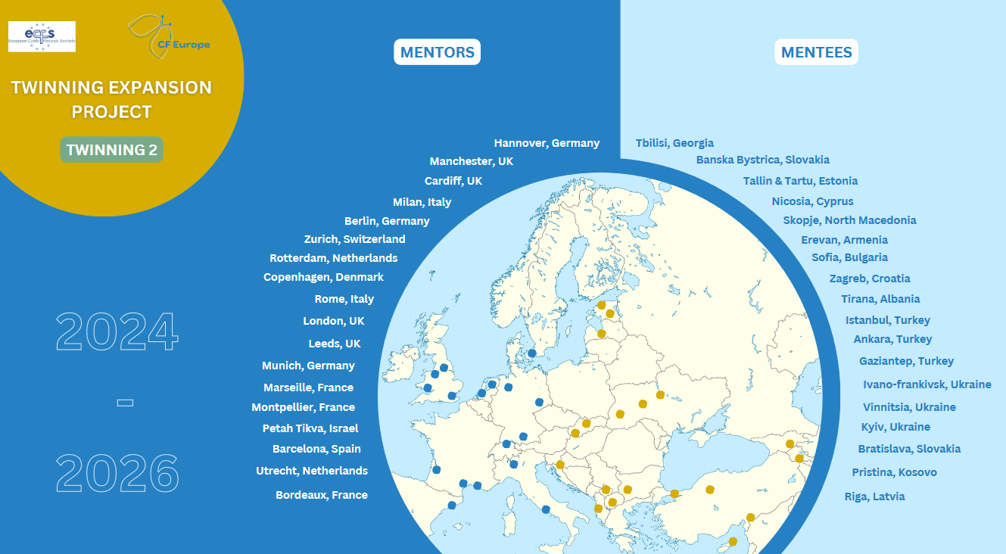

Slide 3
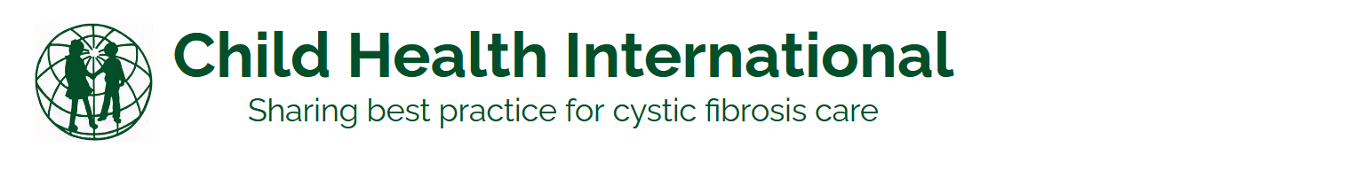
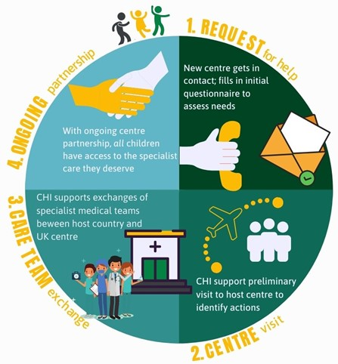
https://childhealthinternational.org

Slide 4


Prof Julian Forton Dr Silvi Plado Dr Maire Vasar

Slide 5
Child Health International: Wales - Estonia collaboration
Historic visits
2009 The Cardiff-Estonia Program established
Dr Iolo Doull in Cardiff. Dr Urve Putnik in Tallinn and Dr Maire Vasar In Tartu.
2014 Estonia visit to Cardiff
Dr Urve Putnik and Dr Maire Vasar visited Cardiff,
Attended the Children’s Hospital for Wales for 4 days with Dr Julian Forton
Attended a one day RSM Annual Symposium on Cystic Fibrosis in London.
2014 Cardiff visit to Estonia
Dr Julian Forton & physiotherapist Natalie Gragosin visited Tallinn and Tartu
Talks on Physiotherapy. Introduction of PEP Physiotherapy. Hypertonic saline nebulisers. Attended clinics.
CHI funded PEP masks for Estonian patients
2017 Estonia visit to Cardiff for medical, physiotherapist and dietetic staff from both Tallinn and Tartu.
Dr Tiia Voor, Karin Tammik Siret Saarsalu (Tartu)
Dr Karin Puks, Margit Juudas, Liina Heinvere (Tallinn)
CF annual assessments, outreach clinics and one on one with therapy partners.

Slide 6
Cardiff Visit to Estonia October 2023 (9-12th October).
Julian Forton, Katherine Ronchetti (physiotherapist) and Hannah Morgan (physiotherapist)

Slide 7
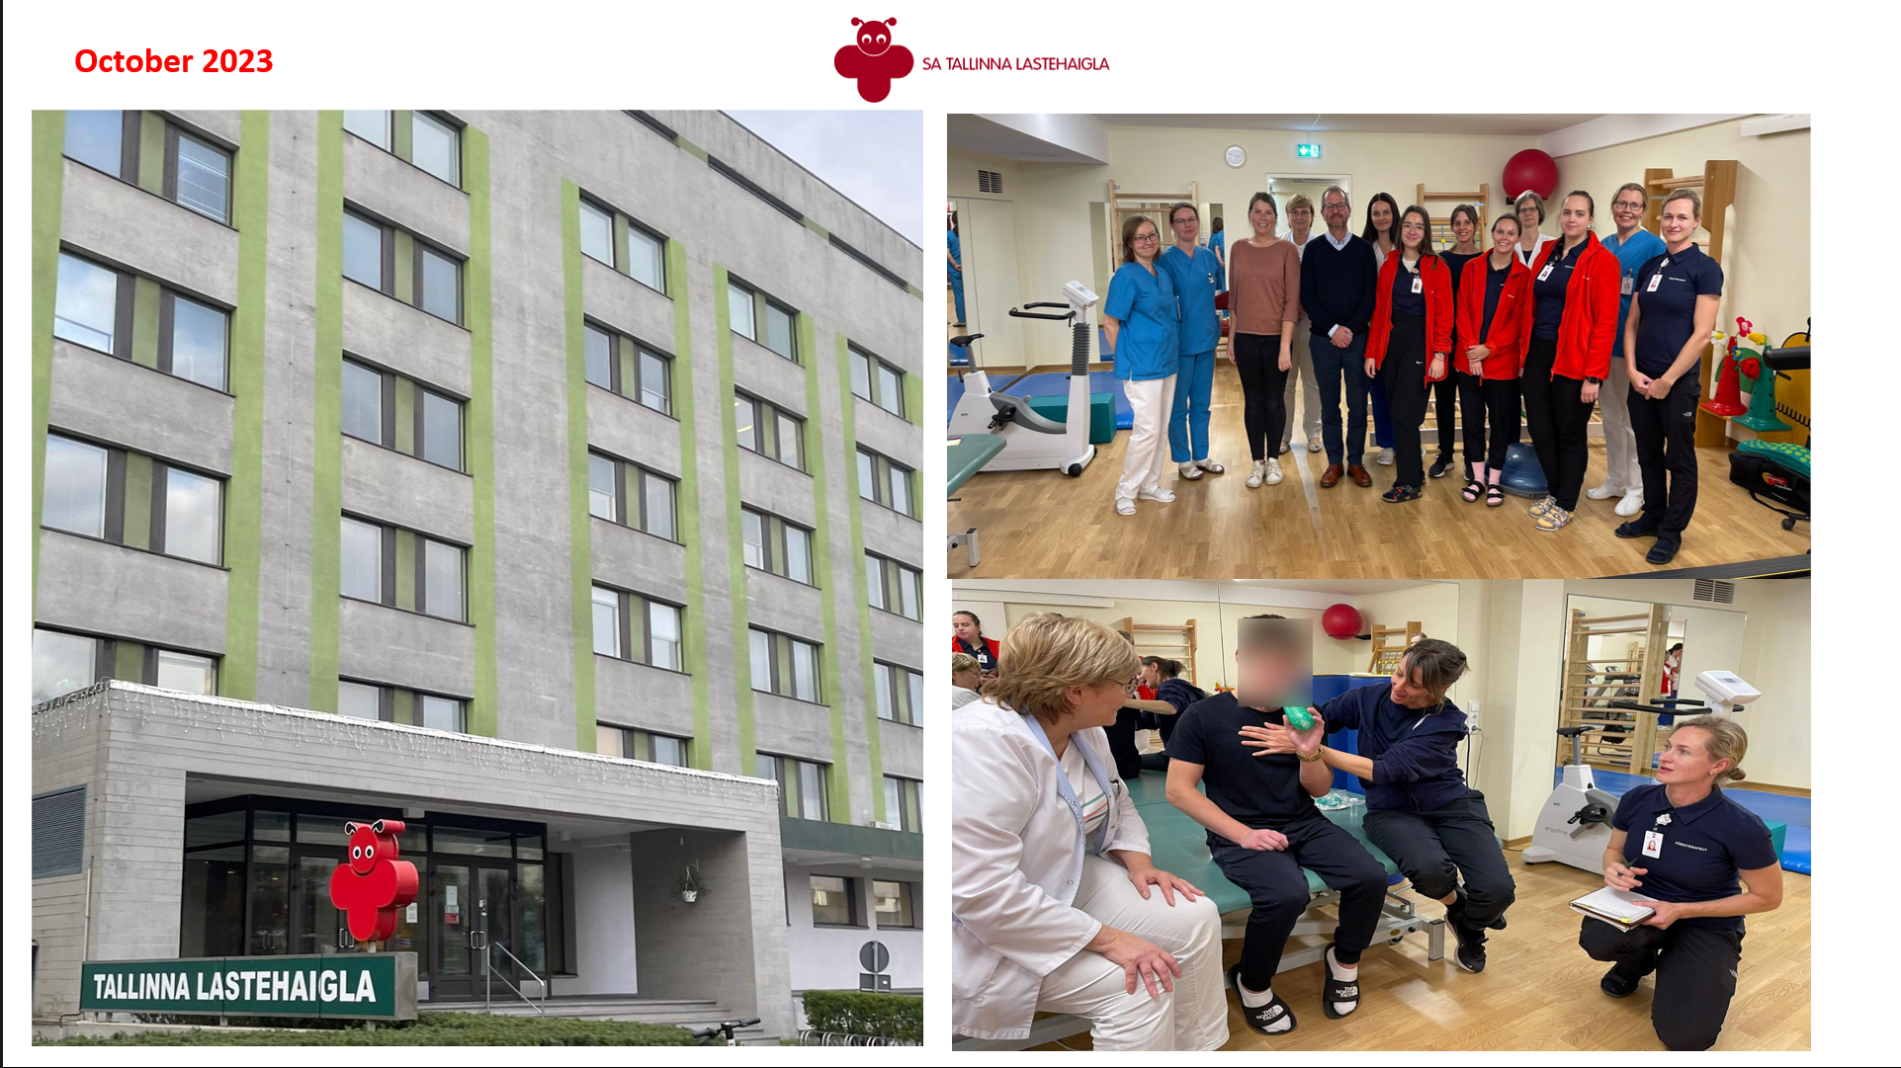

Slide 8
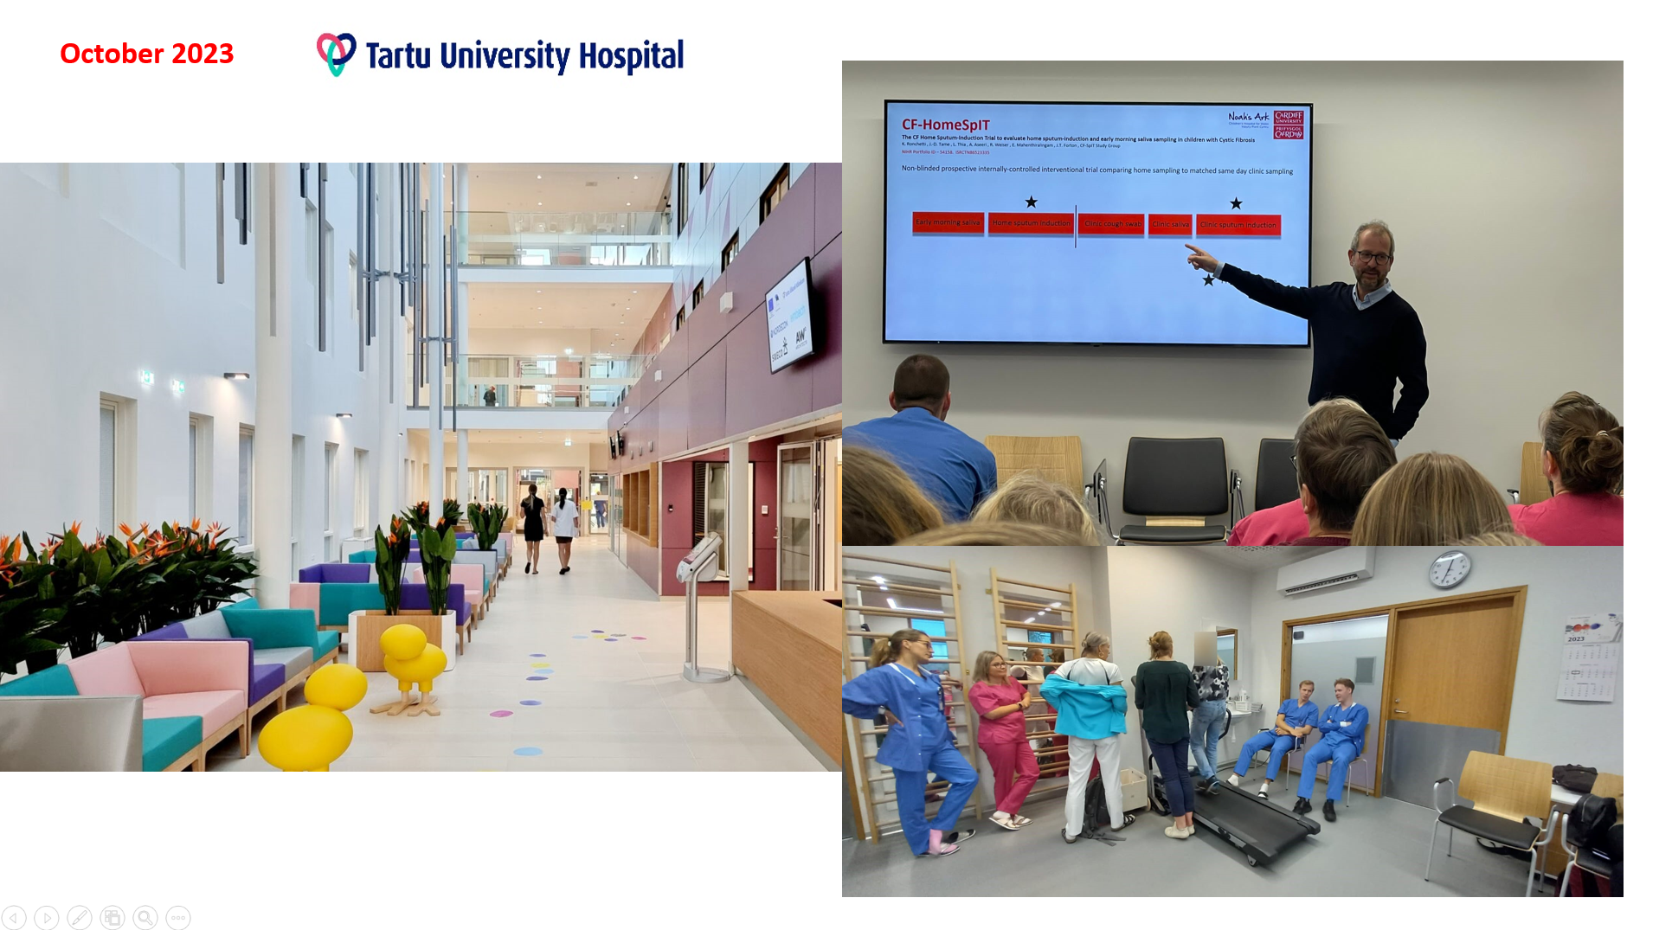

Slide 9
Estonia visit to Cardiff June 2024

Slide 10
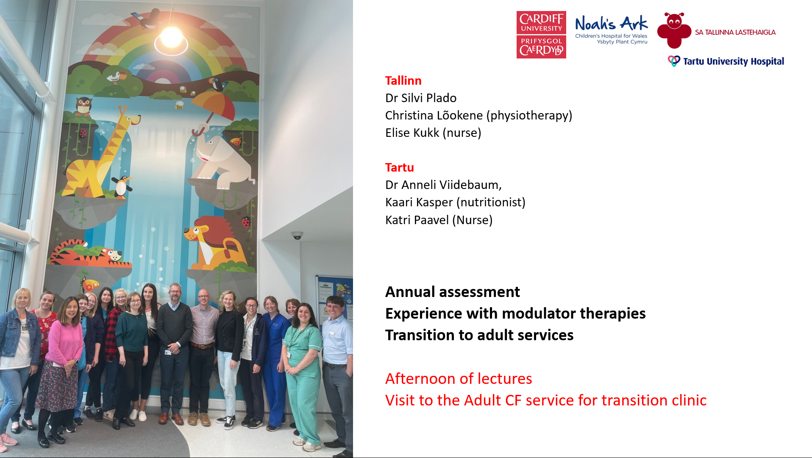

Slide 11
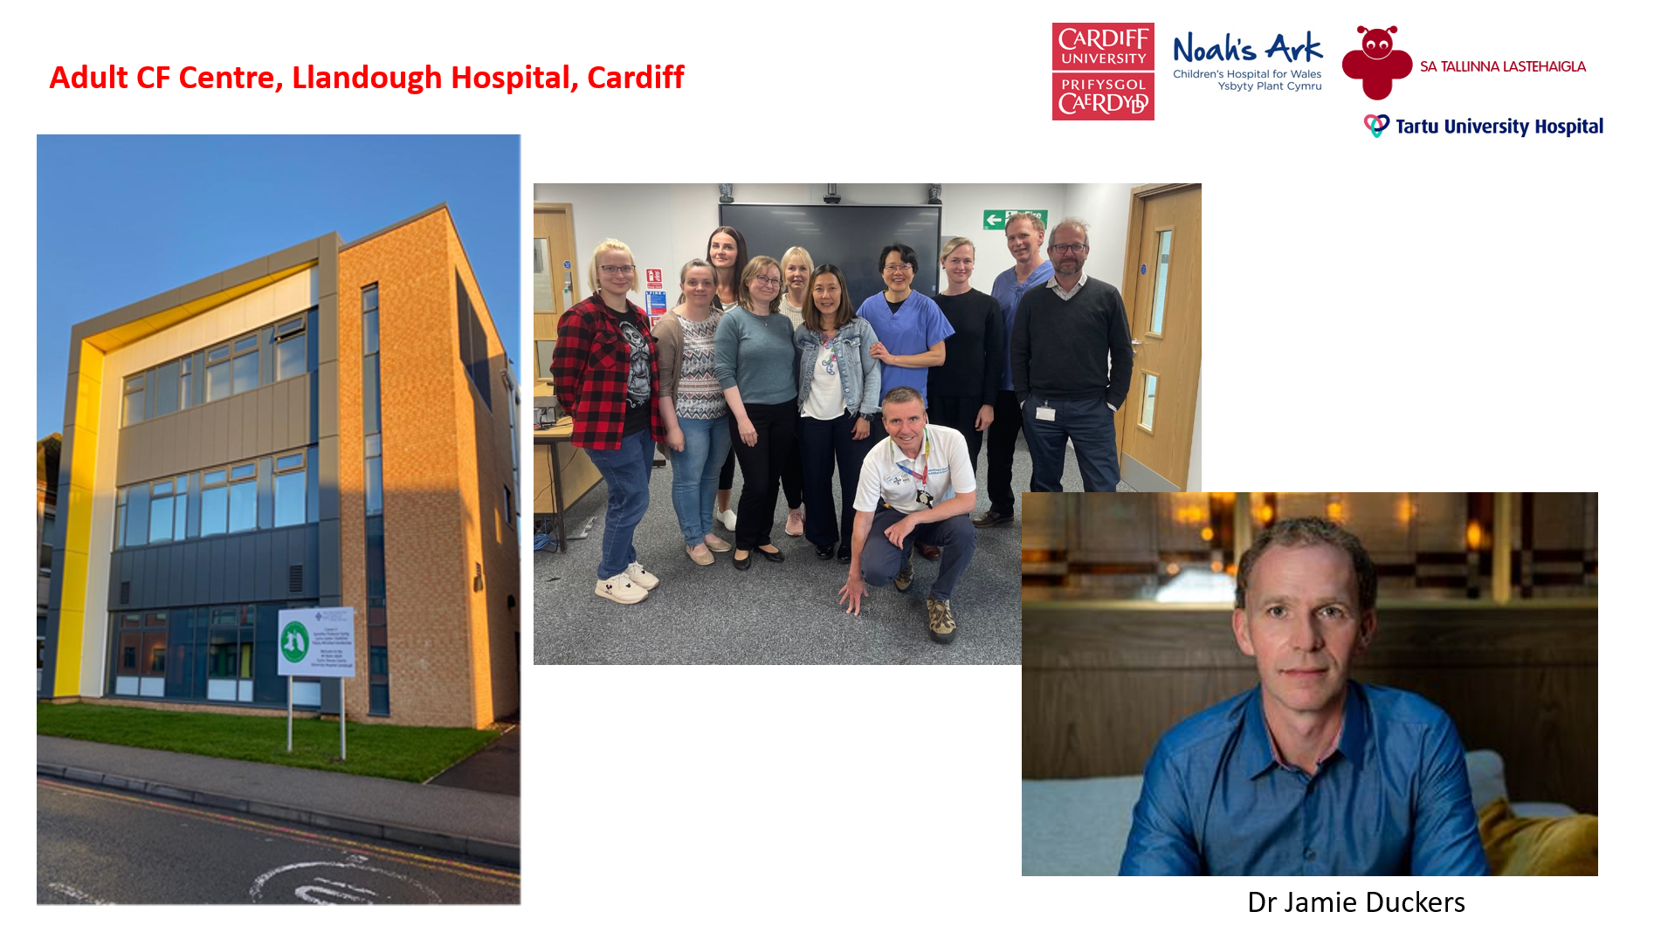

Slide 12
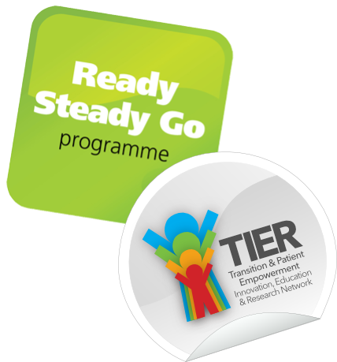
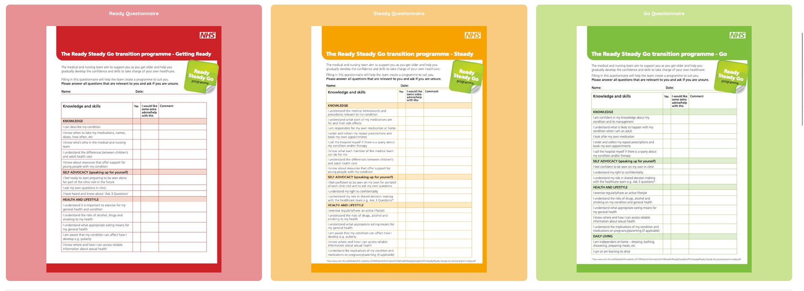
Transition to adult care

Slide 13
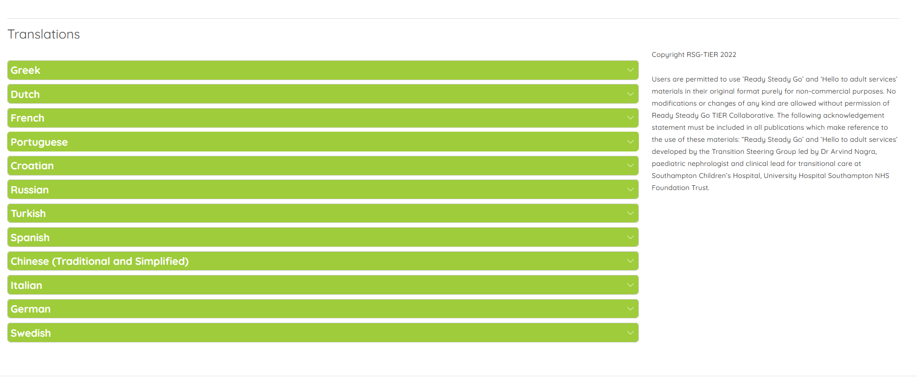

Slide 14
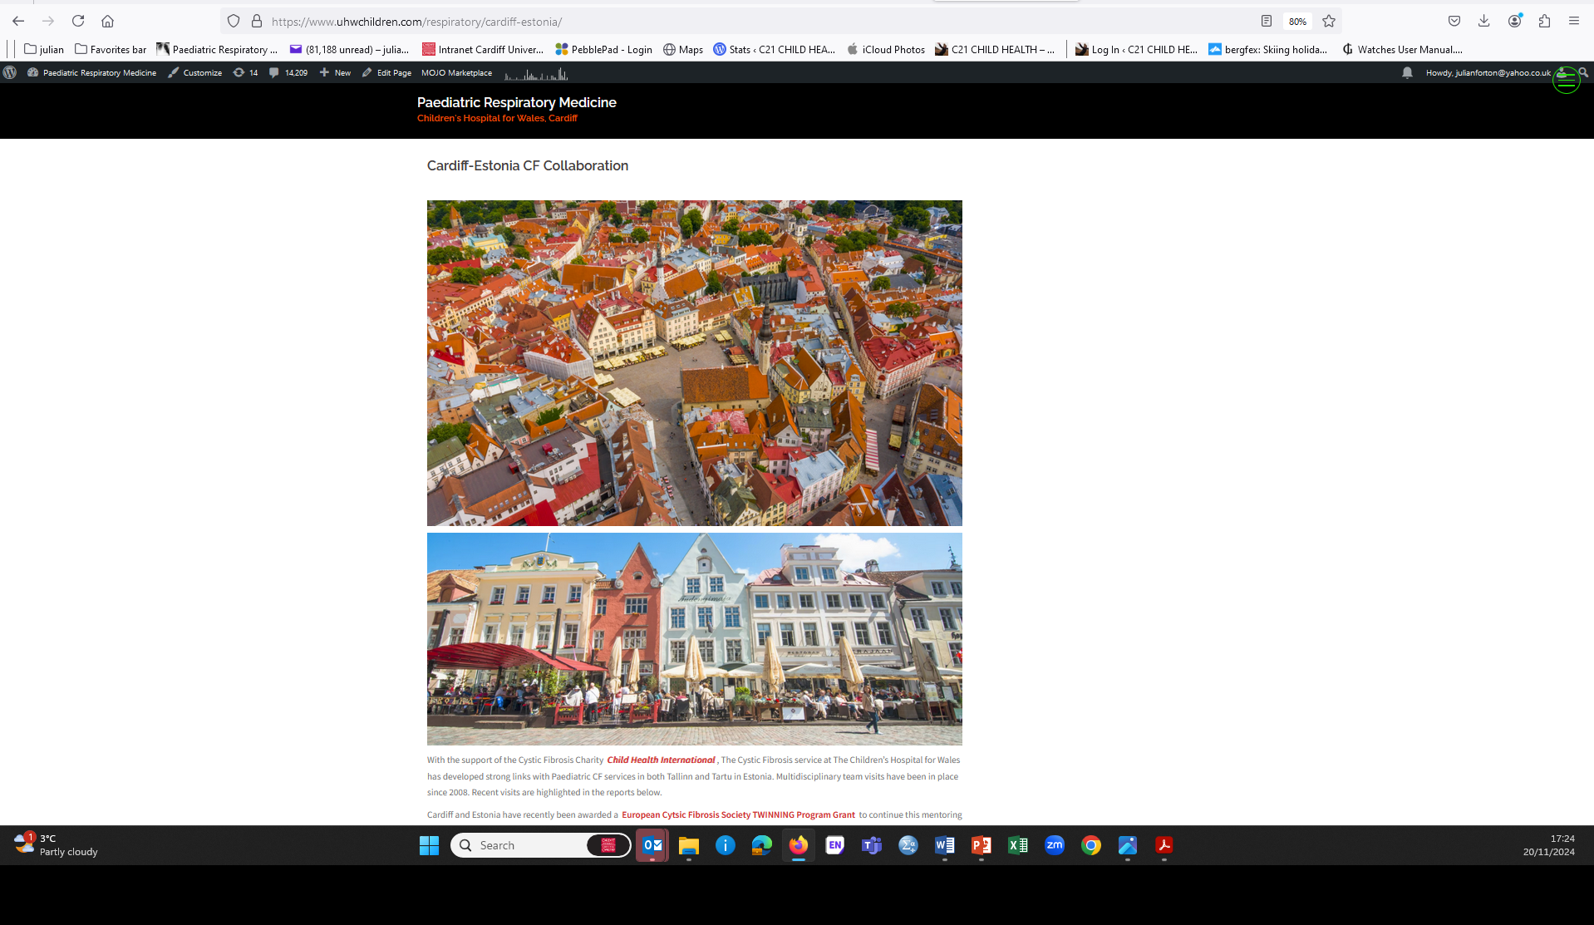

Slide 15
Update on CF in Estonia

Slide 16
Update on CF in Estonia Patients
There are currently 62 patients with CF in Estonia ( aged 11months - 55 years)
0-6 9 children (13%)
6-12 12 children (20%)
12-18 13 children (21%)
>18 28 patients (46%)
Most common CF mutations:
F508del and 394del
89% patients have at least one F508del mutation
1-2 new cases per year, all genetically confirmed
Patient organisation Eesti Tsüstilise Fibroosi Ühing
New Patient Registry established 2023 (ECFSPR)

Slide 17
Update on CF in Estonia
Update on CF in Estonia Patients
35
27

Slide 18
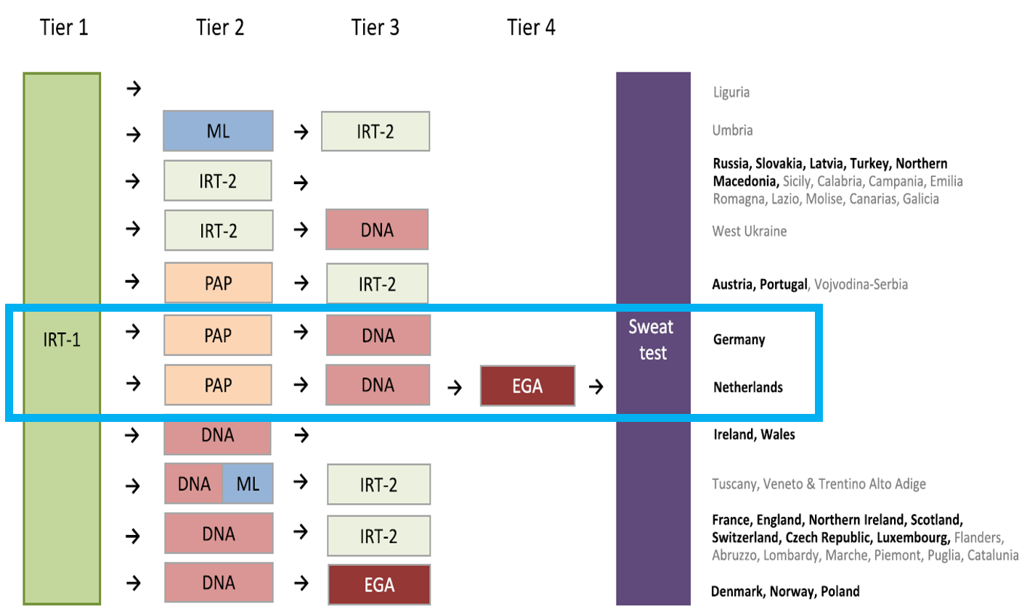
Update on CF in Estonia newborn screening
Laboratory based pilot project commenced 1/4/2023
Tartu University Hospital, Genetics and Personalized Medicine Clinic
University of Tartu, Faculty of Medicine,
Institute of Clinical Medicine Tartu University Hospital Children's Foundation
Results
15 000 newborns screened (birth rate ~11 000)
2 CF patients found
  1 patient diagnosed by screening
  1 patient by family history first (false negative)
DELFIA Neonatal IRT kit
Victor2D device
MucoPAP-F test kit (Dynabio)
Victor2D device
Sanger sequencing
[F508del and 394delTT]
Whole CFTR gene sequencing
(NGS)

Slide 19
Update on CF in Estonia Staff and hospitals
Children
Adults

Slide 20

Update on CF in Estonia Modulators
July 1st 2024: Funding granted for all CFTR modulators (100% reimbursement)
25 CF children and 20 adults on modulators at least for 3 months (75% CF population)
All tolerating medication and with positive effect

Slide 21
Twinning Programme Current Priorities
Establish Annual Assessments in Estonia as standard of Care
Develop virtual support network between Twin services
  Ad Hoc virtual meetings to discuss difficult cases, virtual meetings between therapists
  Sharing of educational materials and protocols via website shared page
  Formal virtual educational meetings
  Emphasis on managing patients on Modulator therapy
Expand collaboration to incorporate Adult CF Teams
Combined Paediatric/Adult Visit to Estonia planned for December 2024 (Forton/Duckers)
Hospital visits in Tartu and Tallinn, meeting of colleagues, sharing of ideas, lectures, planning future
Emphasis on managing patients on Modulator therapy
Organise Estonian Adult team Visit to Cardiff 2025

Slide 22
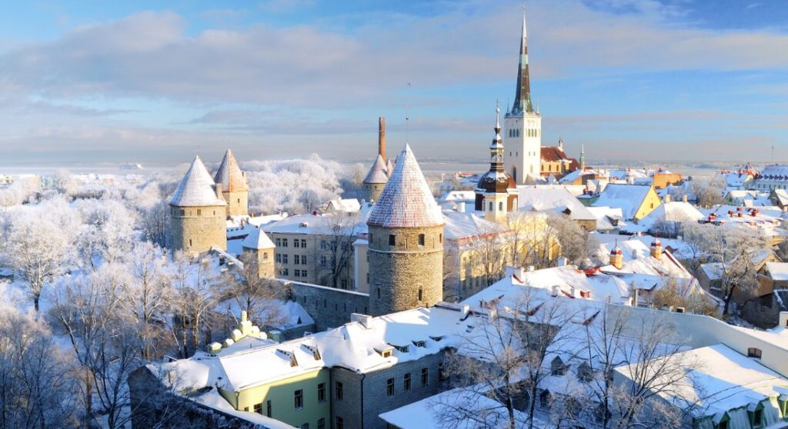
9-12th December 2024
.

