Slide 1


CF-Home SpIT: The Cystic Fibrosis Home Sputum Induction Trial
Home sputum-induction sampling in children with Cystic Fibrosis on modulator therapy. Qualitative results on success and acceptability.
K. Ronchetti , H. Morgan , S. Mitchell , R. Dhillon , E. Mahenthiralingam , L. Thia , J.T. Forton
The Children's Hospital for Wales, Cardiff, United Kingdom, Public Health Wales, Clinical Microbiology, Cardiff, United Kingdom.
Cardiff University, School of Biosciences, Cardiff, United Kingdom, Cardiff University, School of Medicine, Cardiff, United Kingdom.
Notes:
“Hello and thank you for inviting me to talk to you today about the hot topic of sampling and the work we’ve been doing in Cardiff in our CF Home Spit Trial”

Slide 2


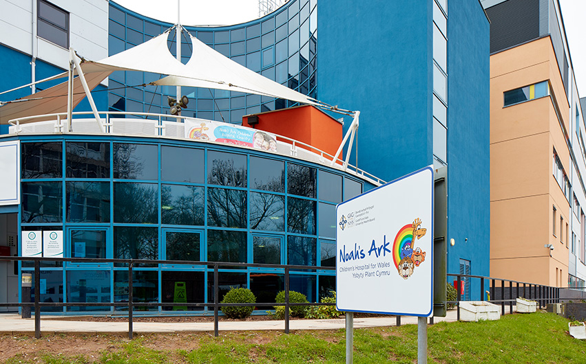

Introduction and conflict of interests
Paediatric Respiratory Physiotherapist - Children’s Hospital for Wales, Cardiff UK.
Research Physiotherapist CF SPiT group.
No conflict of interests.

Slide 3
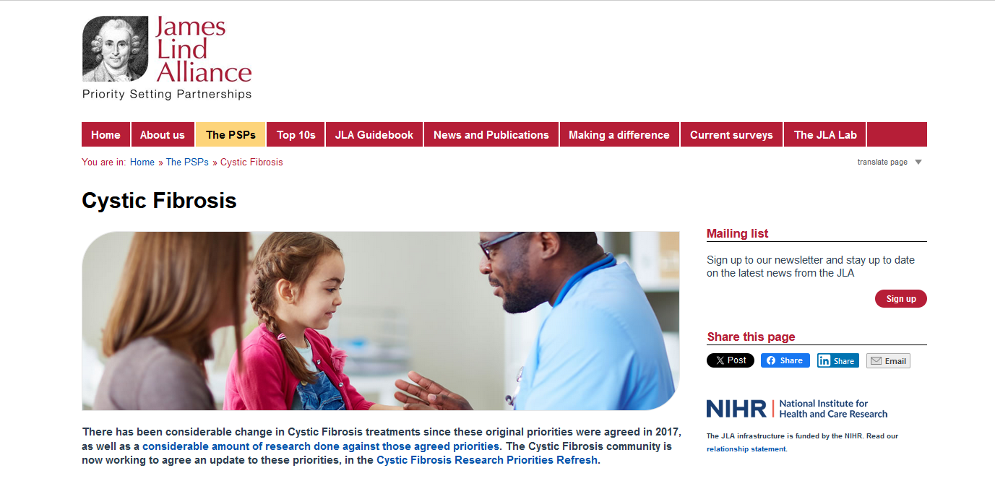
Sampling in patients on HEMT
Rowbotham, N. J. et al (2023).
A refresh of the top 10 research priorities in cystic fibrosis. Thorax 78(8), pp. 840-843. doi: 10.1136/thorax-2023-220100
Notes:
Sampling has always been an integral part of CF care as it holds the key to guide antimicrobial treatment in CF and we must ensure that we understand the ability of each sampling technique available to us to accurately identify lower airway pathogens.
In the era of HEMT obtaining adequate samples has become a challenge with pwCF having reduced sputum volumes.
This has always been a challenge in young patients however it is now the case in our older paediatric and adult patients who are also no longer readily expectorating sputum.
Despite improved clinical outcomes with HEMT pathogens still exist and we are still yet to find out about the long term outcomes of HEMT and so sampling still remains as important as ever and of course we must also consider those patients who are not on HEMT

Slide 4
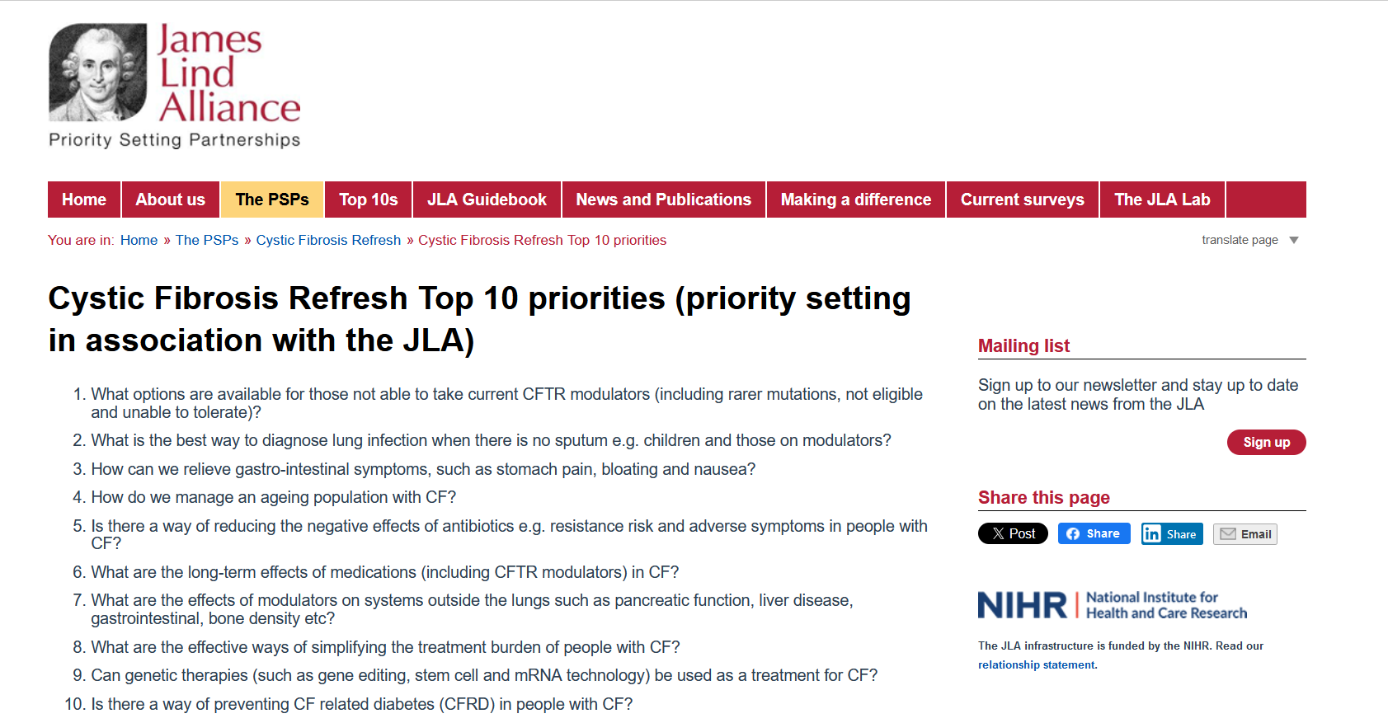


Sampling in patients on HEMT
Rowbotham, N. J. et al (2023).
A refresh of the top 10 research priorities in cystic fibrosis. Thorax 78(8), pp. 840-843. doi: 10.1136/thorax-2023-220100
Notes:
The CF community also put sampling in the refresh of the top 10 James Lind Allinace priorities published last year
2. What is the best way of sampling again in light of reduced or no sputum.
5. With sampling being the key informant in guiding decisions around antimicrobial treatment – ever important when considering not overtreating in the fight against antibiotic resistance.
8. Sampling again plays a key role in assessing whether we can withdraw antibiotic therapy ..In our service … starting to challenge our pts more with regard to raking them off their nebulised antibiotic therapy. & sampling plays a key role in this.

Slide 5
CF-SpIT
Annual
assessment
Acute
exacerbation
Bronchoscopy
indicated
The CF Sputum Induction Trial
How to sample
How to analyse
Cough
swab
Induced
sputum
Bronchoscopy
6 lobes
Bank of samples
CF pathogens detected by
conventional microbiology culture
CF pathogens detected
Culture independent microbiology
Microbiome evolution in children with Cystic Fibrosis
Clinical determinants of accelerated evolution
Ronchetti K. et al (2018)
The CF‐Sputum Induction Trial (CF‐SpIT) to assess lower airway bacterial sampling in young children with cystic fibrosis: a prospective internally controlled interventional trial. Lancet Respir Med. 2018 Jun;6(6):461‐71
Notes:
“In our CF SpIT trial we set out to inform what is the best way to sample and also how to analyse it also.
We collected … matched samples of BAL (6 lobe and 2 lobe) with induced sputum and cough swabs and sent them off not only for conventional microbiology culture but also for culture independent and microbiome”

Slide 6

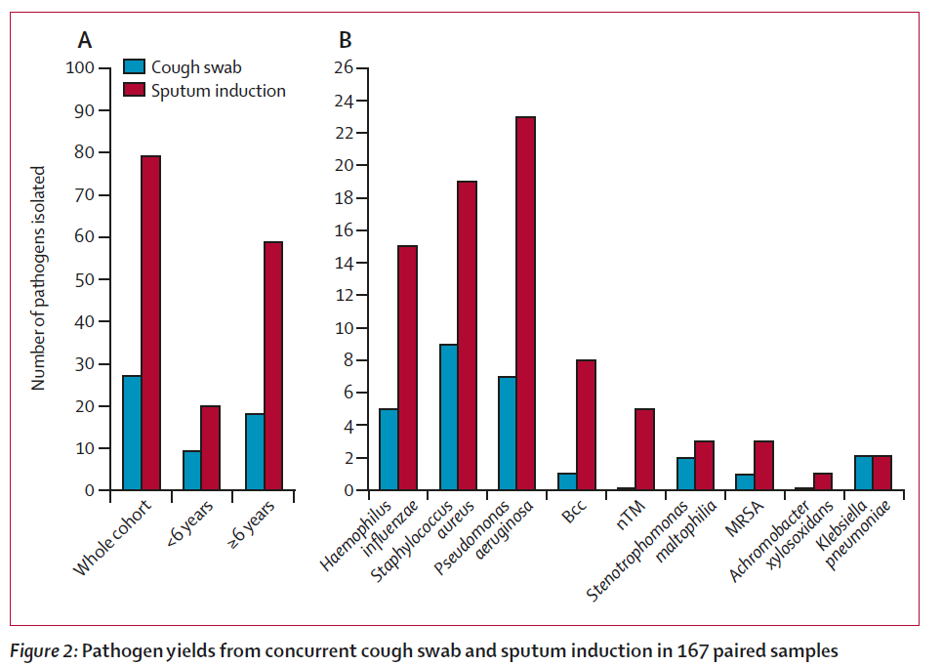
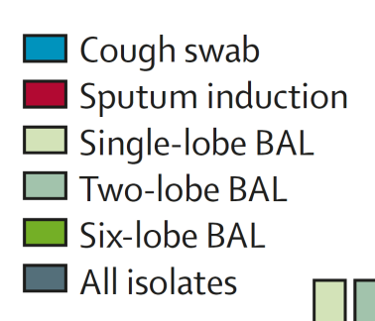
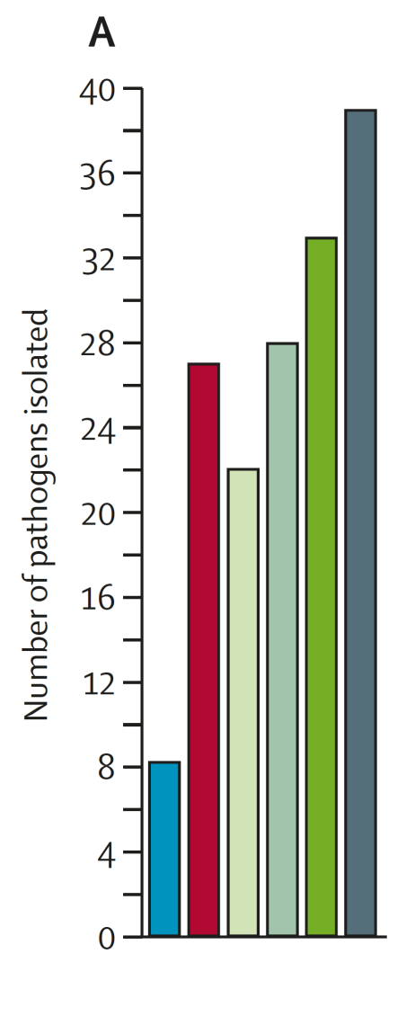
Sputum induction v cough swab
Sputum induction v BAL ( 1 lobe, 2 lobe and 6 lobe)
3 times as many pathogens
Equivalent to 2 lobe BAL
Ronchetti K. et al (2018)
The CF‐Sputum Induction Trial (CF‐SpIT) to assess lower airway bacterial sampling in young children with cystic fibrosis: a prospective internally controlled interventional trial. Lancet Respir Med. 2018 Jun;6(6):461‐71
Notes:
It showed that induced sputum grew 3 times as many pathogens compared to cough swab – highlighting cough swabs poor positive predictive value and sensitivity which other studies have also found
but also that it grew equivalent pathogen yield as the often-quoted gold standard of sampling the 2 lobe BAL. It was also showed that it wasn’t significantly different compared to 6 lobe BAL: taking into account the bacterial heterogeneity of the different lung segments
We put the success of the sputum induction down to the equivocal mobilising of secretions from throughout the bronchial tree.“
Can we also apply these findings to the adult population who no longer produce sputum – in that we have started to recruit adult pt

Slide 7

Time consuming in clinic
Home sampling ?
Difficult to produce a sample
Patient Training ?
Notes:
Sputum induction came out the winner – however there are some practical challenges …. Which is where the concept of home spit was born .,

Slide 8



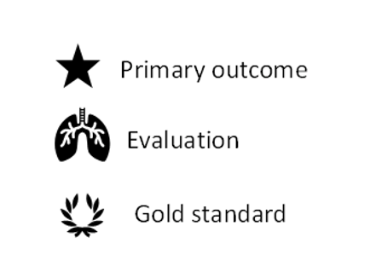
CF-HomeSpIT
The CF Home Sputum Induction Trial
ISRCTN86523335
Early morning
Cough Clear Saliva
Early morning
Home sputum induction
Clinic
Cough Swab
Clinic
Cough Clear Saliva
Clinic
sputum induction
NHS Clinical Microbiology
Microbiome Research
Inflammation
WS13.01 The Cystic Fibrosis Home Sputum-Induction Trial (CF-HomeSpIT - ISRCTN86523335) to evaluate home sputum-induction and early morning saliva sampling in children with cystic fibrosis
Ronchetti, K; Tame, J-D; Thia, L; Aseeri, A; Weiser, R; Mahenthiralingam, E; Forton, J
Journal of Cystic Fibrosis. , 2023, Vol.22, p.S25-S26
DOI: 10.1016/S1569-1993(23)00259-X
Notes:
Currently trial is still open and so far we have recruited 70 patients with the aim for 100 for adequate statistical analysis.
Here we are comparing the primary outcomes of early morning home induced sputum to a physiotherapist led clinic induced sputum.
With also added evaluations for a novel way of sampling being the cough clear saliva, matching it with the standard cough swab.
Samples are split for culture dependant analysis, microbiomee and inflammation – to see of there are pathogens present – is this clinically relevant – as in has it caused inflammation.
We also need to ask the same question about induced sputum in adult pts and for that reason we have started to recruit adult pts.

Slide 9
Early Morning
Cough Clear Saliva
Home sputum induction
Notes:
This is the information sheet that is given to the families before clinic for their home samples

Slide 10
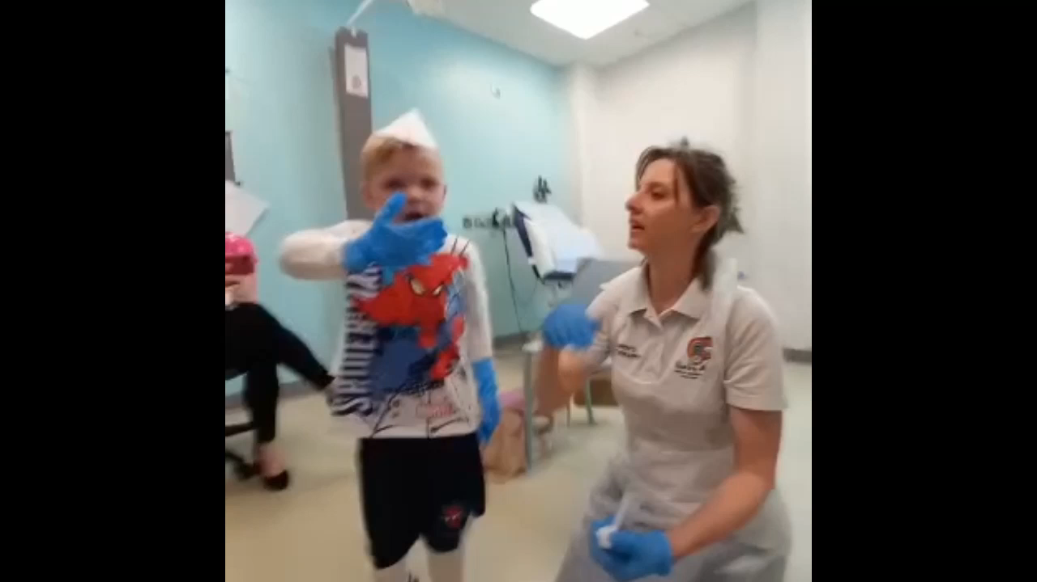
Notes:
This a video to demonstrate the cough huff, cough clear throat spit manaouvre
What a superstar !

Slide 11
CF-HomeSpIT
Interim Results for first 32 recruited patients (July 2023)
Home sampling
10/11 (91%) all pathogens identified on home sampling combined with clinic cough swab (emSAL+hIS+cCS)
Clinic sampling
10/11 (91%) all pathogens were identified on clinic sampling combined with clinic cough swab (cCS+cSAL+cIS)
Notes:
With regards to pathogen yield this is the interim data that was presented by Professor Forton at conference last year, although we cannot draw any conclusions, home sampling is starting to show a trend to be as comparable as clinic based samples.

Slide 12
CF-HomeSpIT
Patient characteristics: first 50 recruits (Jan2024)
Age | 11.4 years [range 4.0-17.1]
FEV1 % | 91% [range 73-121]
Wet cough on day of sampling | 10/50 [20%]
Modulator therapy (all) | 46/50 [92%]
Orkambi | 7/50 [14%]
Kaftrio | 39/50 [78%]
Notes:
Now I want to report on the interim pt characterics so far for the first 50 pts recruited..
Showing snapshot of out typical pt cohort now – average age 11.4 years old, most on HEMT, most with high LFT with only 20% reporting that they had a wet cough on the day of sampling.

Slide 13
CF-HomeSpIT
Qualitative assessment
Data
Interim data on first 50 patients recruited to CF HomeSpIT
46/50 (92%) patients on HEMT
Results
46/50 (92%) patients managed to produce home samples
Median duration taken at home: 10 mins (range 5-20)
No reported side effects
42/46 (91%) home samples reported as sputum rather than saliva
29/42 (69%) sputum samples reported as mucoid, mucopurulent or purulent
Acceptability
48/50 (96%) willing to do home sputum sampling regularly
Fitting in home sampling before clinic was rated 3.1/10
Likert scale 0 -10 easy - difficult
Median chosen frequency from range 1-6 / year = 4
Notes:
This is showing the qualitative data from these same pts
Success rate so far is high with no reported side effects – median duration time 10 mins
We thought that it was important to address the expectations of volume and consistency of the samples as described by our wonderful micro team
Most were described as being sputum rather than saliva (even though visibly there is a reduction in volume) and 69& were described as being mucoid, mc or purelent – and on a purely anedoctal basis – we are finding that the home samples do tend to be more purulent than the clinic samples.
Most families found it to be acceptable to do the samples before clinic – reporting it to be 3.1/10 on a likert scale (0 being easy) and they would be willing to this on average 4 times a year – which fits into their clinic regime

Slide 14
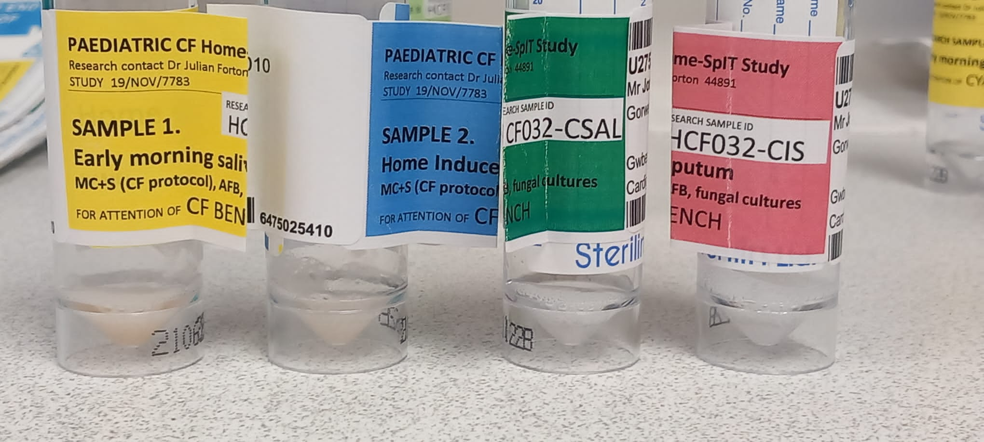

CF-Home-Spit - Challenges
Realistic expectations of what is an adequate sample – educate clinicians
Requires preparation and teaching
Use of hypertonic saline
Engagement of patients on HEMT
Notes:
However I am not suggesting that it has been all plain sailing and there are challenges that come with home sampling in the HEMT era

Slide 15
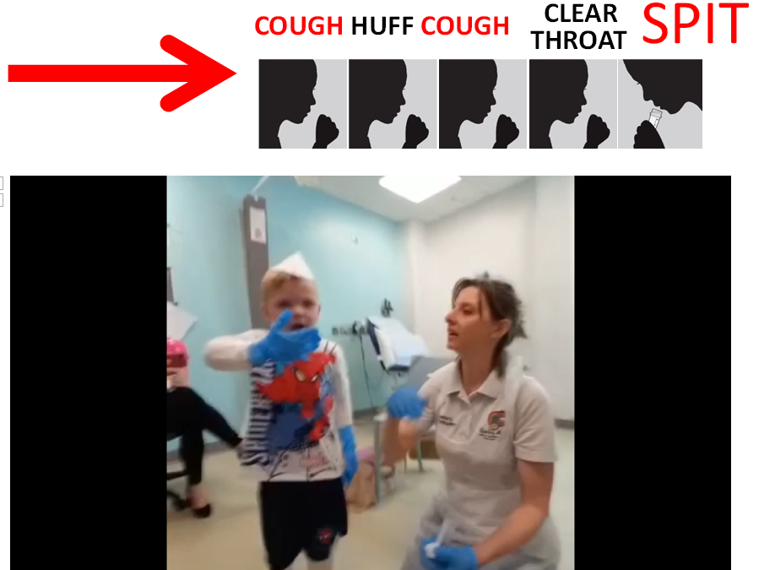
Training
Sputum induction is worth it

Slide 16





CFSpIT Team
The Children’s Hospital for Wales
Professor Julian T. Forton
Kath Ronchetti Research Physiotherapist
Hannah Morgan CF Physiotherapist
Jodee Tame CF Physiotherapist
Dr Juliette Oakley Clinical Research Fellow MD
Department of Biosciences, Cardiff University
Prof Eshwar Mahenthiralingham
Dr Rebecca Weiser
Abdullah Aseeri
Department of Microbiology, UHW, Cardiff
Dr Rishi Dhillon
Notes:
I would now like to leave you with this lovely picture of our beautiful Welsh (salty) coastline and to thank all the members of the CF SPiT team – Prof Forton – the brains behind it all, to my fellow physio fellow colleagues & friends Hannah Morgan and Jodee Tame, Rishi and our wonderful microbiology team who processes whatever we throw at them, and the team in Cardiff University for the brilliant microbiome work.

