Slide 1
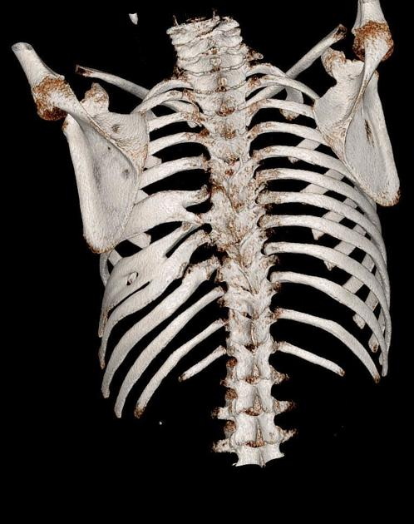
Chest deformity
Professor Julian Forton
Consultant in paediatric respiratory medicine
Children’s Hospital for Wales, Cardiff

Slide 2
Chest deformity
Pectus deformity
Scoliosis
Thoracic insufficiency syndromes

Slide 3
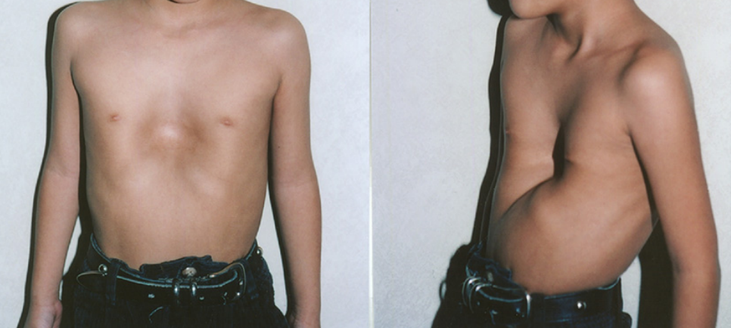
Pectus excavatum
90%
Robicsek et al. Semin Thorac Cardiovasc Surg. 2009 Spring;21(1):64-75.

Slide 4
Pectus excavatum
Body of sternum displaced posteriorly
Unilateral or asymmetrical
Familial
1: 400 live births
Inheritance unresolved
Pathogenesis poorly understood - abnormal costochondral joints
Mostly an isolated finding
Associated with collagen disorders: Marfan’s and Ehlers-Danlos syndrome
Associated with underlying lung disease or pulmonary hypoplasia
One element of a more complex chest wall deformity
90%

Slide 5
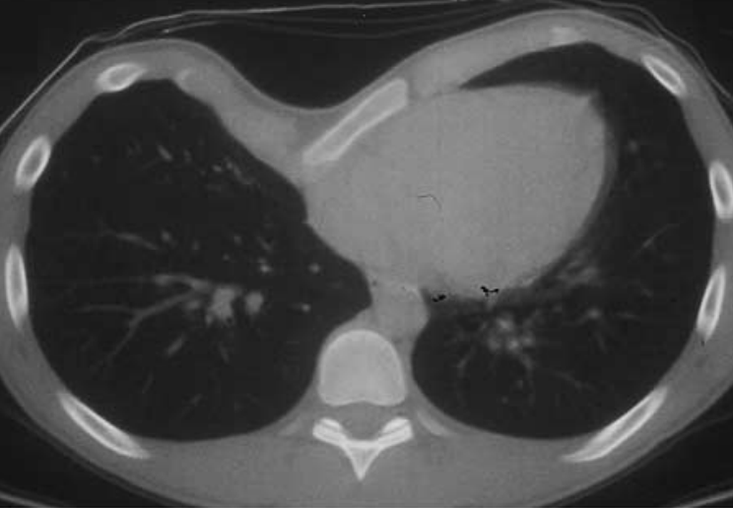
Pectus excavatum
Physiological effects
Major complaint is cosmetic
Decreased exercise ability, cardiovascular function and lower lung volumes compared to age and size matched controls.
Effects are often mild and fall within normal range
Severe PE displaces the heart to the left and can impair optimal right ventricular filling with reduced cardiac output during exercise
Real effect on exercise ability
Reduced lung volumes
Reduced maximal cardiac output
lack of fitness through avoidance of exercise from embarrassment
90%
Radiopaedia.org, rID: 8657

Slide 6
Pectus excavatum
Signs
Look for evidence of Marfan’s Syndrome
Listen for murmurs – mitral valve prolapse, aortic regurgitation
Look for scoliosis
Investigations
Pulmonary function testing
Exercise testing
Echocardiography if murmur present
Chest Xray
CT Chest if surgery contemplated
90%
Radiopaedia.org, rID: 8657

Slide 7
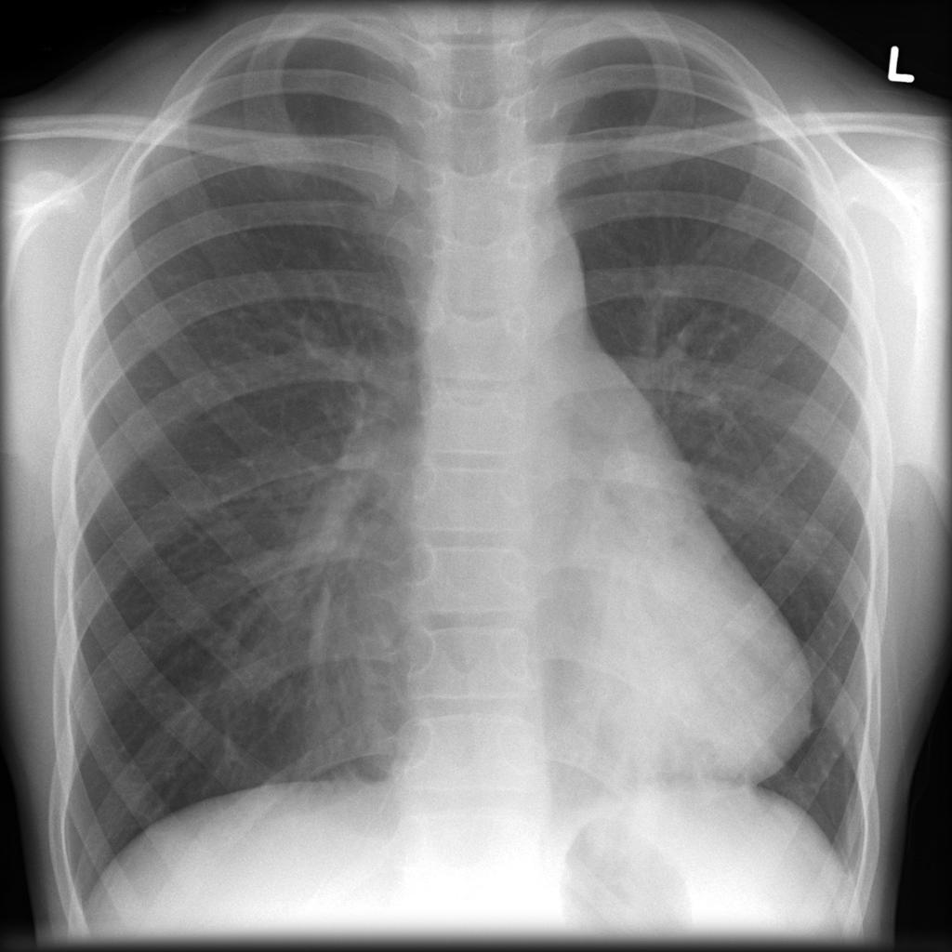
8283
Radiopaedia.org, rID: 15393

Slide 8
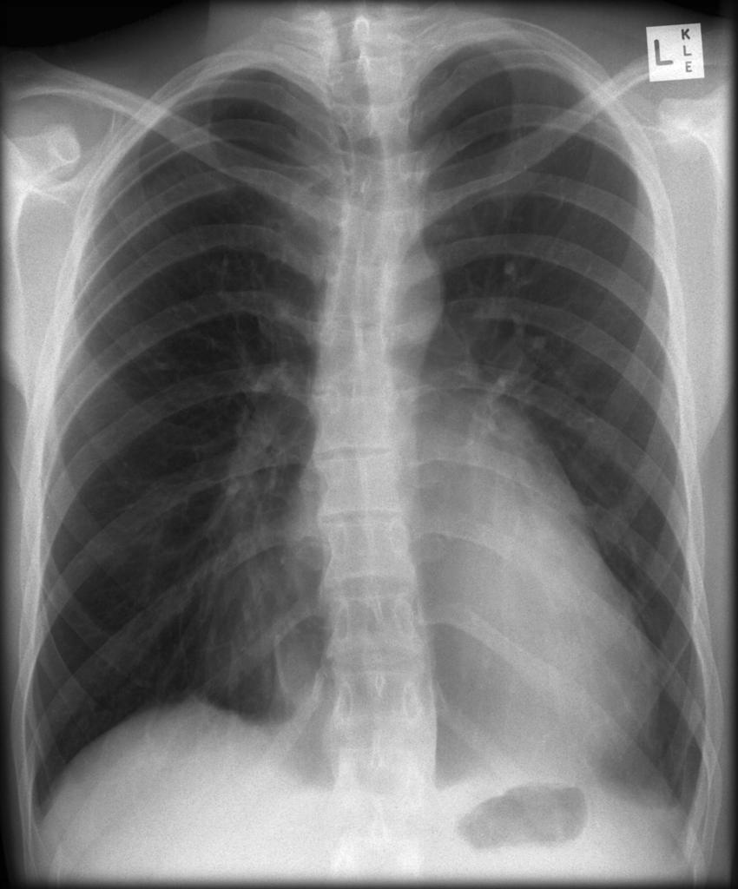
Radiopaedia.org, rID: 15393

Slide 9
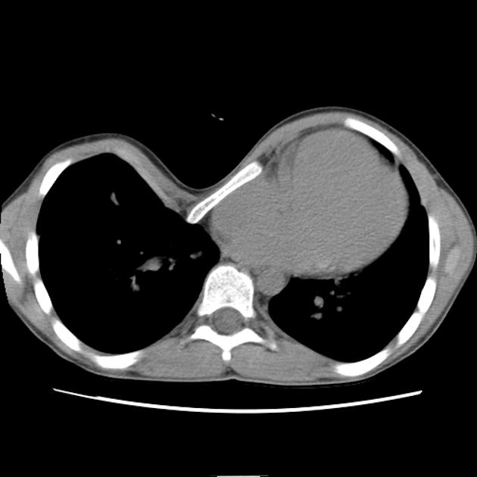
Radiopaedia.org, rID: 8657

Slide 10
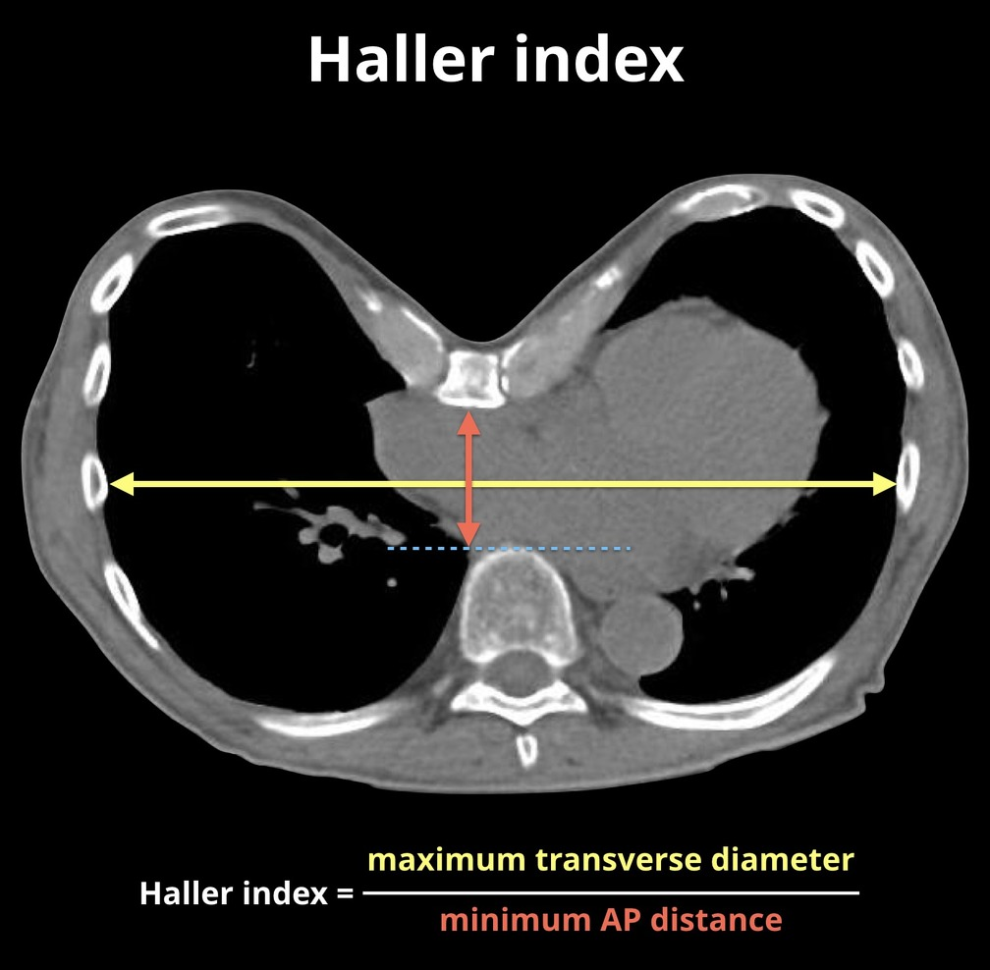
Radiopaedia.org, rID: 57436

Slide 11
Pectus excavatum
Management
No treatment is a reasonable option
Decision for surgery largely made on cosmetic grounds
Restrictive or obstructive lung disease on Pulmonary Function Tests
Cardiac compression or displacement
Haller index greater than 3.2
No correlation between Haller index and body image
No correlation between Haller index and perceived ability for exercise before surgery
Surgical Repair of Pectus Excavatum Markedly Improves Body Image and Perceived Ability for Physical Activity: Multicenter Study. Robert E. Kelly, et al
Pediatrics 2008;122:1218–1222

Slide 12
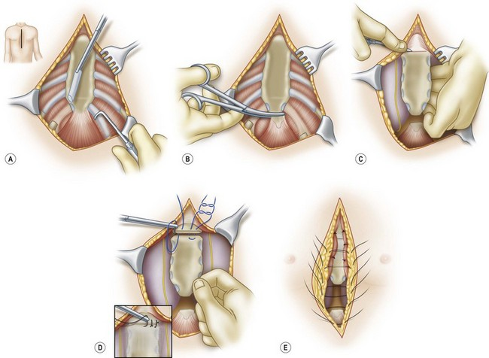
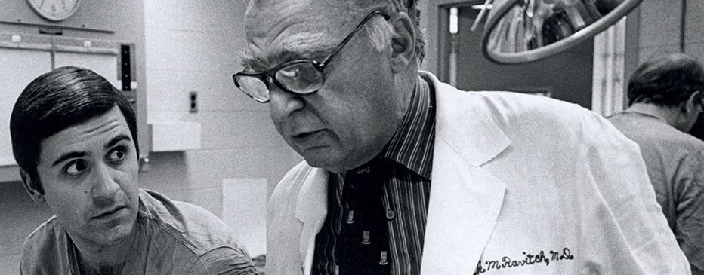
Pectus excavatum surgery
1947: Ravitch procedure
Radical mobilisation of sternum
No need for external fixation
Recurrence
1920: Sauerbruch
Incision
Resection of costal cartilages
Sternal osteotomy
External fixation

Slide 13
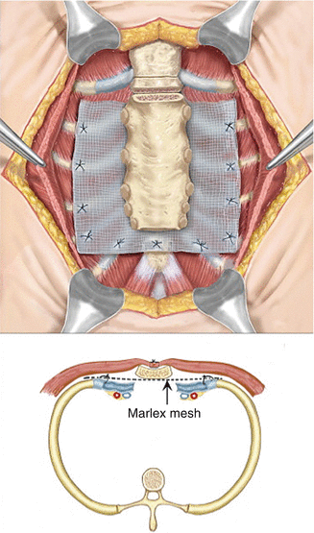
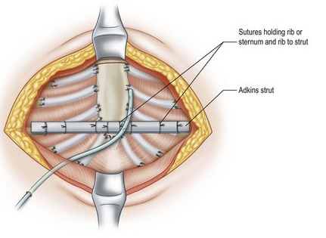
Pectus excavatum
Modified Ravitch procedure
Strut or mesh to support position of sternum
1961 Adkins Robicsek

Slide 14
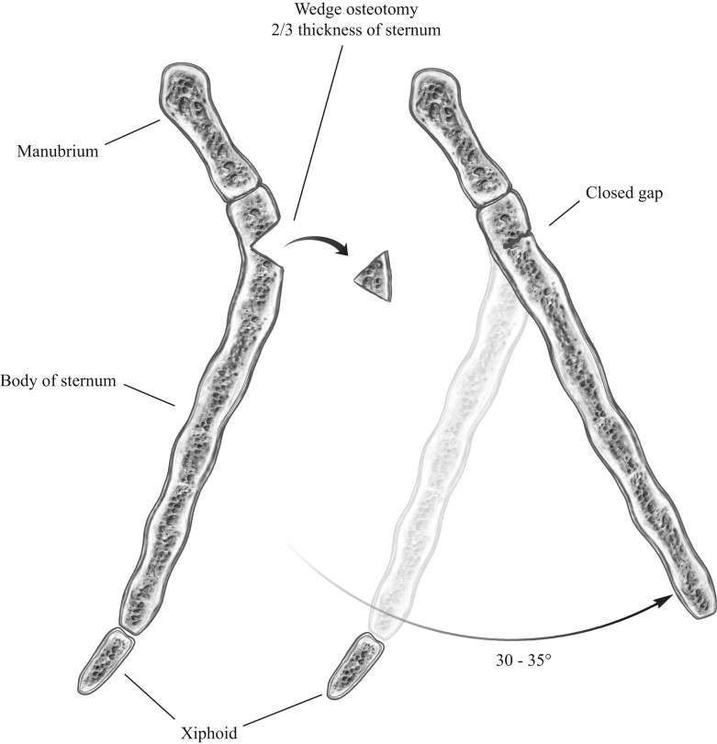
Modified Ravitch procedure (PECTUS EXCAVATUM)

Slide 15
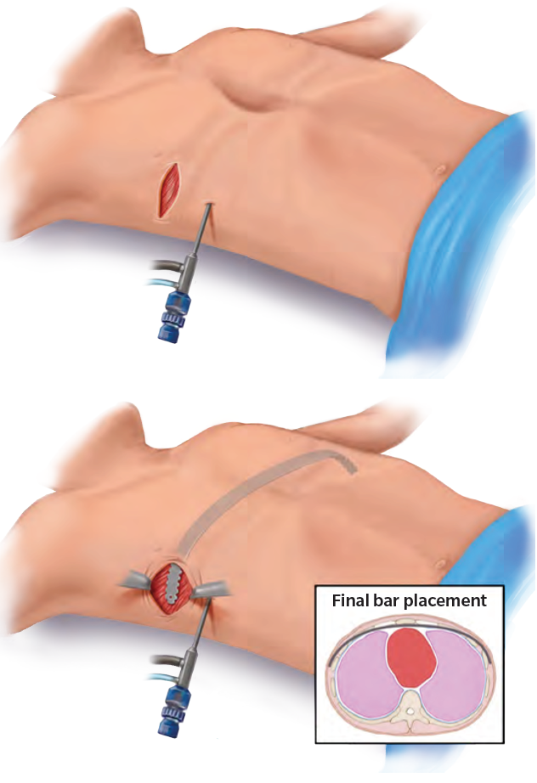
Pectus excavatum
Nuss procedure
Minimally invasive repair of pectus excavatum (MIRPE)

Slide 16
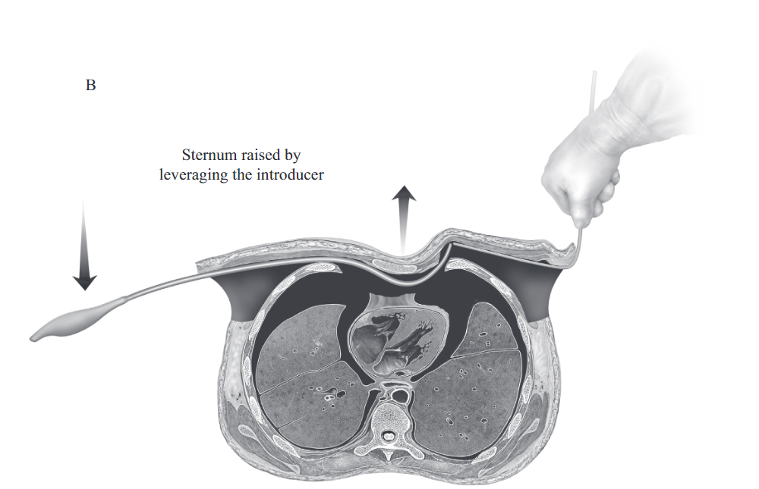
Pectus excavatum
Nuss procedure
Minimally invasive repair of pectus excavatum (MIRPE)
Oper Tech Thorac Cardiovasc Surg
Autumn 2014 Volume 19, Issue 3, Pages 324–347
The Minimally Invasive Repair of Pectus Excavatum
Nuss D, Kelly R

Slide 17
Pectus excavatum
Nuss Procedure
✓ Cosmetic outcome 80%
✓ Exercise ability Improvement in about 10%
✓ Cardiovascular function Improvement in 5-25%
✓ Lung function Possible improvement (FVC < 70%)
X No physical activity for 6 weeks after surgery
Young children
Surgery has potential to allow greater lung growth
Surgery not offered to children under age 6 years
Bar displacement more likely in kids that can’t keep still
Teenagers
Effective in adults so no time pressure on adolescents

Slide 19
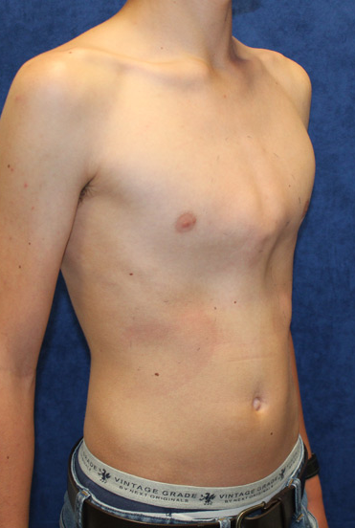
Pectus carinatum
Chondrogladiolar Costomanubrial
Prominent sternum and anterior chest wall
? Overgrowth of costal cartilages
Paediatr Respir Rev. 2015 Jan;16(1):18-24. doi: 10.1016/j.prrv.2014.10.009. Epub 2014 Nov 4.

Slide 20
Pectus carinatum
Less common than pectus excavatum
Usually apparent from birth. May worsen in adolescence
Physiological effects
Little if any effect on lung volumes, or exercise related cardiac output
Presentation
Cosmetic
Pain
Exercise induced dyspnoea
Underlying lung disease
Air trapping : asthma, CF
Neuromuscular disease
Thoracic dystrophies
Scolioisis
Collagen disorders ( Marfan’s syndrome; Ehlers-Danlos syndrome)

Slide 21
Pectus carinatum
Surgery
Ravitch procedure
Incision
Resection of costal cartilages
Sternal osteotomy
https://plasticsurgerykey.com/pediatric-chest-and-trunk-defects/

Slide 22
Pectus carinatum
Modified Ravitch procedure
Mesh or strut to support position of sternum

Slide 23
Chondrogladiolar Costomanubrial

Slide 24
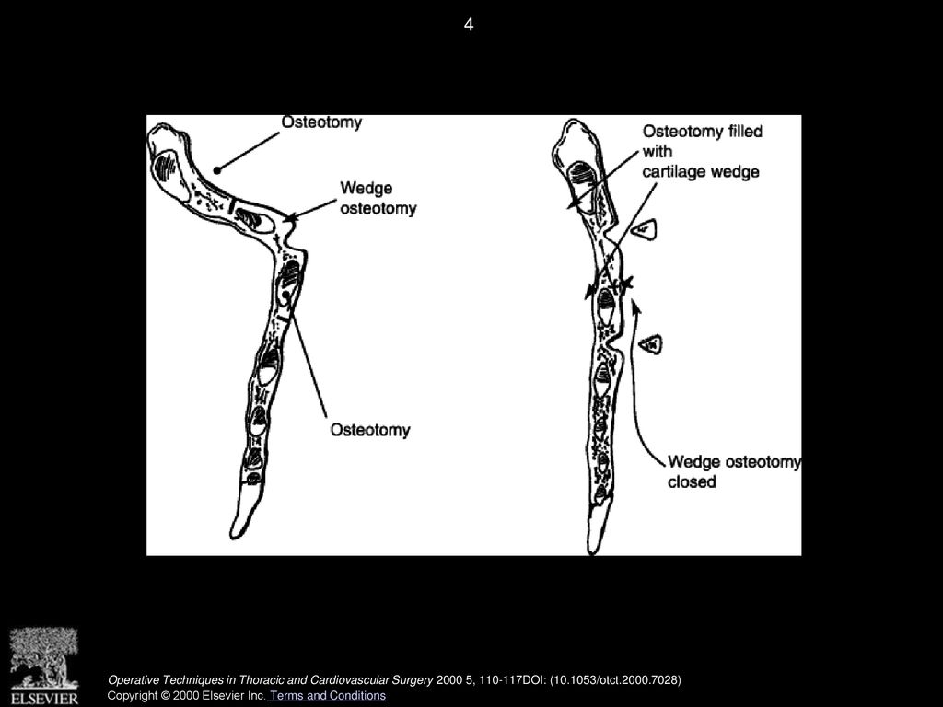
Modified Ravitch procedure (PECTUS CARINATUM)

Slide 25
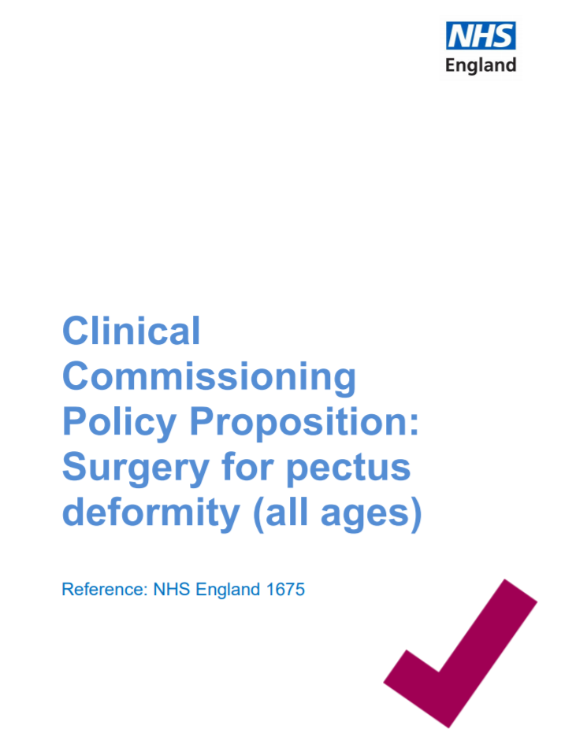
x

Slide 26
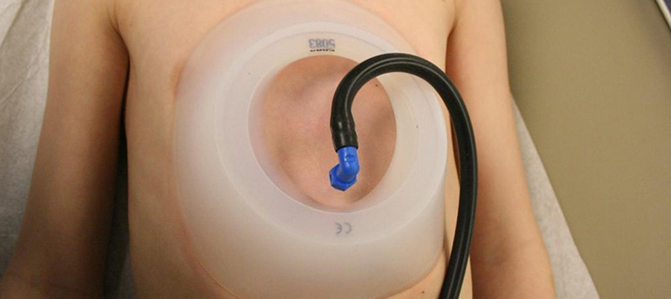
Pectus Excavatum
Two hours twice a day with
The Vacuum Bell

Slide 27


Does Vacuum Bell Therapy work ?
Largest series from Switzerland (Haeker)
Patients recruited from 2006
133 patients treated for 3 months (mean 120 minutes / day)
105 (79%) > 1 cm elevation to sternum
CT confirms the effect
Best outcomes in those that present earlier, have milder forms of PE, symmetric PE, and a more compliant chest wall.
Little evidence to date of permanence of correction
Patel A,, Hunt I. Is vacuum bell therapy effective in the correction of pectus excavatum?
Interactive CardioVascular and Thoracic Surgery 29 (2019) 287–290 BEST EVIDENCE TOPIC 28 March 2019

Slide 28
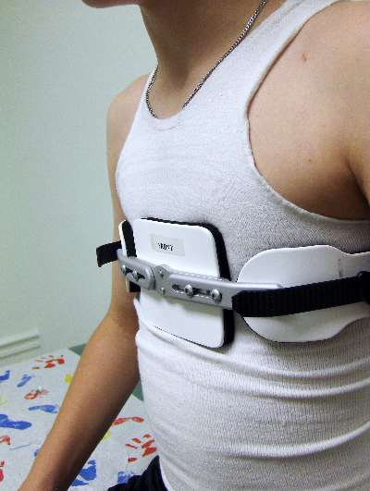
Pectus Carinatum
Compressive orthotic bracing
with The Pectus Brace
First described in 1993
Case series 2006. Frey, Garcia, Brown et. al Cincinnati Children's Hospital
First line therapy in many centres
The brace is worn 14 hours a day for 2 years, or until full height is achieved.
Ideal age for bracing is age 11 or 12 years, while cartilage is still pliable.
Success described from 6 to 16 years of age.
Most patients wear it in the day and remove the brace to sleep.
Most improvement occurs within the first year.
Little additional benefit after 18 months.
Frey, Garcia, Brown et. al “Nonoperative management of pectus carinatum”Journal of Pediatric Surgery 41: 40-45, 2006

Slide 29
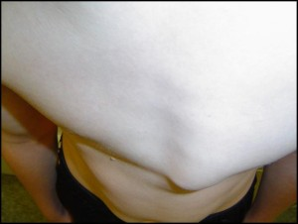
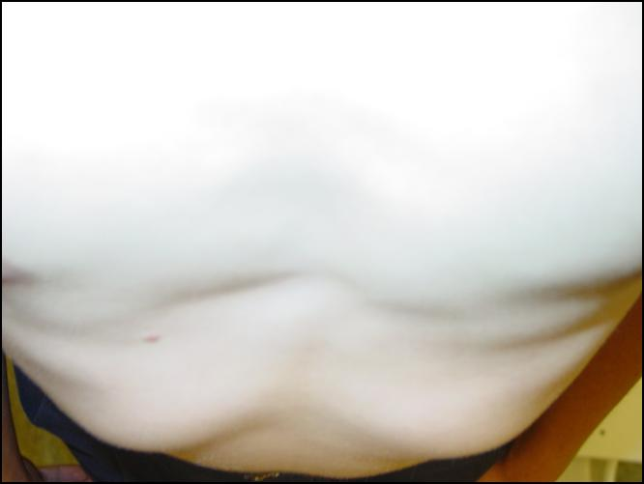
The Pectus Brace
Before After

Slide 31
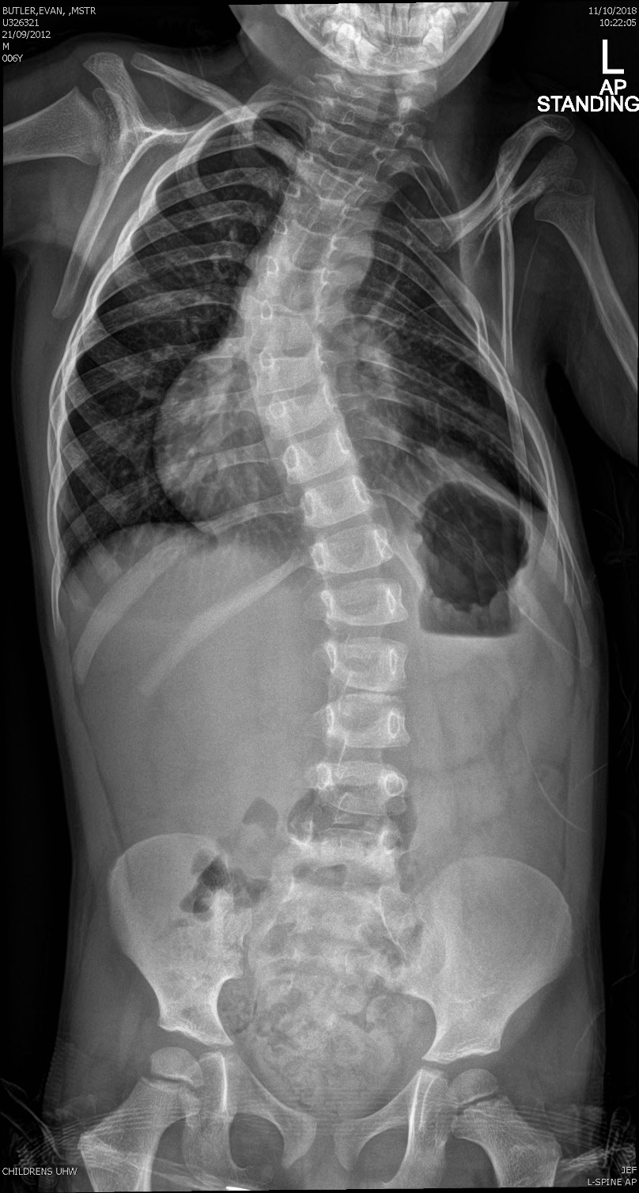
Scoliosis
Adolescent scoliosis
Muscular imbalance
Neuromuscular weakness
Spasticity
Collagen disorders
Marfan’s syndrome
Ehlers-Danlos syndrome
Congenital scoliosis
Part of complex thoracic dystrophy
Thoracic insufficiency syndromes

Slide 32
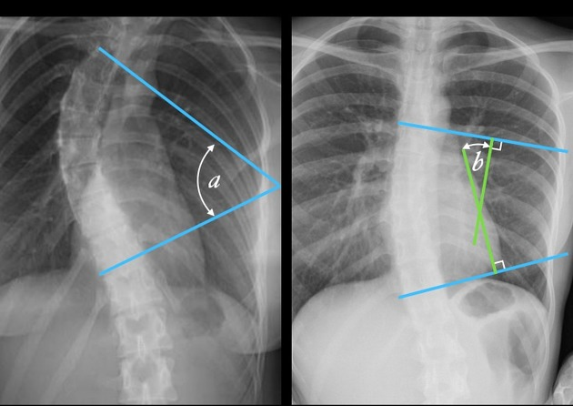
Scoliosis
Cobb angle
Radiopaedia.org, rID: 49374

Slide 33
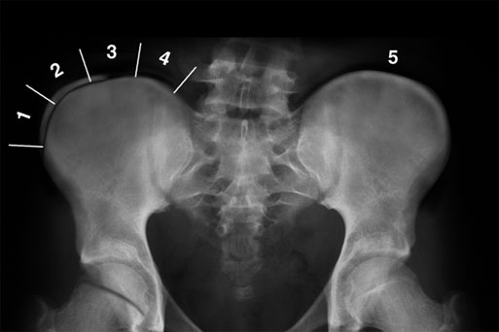
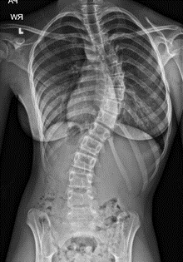
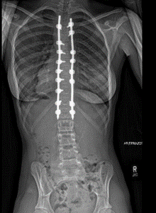
Adolescent Scoliosis Surgery
Cobb angle >45%
Benefits
Reduced back pain in adult life
Cosmetic improvement
Probably no effect on lung function *
Risser staging
Degree of ossification of the iliac crest apophysis is a
good guide to stage of spinal growth
Surgical approach
Where growth is almost complete
Posterior approach
Spinal fusion - iliac crest autograft
Spinal rods to hold spine straight
whilst fusion becomes secure (rarely removed)
www.srs.org

Slide 34
Control lordosis kyphosis hyperkyphosis
Farrell J, Garrido E. Effect of idiopathic thoracic scoliosis on the tracheobronchial tree
BMJ Open Respiratory Research. bmjresp-2017-000264

Slide 35
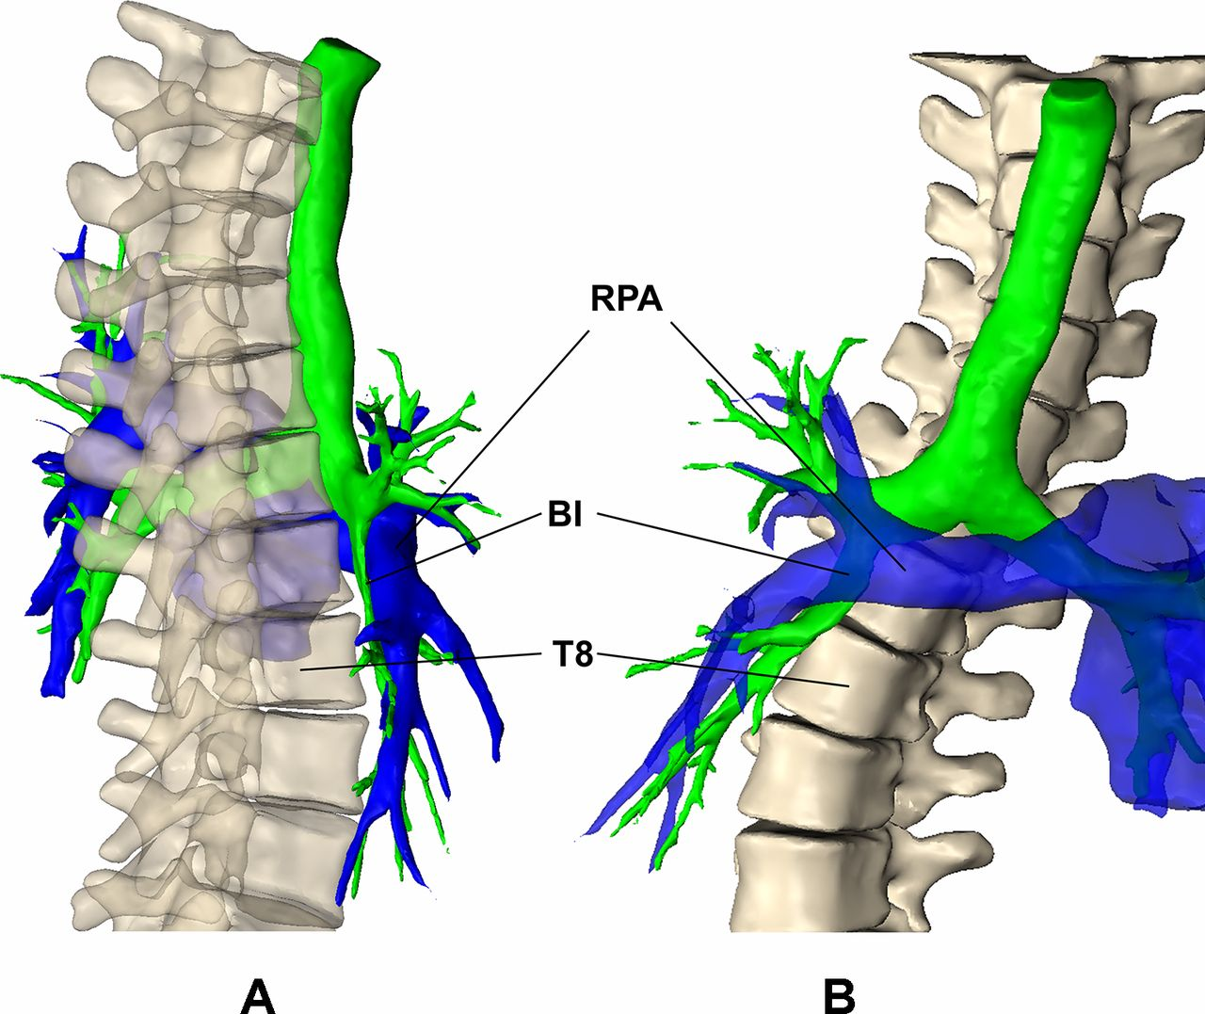
Relative position of bronchus intermedius (green), right pulmonary artery (blue) and spine in a patient with idiopathic scoliosis and relative lordosis
Farrell J, Garrido E. Effect of idiopathic thoracic scoliosis on the tracheobronchial tree
BMJ Open Respiratory Research. bmjresp-2017-000264

Slide 36
Neuromuscular Scoliosis
Life events for a child with muscle disease
Respiratory infection
Nocturnal ventilation
Non-ambulation
Spinal surgery
SMA type 2
Duchenne Muscular Dystrophy

Slide 37
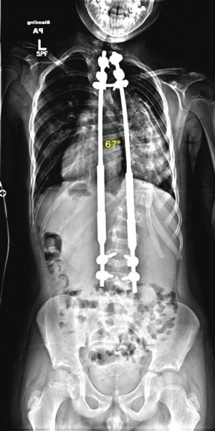
Neuromuscular Scoliosis
Spinal muscular atrophy type 2
Duchenne muscular dystrophy
Co-morbidities
Muscle weakness
Poor cough and secretion management
Aspiration lung disease
Bracing
interferes with respiratory function particularly at night
Should not be worn if evidence of night time hypoventilation
Surgery
Surgery is a major undertaking
If performed on a growing spine – spinal fusion avoided
Growing rods
Magnetically controlled Growing Rods (MCGR) (MAGEC™)

Slide 38
Neuromuscular Scoliosis
Perioperative period
Surgery is a major undertaking
Scoliosis surgery is associated with a 40% drop in FVC because of pain and atelectasis
Pre-operative VC <60% - increased risk of prolonged post-operative ventilation
Pre-op
Introduce mask ventilation and cough assist physiotherapy
Post-op
Specific extubation protocols for neuromuscular children which incorporate effective cough assist and extubation to mask ventilation reduce re-intubation rates

Slide 39
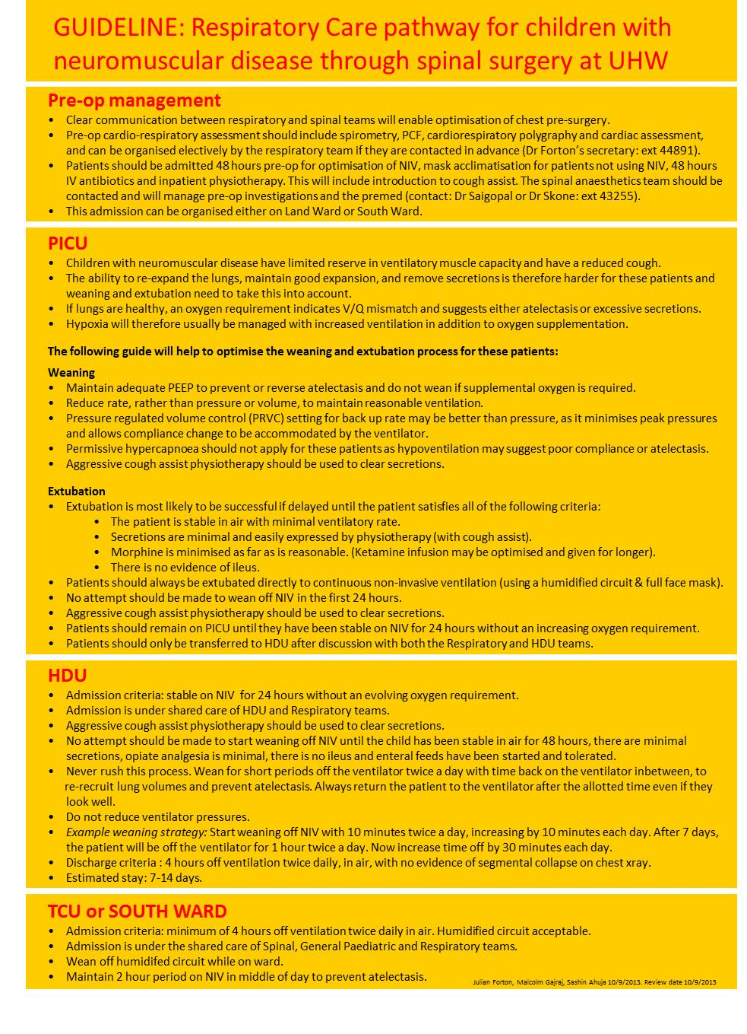


Slide 41
Thoracic insufficiency syndromes
Congenital disorders of the chest wall and spine that cause respiratory distress
mechanical compromise from abnormal ribs and scoliosis
Persisting small volume thorax
Inadequate lung development – pulmonary hypoplasia
Often severe
Respiratory failure, pulmonary hypertension
Ventilator dependent from birth
Condition may be incompatible with life
Surgery
Increasing thoracic volume could potentially increase lung growth

Slide 42
Short Rib dysplasia
Jeune syndrome
Ellis Van Creveld syndrome
Beemer-Langer type
Majewski type
Saldino-Noonan type
Verma-Naumoff type
Mainzer-Saldino syndrome
Severe congenital thoracic scoliosis
VACTERL
Jarcho-Levin syndrome
Poland syndrome
Ciliopathies
Short ribs
Short long bones
Polydactyly
Kidney, eyes
Notes:
Ciliopathies
Short ribs
Short long bones
Polydactyly
Kidney, eyes
VACTERL
Vertebral anomalies, anal atresia, Cardiac, TOF, Renal ,Radial abinormalities
Jarcho-Levin syndrome
Spondylothoracic dysplasia
Short stature, short thorax, severe pulmonary hypoplasia, vertebral and rib defects, lordosis and kyphoscoliosis

Slide 43
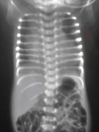
Chest expansion surgery
3 approaches
Sternal split
Lateral thoracic expansion
VEPTR (Vertical Expandable Prosthetic Titanium Rib)

Slide 44
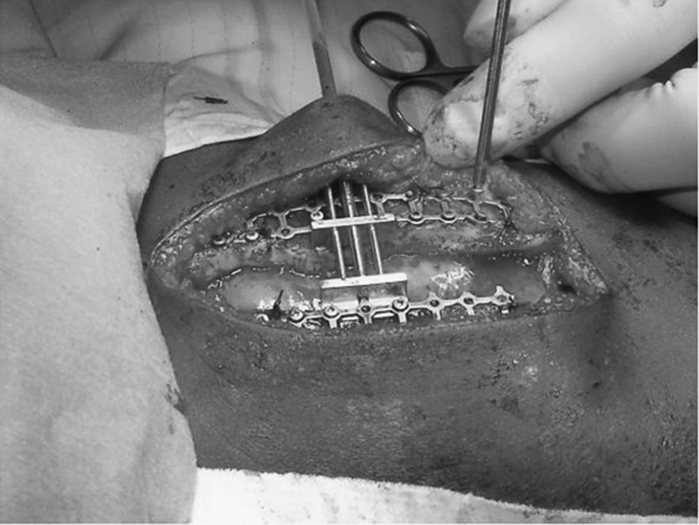
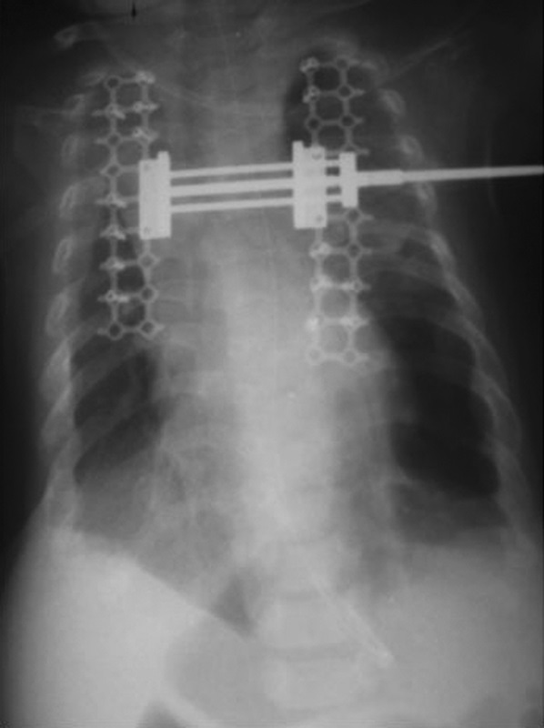
Chest expansion surgery
Sternal split

Slide 45
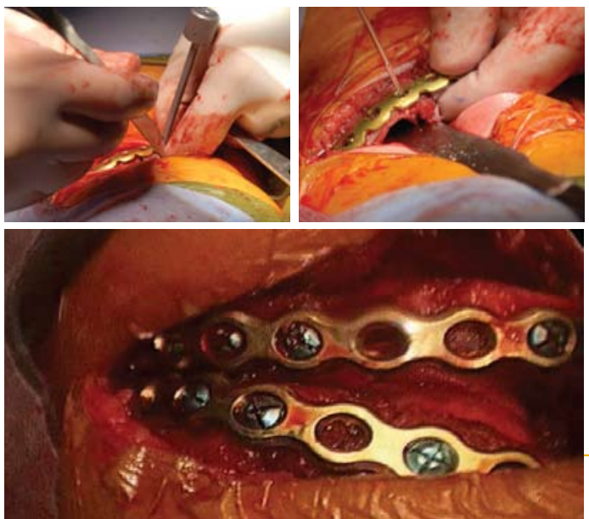
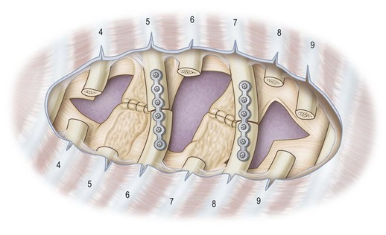
Chest expansion surgery
Lateral thoracic expansion
Davis JT, Ruberg RL, Leppink DM, McCoy KS, Wright CC.
Lateral thoracic expansion for Jeune’s asphyxiating dystrophy: a new approach. Ann Thorac Surg 1995;60:694–6.

Slide 46
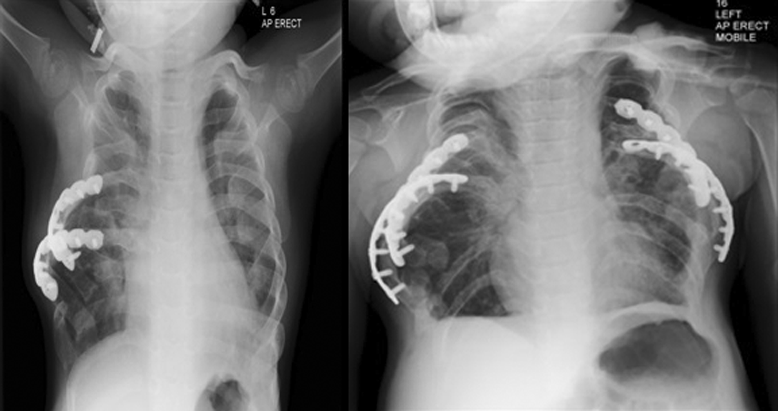
Chest expansion surgery
Lateral thoracic expansion
Nagarajan Muthialu Shafi Mussa Catherine M. Owens Neil Bulstrode Martin J. Elliott
European Journal of Cardio-Thoracic Surgery, Volume 46, Issue 4, October 2014, Pages 643–647

Slide 47
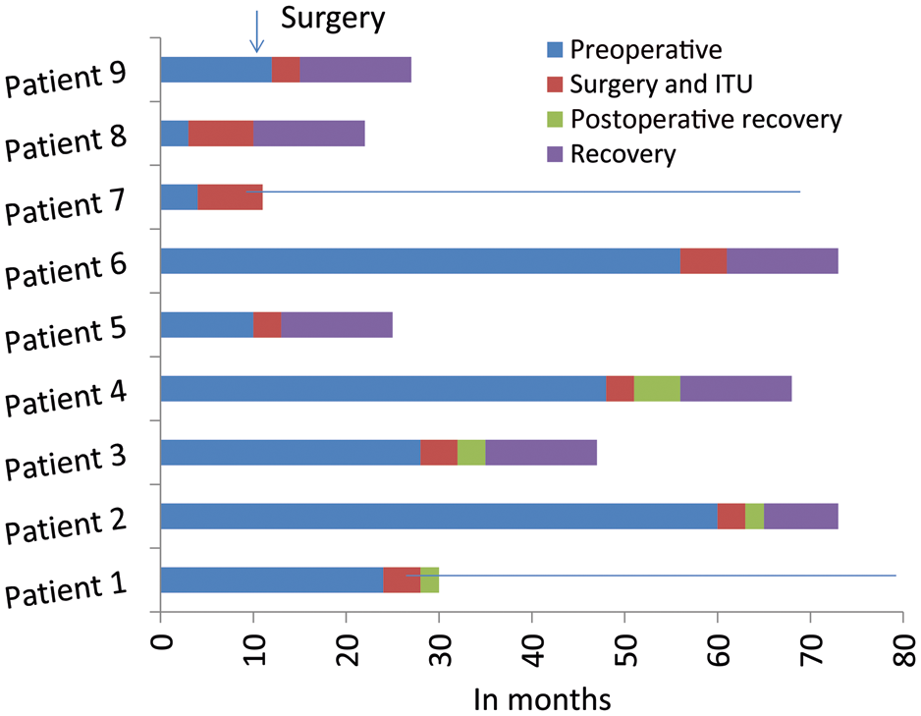
Chest expansion surgery
Lateral thoracic expansion
At 12 months post surgery
5 on nocturnal NIV
2 on 24/7 invasive ventilation
2 deaths
Nagarajan Muthialu Shafi Mussa Catherine M. Owens Neil Bulstrode Martin J. Elliott
European Journal of Cardio-Thoracic Surgery, Volume 46, Issue 4, October 2014, Pages 643–647
Notes:
Figure 5: The chronology of individual patients through the surgical treatment process. Point of surgical intervention is shown by the colour coding, and each phase is differentiated similarly.
Unless provided in the caption above, the following copyright applies to the content of this slide: © The Author 2014. Published by Oxford University Press on behalf of the European Association for Cardio-Thoracic Surgery. All rights reserved.

Slide 48
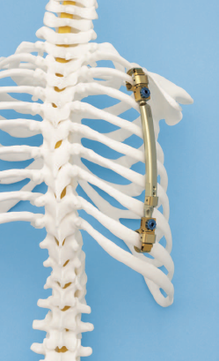
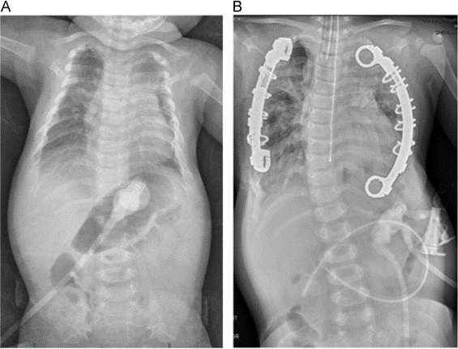
Chest expansion surgery
VEPTR
Vertical Expandable Prosthetic Titanium Rib

Slide 49
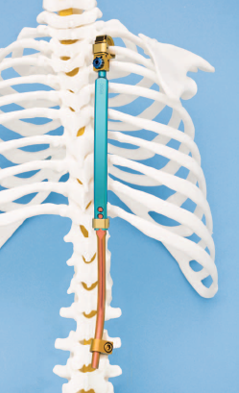
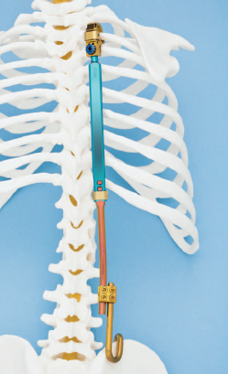
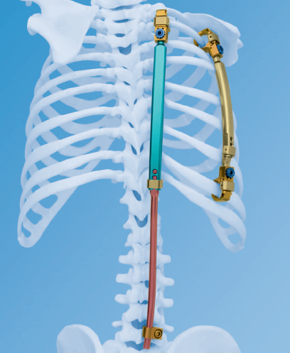
Chest expansion surgery
VEPTR
Approved for the treatment of Thoracic insufficiency syndrome in paediatric patients due to fused ribs and scoliosis, absent ribs, hypoplastic thorax syndromes, and congenital or neuromuscular scoliosis without rib abnormality.

Slide 50
Chest deformity
Pectus deformity
Scoliosis
Thoracic insufficiency syndromes
Professor Julian Forton
Consultant in paediatric respiratory medicine
Children’s Hospital for Wales, Cardiff

Slide 51



Slide 52
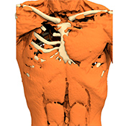
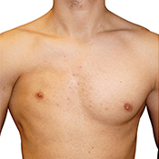
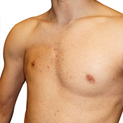
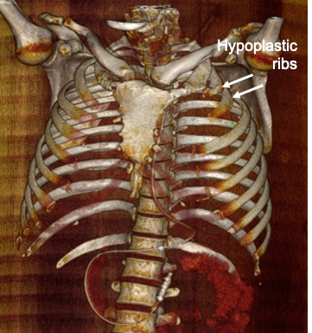
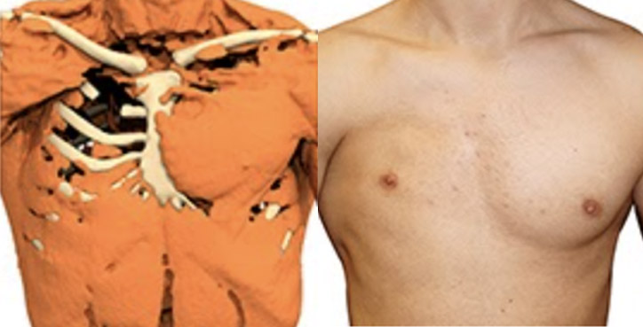
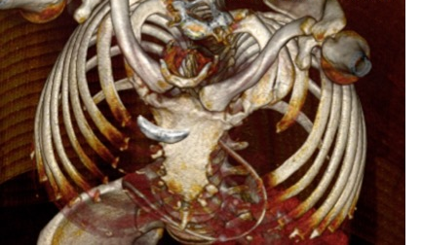
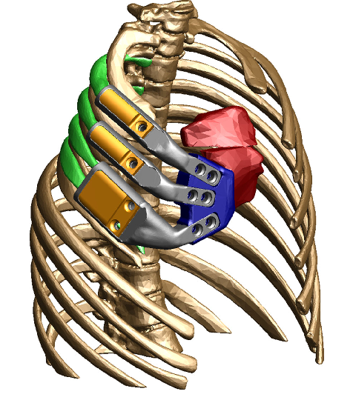
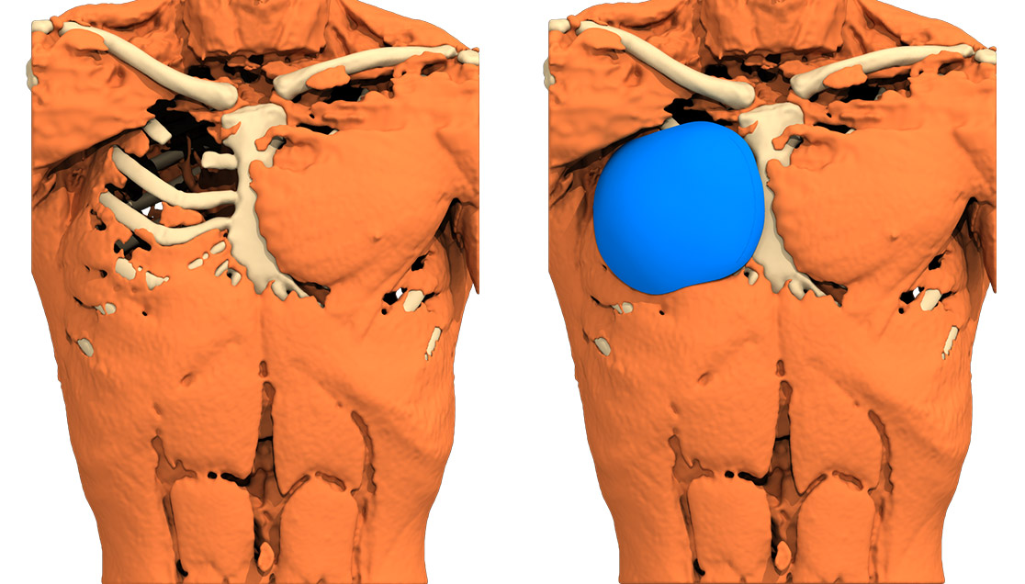
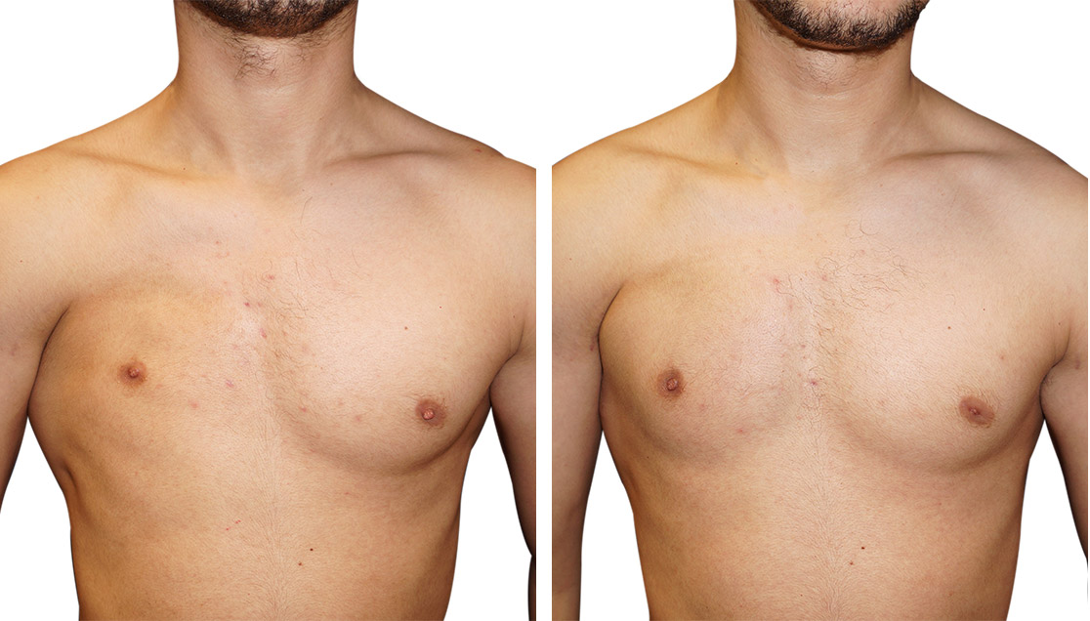
https://www.anatomikmodeling.com/en/poland-syndrome
https://beverlyhillsbreastinstitute.com/poland-syndrome/
http://radiologycases.my/2021/11/03/poland-syndrome/

